Slide 1
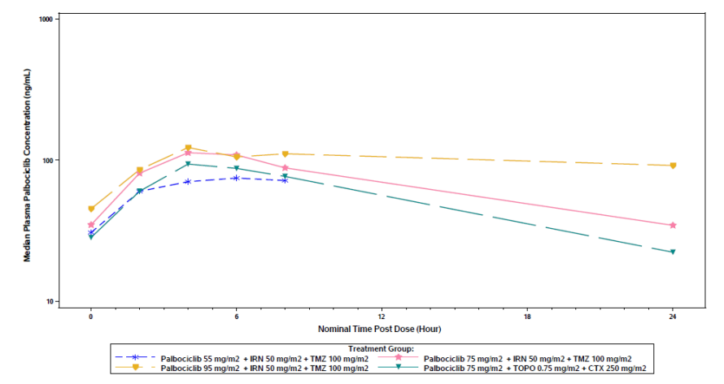
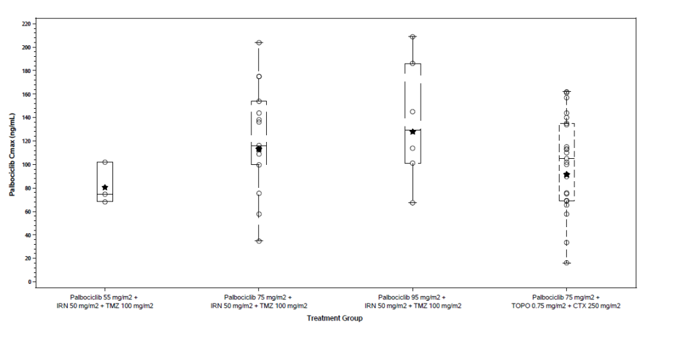
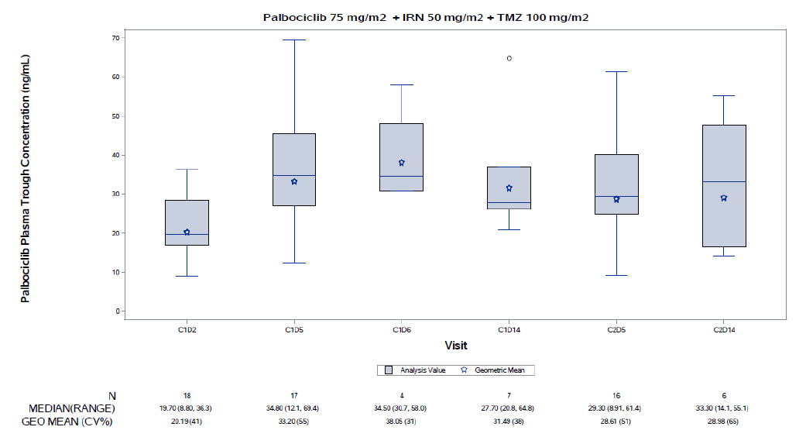
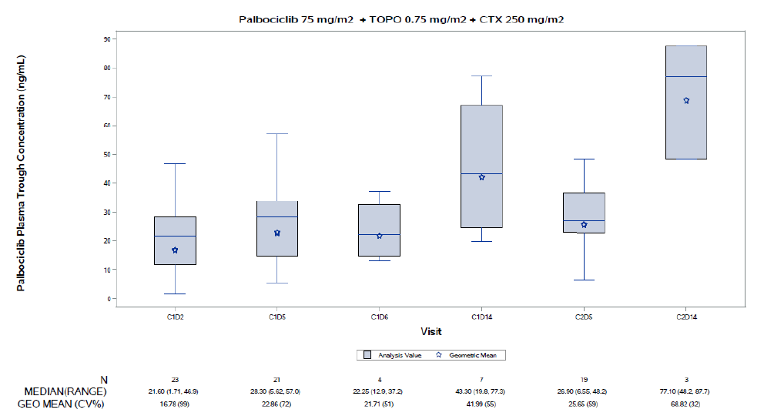

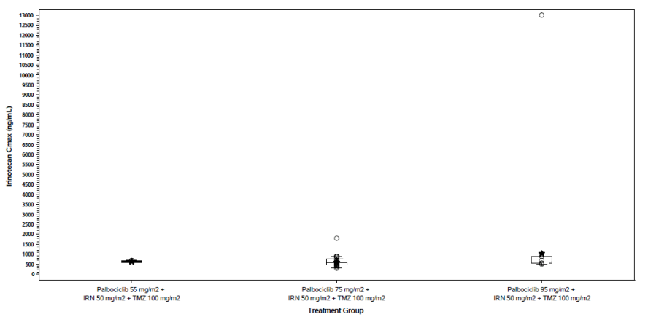
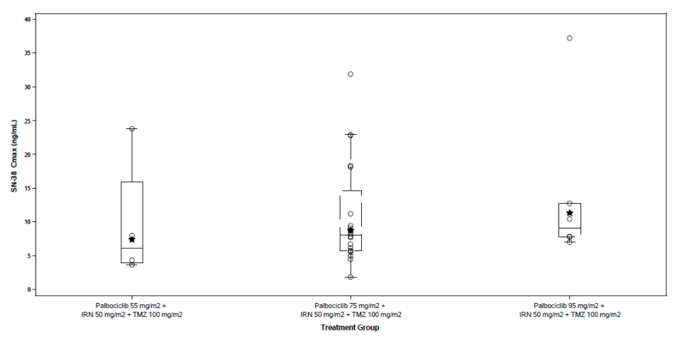
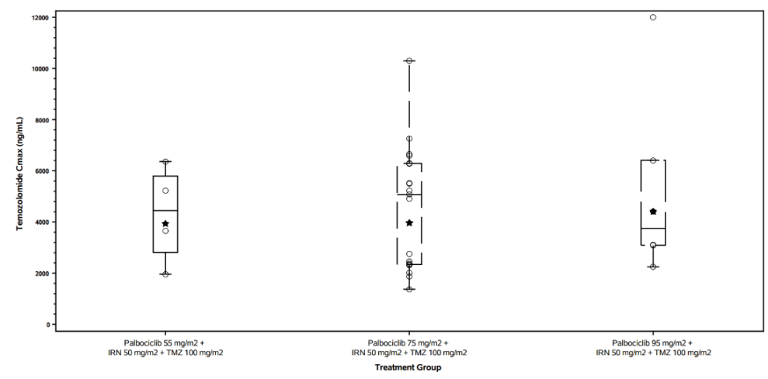
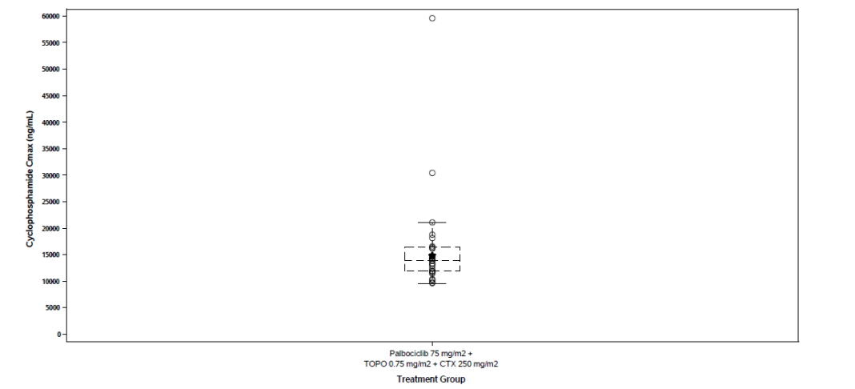
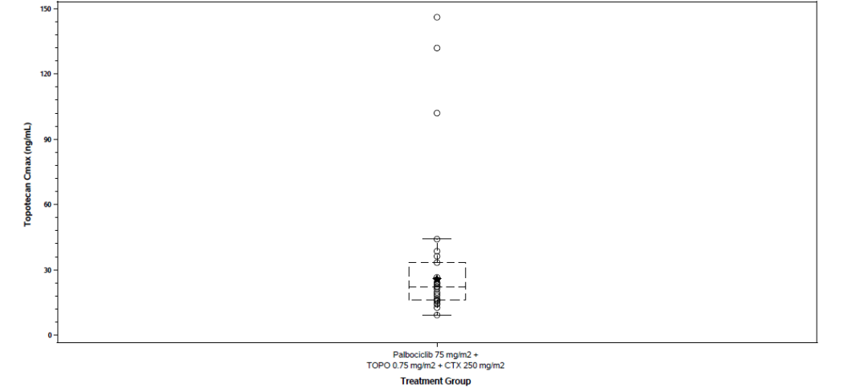
071
Charvi Nanavati,¹ Jennifer Winton,² Katarzyna A. Juszczak-Kosela,³
Theodore W. Laetsch⁴, Brenda J. Weigel⁵, Elizabeth Fox⁶, Tanya C. Watt⁷, Margaret E. Macy⁸, Kimberly Lee² and Justin T. Hoffman¹
¹ Pfizer Inc, La Jolla, CA; ²Pfizer Inc, Groton, CT; ³Pfizer Inc, Warsaw, Poland; ⁴Division of Oncology, Children’s Hospital of Philadelphia, and Abramson Cancer Center, University of Pennsylvania, Philadelphia, PA; ⁵Department of Pediatrics, University of Minnesota, Minneapolis, MN; ⁶St. Jude Children's Research Hospital, Memphis, TN; ⁷Children’s Medical Center of Dallas, and University of Texas Southwestern, Dallas, TX; ⁸Children’s Hospital Colorado, Aurora, CO.
Evaluation of Palbociclib and Combinatorial Chemotherapy Pharmacokinetics in Pediatric Patients with Recurrent or Refractory Solid Tumors
Background
Irinotecan (IRN)/Temozolomide (TMZ) and Cyclophosphamide (CTX)/Topotecan (TOPO) are used in pediatric, adolescent or young adult patients with relapsed or refractory solid tumors, but outcomes remain poor.
Non-clinical and clinical data suggest aberrations in cyclin-dependent- kinases (CDK)4/6 pathway can drive the growth of pediatric tumors.
Palbociclib is a highly selective, reversible, small molecule inhibitor of CDK 4 and 6, administered orally.
Hence, the objective of this study was to evaluate the PK of palbociclib, TMZ, IRN, CTX, and TOPO in pediatric patients when given in combination in a Phase 1 study.
Table 1: PK sample collection timepoints
Drug | Study Visit (Cycle and Day) and Sampling time (hr) Post-Dose
 | C1D2 | C1D5 |  |  |  |  |  |  | C1D6 | C1D14 | C2D5 |  |  | C2D14
 | Pre-dose | Pre-dose | Post-infusion | 1 | 2 | 4 | 6 | 8 | 24 | Pre- dose | Pre-dose | Post-infusion | 1 | Pre-dose
Palbociclib (Oral) | X | X |  |  | X | X | X | X | X | X | X |  |  | X
Irinotecan (IV) | X | X | X |  |  | X |  | X | X |  | X | X
Temozolomide (Oral) |  | X |  | X |  | X |  | X |  |  | X |  | X
Temozolomide (IV) |  | X | X |  |  | X |  | X |  |  | X | X
Topotecan (IV) | X | X | X |  |  | X |  | X | X |  | X | X
Cyclophosphamide (IV) | X | X | X |  |  | X |  | X | X |  | X | X
Objective
To evaluate the pharmacokinetics (PK) of palbociclib, temozolomide, irinotecan, cyclophosphamide, and topotecan in pediatric patients when given in combination.
Materials and Methods
In an open-label, multicenter, non-randomized Phase 1 portion of the study (ClinicalTrials.gov ID: NCT03709680) palbociclib was given in combination with either IRN/TMZ or TOPO/CTX in children, adolescent, and young adult patients with recurrent/refractory solid tumors.
Palbociclib was administered orally QD on Days 1 to 14 followed by 7 days off in both combinations (doses of 55, 75, and 95 mg/m² with IRN/TMZ and 75 mg/m² with CTX/TOPO).
TMZ was administered QD at 100 mg/m², IRN was administered IV at 50 mg/m² over 90 minutes, CTX was administered IV at 250 mg/m² over 30-60 minutes, and TOPO was administered IV at 0.75 mg/m² over 30 minutes, all on Days 1 to 5.
PK samples were collected as detailed in Table 1. PK parameters were calculated for each analyte, each participant and treatment, using noncompartmental analysis.
Conclusions
Palbociclib exhibited dose-proportional PK over the range of 55-95 mg/m² QD and comparable exposure across the chemotherapy combinations.
Palbociclib and combinatorial chemotherapy had similar exposure as reported in previous studies indicating a lack of drug-drug interaction between them.
Palbociclib exposure at the 75 mg/m² QD was similar to that observed in adult participants at the approved 125 mg QD dose suggesting appropriate body surface area-based dosing and attainment of expected target exposure in pediatric population.
Figure 1: Palbociclib Plasma Concentrations Time Profiles, C_{max} and C_{trough} values by Treatment
Results
A. Median Plasma Steady-State Palbociclib Concentration-Time Profiles by Treatment (C1D5)
B. Palbociclib Steady State C_{max} Values by Treatment (C1D5)
Palbociclib exposure increased proportionally with dose. Palbociclib exposure on C1D5 (75 mg/m² dose) when dosed with IRN/TMZ was similar to that observed when dosed with CTX/TOPO (Table 2)
Palbociclib steady state exposure in pediatric participants based on AUC_{τ} and C_{max} (Table 2) was similar to exposure in adult participants following 125 mg QD dosed as monotherapy (Day 1 to Day 21 followed by 7 days off) on C1D21 (mean AUC_{τ} = 1733 h∙ng/mL and C_{max} = 97.4 ng/mL)¹. Palbociclib exposure on C1D5 in pediatric participants following 75, or 95 mg/m² QD doses in combination with IRN + TMZ or TOPO + CTX in this study (Table 2) were similar to those observed on C1D21 when palbociclib was administered alone in pediatric participants (mean C_{max} = 139.9 ng/mL (Palbociclib 75 mg/m²)and 190 ng/mL (Palbociclib 95 mg/m².)^{2.}
Exposure of IRN/SN-38 (mean IRN C_{max} = 629.3, 595.5, 1033 ng/mL, mean SN-38: C_{max} = 7.386, 8.746, 11.32 ng/mL for 55, 75, and 95 mg/m² palbociclib dose combination, respectively), TMZ (mean C_{max} = 3930, 3960, 4404 ng/mL for 55, 75, and 95 mg/m² palbociclib dose combination, respectively), CTX (mean CL=3.772 L/h/m²), and TOPO (mean AUC_{τ} = 49.27 h∙ng/mL) were also generally consistent with exposure/parameters observed in published studies ^{3,4,5,6} (mean IRN C_{max} = 726 ng/mL, SN-38 C_{max} = 13 ng/mL; mean TMZ C_{max}= 3510 ng/mL; mean CTX CL = 2.14 L/h/m²; mean TOPO AUC_{τ} = 42.8 h∙ng/mL).
C. Palbociclib C_{trough} Values by Visit for Palbociclib 75 mg/m² + IRN +TMZ
D. Palbociclib C_{trough} Values by Visit for Palbociclib 75 mg/m² + TOPO + CTX
Table 2: Palbociclib Steady-State PK Parameter Summary
Parameter | Palbociclib 55 mg/m² + IRN/TMZ (N=4) |  | Palbociclib 75 mg/m² + IRN/TMZ (N=20) |  | Palbociclib 95 mg/m² + IRN/TMZ (N=6) |  | Palbociclib 75 mg/m² + TOPO/CTX (N=26)
 | n | Value | n | Value | n | Value | n | Value
AUC_{ꚍ} (hr∙ng/mL) | 3 | 1161 (7) | 14 | 1538 (49) | 6 | 2082 (38) | 20 | 1290 (59)
CL/F (L/hr/m²) | 3 | 47.31 (8) | 14 | 48.75 (49) | 6 | 45.61 (39) | 20 | 58.12 (59)
C_{max} (ng/mL) | 3 | 80.44 (21) | 15 | 113.2 (49) | 6 | 127.9 (44) | 23 | 91.45 (58)
C_{trough} (ng/mL) | 3 | 30.42 (7) | 15 | 36.01 (50) | 6 | 44.75 (54) | 23 | 23.98 (81)
T_{max} (hr) | 3 | 6.03 (2.02-6.08) | 15 | 4.17 (1.85-6.47) | 6 | 5.02 (2.07-8.05) | 23 | 4.05 (1.97-24.0)
A. IRN
B. SN-38
C. TMZ
Click or scan this quick response (QR) to download this poster
A. IRN
References:
Flaherty KT, et al,, Clin Cancer Res 2012;18(2):568-76.
Van Mater D et al. Pediatric Blood and Cancer 2021, 68(4)”e28879.
Bomgaars LR, et al. J Clin Oncol 2007;25(29):4622-7.
Baruchel S, et al. Eur J Cancer 2006
Tasso MJ., et al. Cancer Chemotherapy and Pharmacology 1992;30 3:207-211.
Saylors RL, et al., J Clin Oncol. 1998, 16(3):945-52
D. TOPO
E. CTX
Figure 2: Combinatorial Chemotherapy C_{max} Values on C1D5 by Treatment
Acknowledgements:
The authors would like to thank Dr. Mohamed Elmeliegy and Dr. Diane Wang for their initial contribution to the study and scientific discussions on the PK data, and Dr Ariadna Holynskyj, Dr Jodi Muscal, and Dr Ayşe Neslihan Aslan for their continuous scientific and clinical support for study execution.
Disclosures: The study was sponsored by Pfizer.
N = Total number of participants in the treatment group in the indicated population. n = number of participants contributing to the summary statistics. a. Geometric mean (geometric %coefficient of variation) for all except median (range) for T_{max}. Summaries include parameters derived from profiles that meet steady state criteria. Patients with reported vomiting events are excluded in summaries. Make-up visits are included only if Cycle 1 Day 5 is not available/reportable.

Slide 2
Background, Materials, and Methods
Background
Irinotecan (IRN)/Temozolomide (TMZ) and Cyclophosphamide (CTX)/Topotecan (TOPO) are used in pediatric, adolescent or young adult patients with relapsed or refractory solid tumors, but outcomes remain poor.
Non-clinical and clinical data suggest aberrations in cyclin-dependent- kinases (CDK)4/6 pathway can drive the growth of pediatric tumors.
Palbociclib is a highly selective, reversible, small molecule inhibitor of CDK 4 and 6, administered orally.
Hence, the objective of this study was to evaluate the PK of palbociclib, TMZ, IRN, CTX, and TOPO in pediatric patients when given in combination in a Phase 1 study.
Materials and Methods
In an open-label, multicenter, non-randomized Phase 1 portion of the study (ClinicalTrials.gov ID: NCT03709680) palbociclib was given in combination with either IRN and TMZ or TOPO and CTX in children, adolescent, and young adult patients with recurrent/refractory solid tumors.
Palbociclib was administered orally QD on Days 1 to 14 followed by 7 days off in both combinations (doses of 55, 75, and 95 mg/m² with IRN/TMZ and 75 mg/m² with CTX/TOPO).
TMZ was administered QD at 100 mg/m², IRN was administered IV at 50 mg/m² over 90 minutes, CTX was administered IV at 250 mg/m² over 30-60 minutes, and TOPO was administered IV at 0.75 mg/m² over 30 minutes, all on Days 1 to 5.
PK samples were collected as detailed in Table 1. PK parameters were calculated for each analyte, each participant and treatment, using noncompartmental analysis.
Table 1: PK sample collection timepoints
Drug | Study Visit (Cycle and Day) and Sampling time (hr) Post-Dose
 | C1D2 | C1D5 |  |  |  |  |  |  | C1D6 | C1D14 | C2D5 |  |  | C2D14
 | Pre-dose | Pre-dose | Post-infusion | 1 | 2 | 4 | 6 | 8 | 24 | Pre- dose | Pre-dose | Post-infusion | 1 | Pre-dose
Palbociclib (Oral) | X | X |  |  | X | X | X | X | X | X | X |  |  | X
Irinotecan (IV) | X | X | X |  |  | X |  | X | X |  | X | X
Temozolomide (Oral) |  | X |  | X |  | X |  | X |  |  | X |  | X
Temozolomide (IV) |  | X | X |  |  | X |  | X |  |  | X | X
Topotecan (IV) | X | X | X |  |  | X |  | X | X |  | X | X
Cyclophosphamide (IV) | X | X | X |  |  | X |  | X | X |  | X | X

Slide 3
Results
Palbociclib exposure increased proportionally with dose. Palbociclib exposure on C1D5 (75 mg/m² dose) when dosed with IRN/TMZ was similar to that observed when dosed with CTX/TOPO (Table 2)
Palbociclib steady state exposure in pediatric participants based on AUC_{τ} and C_{max} (Table 2) was similar to exposure in adult participants following 125 mg QD dosed as monotherapy (Day 1 to Day 21 followed by 7 days off) on C1D21 (mean AUC_{τ} = 1733 h∙ng/mL and C_{max} = 97.4 ng/mL)¹. Palbociclib exposure on C1D5 in pediatric participants following 75, or 95 mg/m² QD doses in combination with IRN/TMZ or TOPO/CTX in this study (Table 2) were similar to those observed on C1D21 when palbociclib was administered alone in pediatric participants (mean C_{max} = 139.9 ng/mL (Palbociclib 75 mg/m²)and 190 ng/mL (Palbociclib 95 mg/m².)^{2.}
Exposure of IRN/SN-38 (mean IRN C_{max} = 629.3, 595.5, 1033 ng/mL, mean SN-38: C_{max} = 7.386, 8.746, 11.32 ng/mL for 55, 75, and 95 mg/m² palbociclib dose combination, respectively), TMZ (mean C_{max} = 3930, 3960, 4404 ng/mL for 55, 75, and 95 mg/m² palbociclib dose combination, respectively), CTX (mean CL=3.772 L/h/m²), and TOPO (mean AUC_{τ} = 49.27 h∙ng/mL) were also generally consistent with exposure/parameters observed in published studies ^{3,4,5,6} (mean IRN C_{max} = 726 ng/mL, SN-38 C_{max} = 13 ng/mL; mean TMZ C_{max}= 3510 ng/mL; mean CTX CL = 2.14 L/h/m²; mean TOPO AUC_{τ} = 42.8 h∙ng/mL).
Table 2: Palbociclib Steady-State PK Parameter Summary
Parameter | Palbociclib 55 mg/m² + IRN/TMZ (N=4) |  | Palbociclib 75 mg/m² + IRN/TMZ (N=20) |  | Palbociclib 95 mg/m² + IRN/TMZ (N=6) |  | Palbociclib 75 mg/m² + TOPO/CTX (N=26)
 | n | Value | n | Value | n | Value | n | Value
AUC_{ꚍ} (hr∙ng/mL) | 3 | 1161 (7) | 14 | 1538 (49) | 6 | 2082 (38) | 20 | 1290 (59)
CL/F (L/hr/m²) | 3 | 47.31 (8) | 14 | 48.75 (49) | 6 | 45.61 (39) | 20 | 58.12 (59)
C_{max} (ng/mL) | 3 | 80.44 (21) | 15 | 113.2 (49) | 6 | 127.9 (44) | 23 | 91.45 (58)
C_{trough} (ng/mL) | 3 | 30.42 (7) | 15 | 36.01 (50) | 6 | 44.75 (54) | 23 | 23.98 (81)
T_{max} (hr) | 3 | 6.03 (2.02-6.08) | 15 | 4.17 (1.85-6.47) | 6 | 5.02 (2.07-8.05) | 23 | 4.05 (1.97-24.0)
N = Total number of participants in the treatment group in the indicated population. n = number of participants contributing to the summary statistics. a. Geometric mean (geometric %coefficient of variation) for all except median (range) for T_{max}. Summaries include parameters derived from profiles that meet steady state criteria. Patients with reported vomiting events are excluded in summaries. Make-up visits are included only if Cycle 1 Day 5 is not available/reportable.

Slide 4
Results
Figure 1: Palbociclib Plasma Concentrations Time Profiles
A. Median Plasma Steady-State Palbociclib Concentration-Time Profiles by Treatment (C1D5)
B. Palbociclib Steady State C_{max} Values by Treatment (C1D5)
C. Palbociclib C_{trough} Values by Visit for Palbociclib 75 mg/m² + IRN +TMZ
D. Palbociclib C_{trough} Values by Visit for Palbociclib 75 mg/m² + TOPO + CTX

Slide 5
Results
Figure 2: Combinatorial Chemotherapy C_{max} Values on C1D5 by Treatment
A. IRN
B. SN-38
C. TMZ
D. TOPO
E. CTX

Slide 6
References
Flaherty KT, et al,, Clin Cancer Res 2012;18(2):568-76.
Van Mater D et al. Pediatric Blood and Cancer 2021, 68(4)”e28879.
Bomgaars LR, et al. J Clin Oncol 2007;25(29):4622-7.
Baruchel S, et al. Eur J Cancer 2006
Tasso MJ., et al. Cancer Chemotherapy and Pharmacology 1992;30 3:207-211.
Saylors RL, et al., J Clin Oncol. 1998, 16(3):945-52

