Slide 1
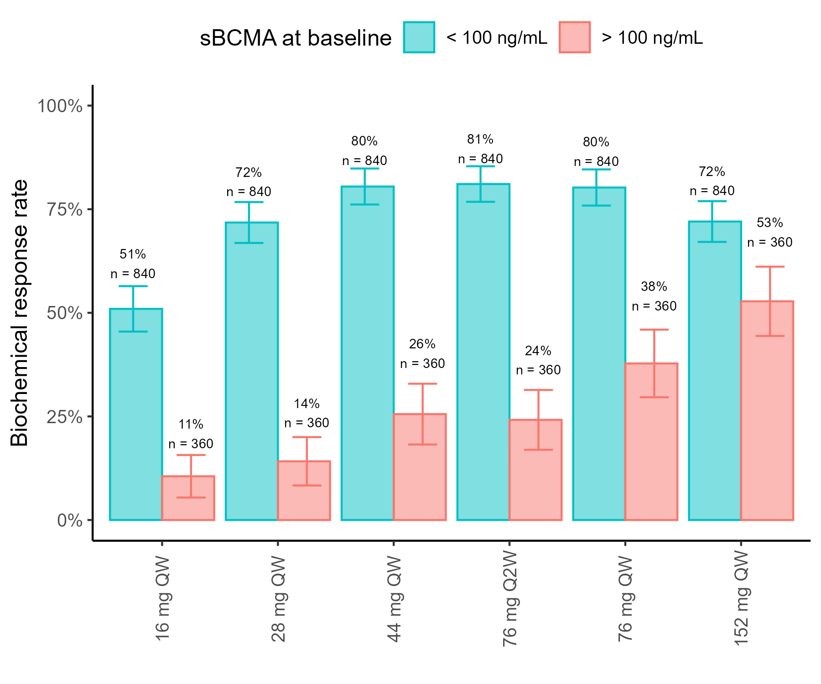
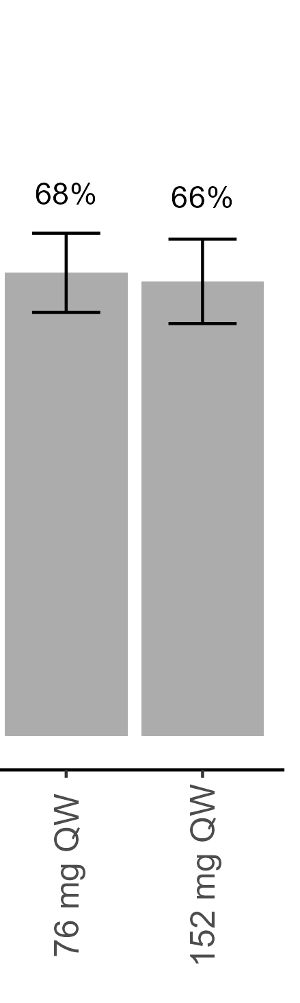
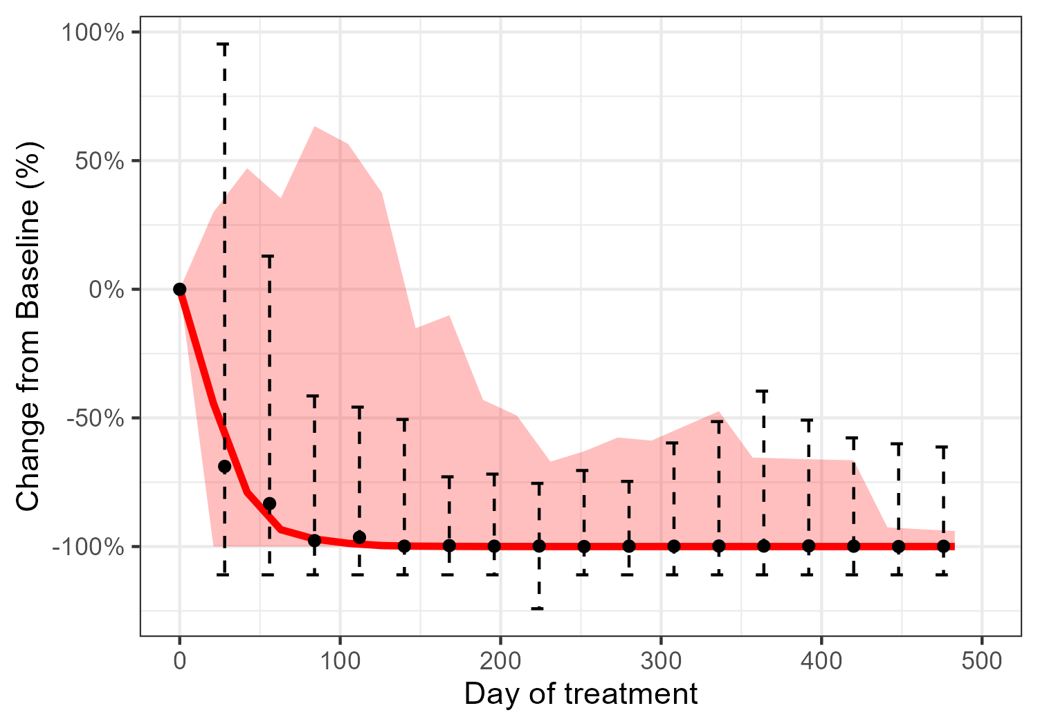
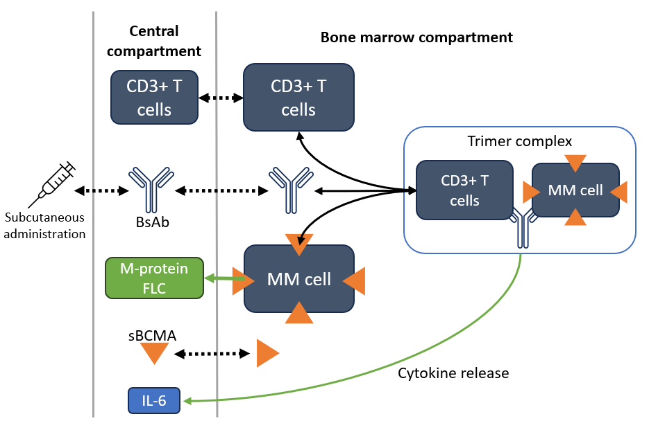
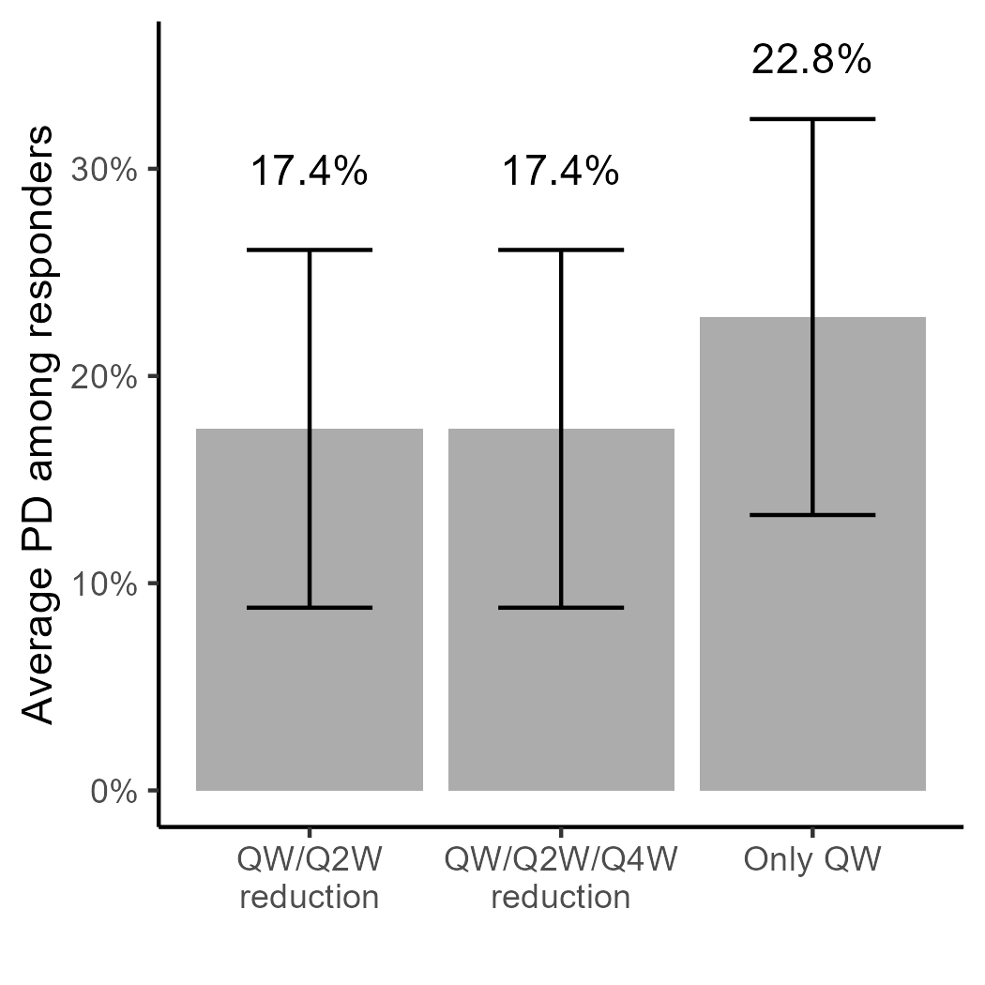
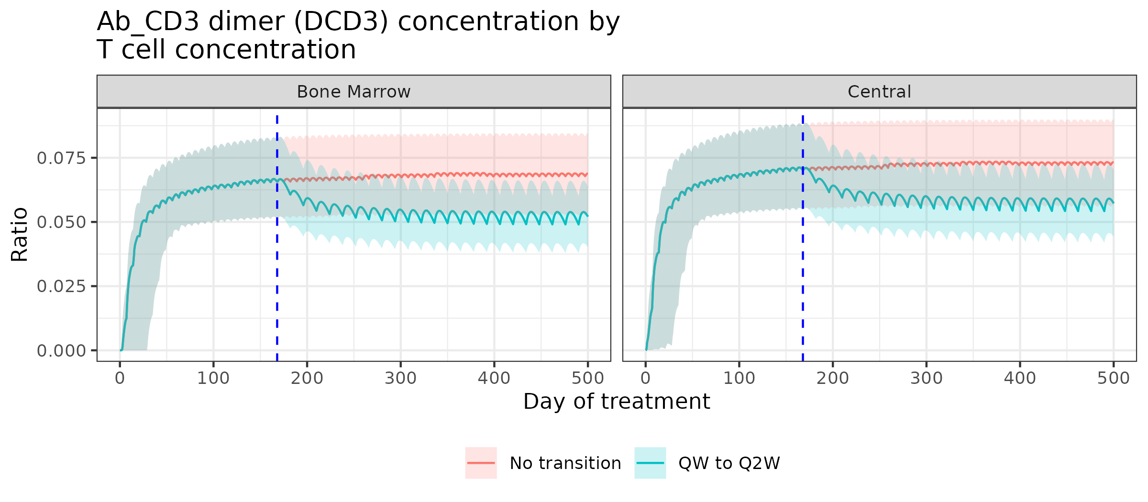
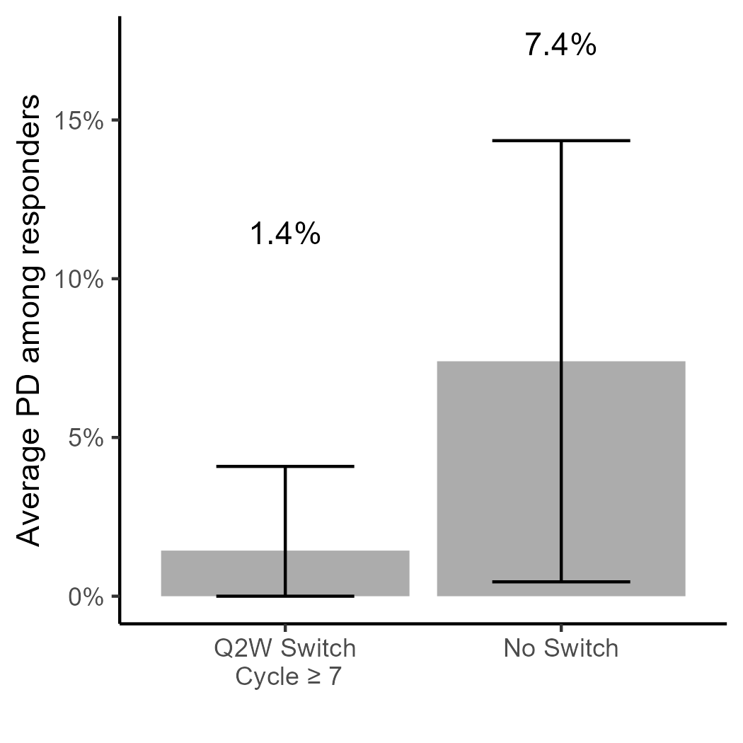
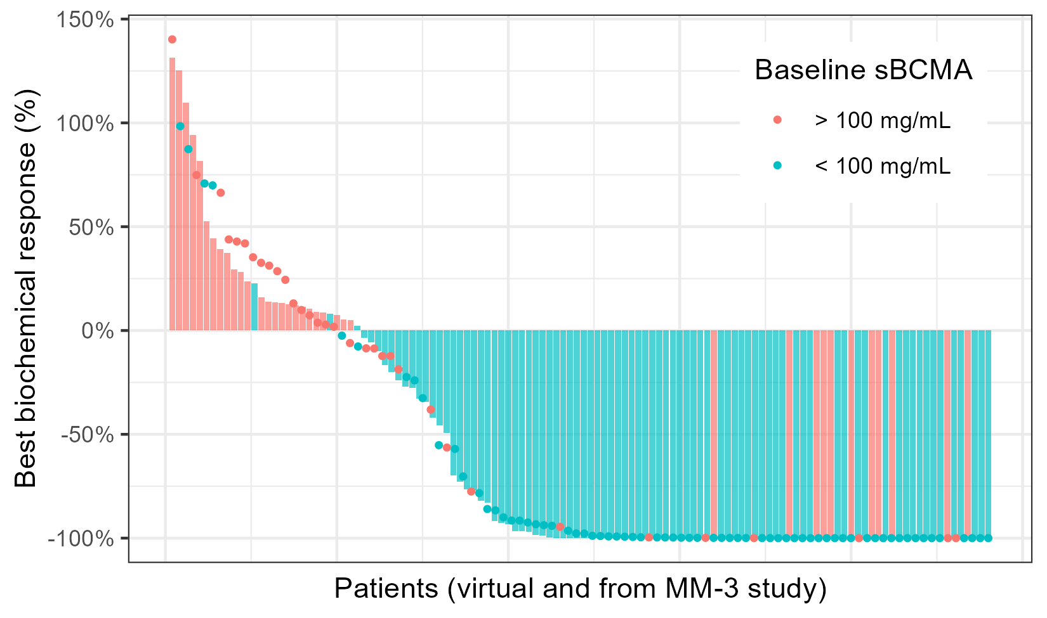
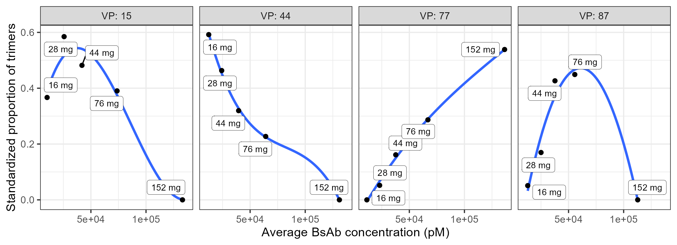
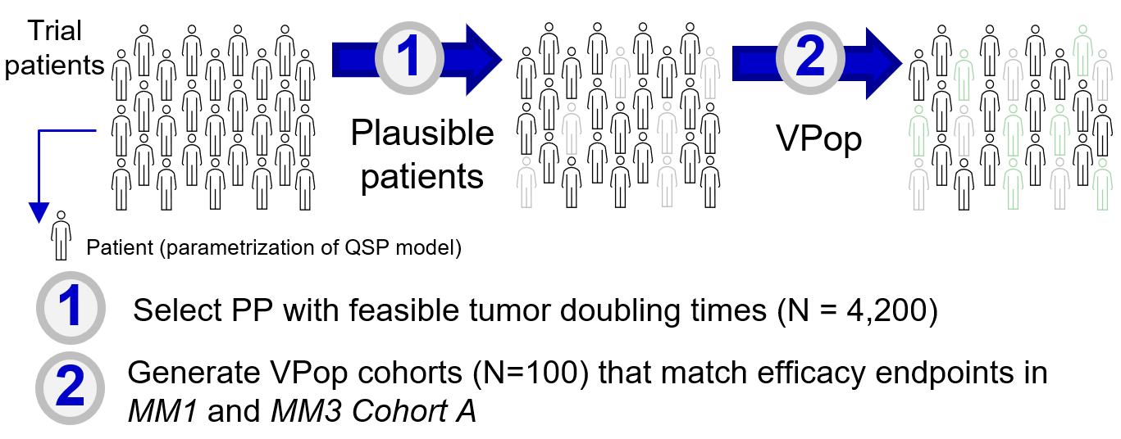
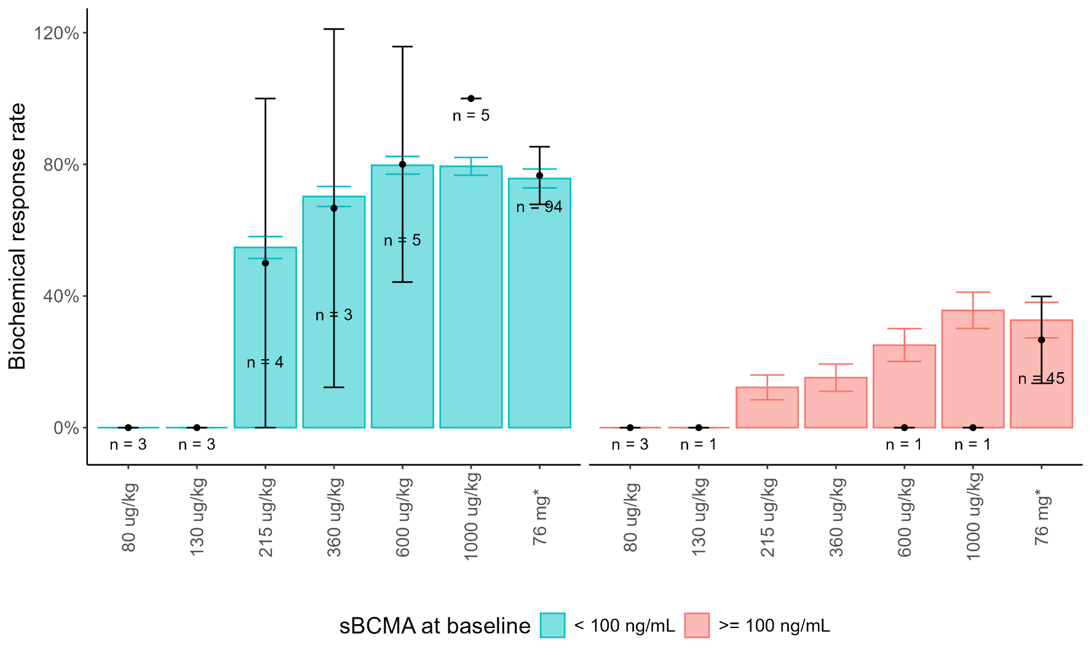
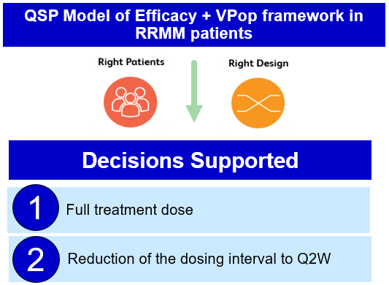
W-098
Role of Quantitative Systems Pharmacology (QSP) in
Optimizing Elranatamab Dosing Regimen for
Relapsed/Refractory Multiple Myeloma
Kamrine E. Poels¹, Mohamed Elmeliegy², Diane Wang², Jennifer Hibma¹, C.J. Musante¹, Blerta Shtylla¹
¹Pharmacometrics & Systems Pharmacology, Pfizer Inc, San Diego, CA, USA; ²Oncology Research and Development, Pfizer Inc, San Diego, CA, USA
Objectives
Develop a mathematical model that captures the mechanism of action of elranatamab and corresponding disease dynamics for patients with multiple myeloma
Use QSP to form a framework to help inform dosing decisions for elranatamab monotherapy in patients with relapsed/refractory multiple myeloma
Background
Bispecific antibodies (BsAb) are a rapidly evolving treatment modality for multiple myeloma (MM), a type of blood cancer
Elranatamab, an approved BsAb, forms an immune synapse between T-cells via surface marker CD3 and B-cell maturation antigens (BCMA) on tumor cells¹
Membrane-bound BCMA can undergo shedding from the cell surface, leading to circulation of soluble BCMA (sBCMA). sBCMA is associated with disease burden and reduced drug exposure, which may impact efficacy
Establishing a recommended dose based on non-clinical and early clinical data can be challenging especially for drugs with complex dynamics such as BsAb and for a disease with a shed target
QSP models can be leveraged to quantitatively explore mechanistic hypotheses around drug mechanism of action and enable systematic extrapolation of optimal dose and regimen for compounds with a complex mechanism of action
Methods
Model Structure
We developed a mathematical model (Figure 1) that captures the mechanism of action of elranatamab and disease dynamics for patients with MM
Myeloma cells in bone marrow shed BCMA at a rate proportional to tumor burden (myeloma cells); BCMA densities were informed by the literature
sBCMA binds BsAb (forming a dimer) or it can exit in circulation
T cells have CD3 receptors that bind BsAb (forming a dimer); CD3 receptor densities were informed by the literature
Production rate of FLC and M-protein is assumed to be constant per tumor cell and proportional to tumor burden or myeloma cell numbers
Trimers (myeloma cell+BsAb+CD3) drive tumor killing and cytokine production
High cytokine levels block movement of T cells back into circulation
Results and Conclusions
Figure 4. Simulated BRR of ten VPops across increasing dose schedules
Biochemical response rate (BRR) is defined as a 50% decrease of simulated paraprotein for 2 consecutive tumor assessments. BRR stratified by baseline sBCMA levels. Model suggests that the optimal regimen for patients with low sBCMA levels (blue) and high sBCMA levels (red) is 76 mg QW (BRR 80%) and 152 mg QW (BRR 53%), respectively. In the general virtual populations (grey), the identified optimal dose is 76 mg QW with a BRR of 68%.
General virtual populations (n=1200)
Figure 3. Efficacy endpoints and summary metrics used to calibrate VPops to clinical data
Change from baseline in serum M-spike or FLC and the best response was fitted both studies. Biochemical objective response rates were fitted to patient populations stratified by sBCMA levels due to its effect as a drug-sink.
MM3 Cohort A (n = 120)
VPop
Figure 1. Schema of CD3-BCMA BsAb model with tumor dynamics
Change from baseline, %
Simulations predict 76 mg QW as the optimal dose regimen that would benefit most patients with RRMM, especially those with high sBCMA levels (Figure 4)
Figure 5. Optimal dose for tumor-killing activity depends on patient-specific and time-dependent factors
Progressive disease (PD) is defined as a 20% increase from nadir in serum paraproteins and an increase in absolute value depending on which paraprotein is used (FLC or M-protein). Standardized proportion of trimers is defined as median trimer levels divided by tumor burden (MM cell count). A higher proportion of trimers suggests more antitumor activity based on the bell-shaped dose response theory for BsAb. QSP model shows distinct proportion of trimer curves across virtual patients, showcasing inter-patient variability in tumor-killing efficacy.
BsAb-CD3 dimer concentration normalized by
T-cell concentration
Observed patient
Virtual population (VPop) methods are computational approaches that fit QSP models to clinical biomarker datasets through selection of virtual patients for a virtual trial²
Change from baseline, %
Virtual patient
Figure 2. Workflow of Virtual Population (VPop) generation
120
Biochemical objective response %
Simulations suggest a left-shift in the bell-shaped dose-response curves among virtual responders, supporting gradual reduction of the dosing intensity after persistent response. Specifically, our model supports a dosing transition from QW to Q2W after cycle 6 for patients with triple-class refractory MM
Our mechanistic model supports the dosing regimen in the phase 2 MagnetisMM-3 study (Figure 6). This modeling platform continues to be used to inform dosing recommendations for elranatamab studies with combination treatments or in earlier treatment lines. Additionally, this framework can be expanded and applied to the next generation of CD3 BsAb
References: 1. Shah N, et al. Leukemia 2020;34:985-1005. 2. Allen RJ, et al. CPT Pharmacometrics Syst Pharmacol 2016;5:140-146.
3. Bahlis NJ, et al. Nat Med 2023;29:2570-2576. 4. Lesokhin AM, et al. Nat Med 2023;29:2259-2267. 5. Elrexfio (elranatamab). Prescribing information. Pfizer; 2023.
Acknowledgments: We acknowledge Tanvi, Aijaz, and Rukmini for their contributions to code development for earlier versions of this model. The study was sponsored by Pfizer.
Disclosures: The authors of this poster are employed by Pfizer.
Contact: Kamrine Poels, kamrine.poels@pfizer.com
Copyright © 2024. All rights reserved.
Model calibration and simulation
We formed virtual populations (VPop) that represent variability in biological, pharmacological, and tumor-related parameters from clinical participants to inform clinical dose-response relationships, and to identify biological determinants of clinical response (Figure 2)
Each VPop was calibrated to efficacy endpoints from the MagnetisMM-1 and MagnetisMM-3 studies (Figure 3)³⁻⁴
Additional biomarkers were used for VPop model validation (ie, sBCMA, IL-6, PK)
Schedules of interest with distinct full doses and dose reductions conditional on response (Figures 4 and 5) were simulated to explore impact on efficacy
  Dose reduction scenario: if virtual patient is a partial responder or better, dosing is reduced from once weekly (QW) to every 2 weeks (Q2W) after cycle 6
Figure 6. Summary of modeling workflow and impact
Input data and sources
Informs BsAb binding, immune cell interactions, tumor dynamics
Informs drug distribution
Informs VPop selection
Elranatamab PopPK model
Preclinical in-vitro assays, biological literature, competitor molecules
MM-1 and MM-3 Cohort A efficacy and immune biomarkers

