Slide 1
7504
Elranatamab in combination with daratumumab and lenalidomide in patients with newly diagnosed multiple myeloma not eligible for transplant: initial results from MagnetisMM-6 part 1
Hang Quach¹, Luděk Pour², Sebastian Grosicki³, Hanlon Sia⁴, Jiri Minarik⁵, Ja Min Byun⁶, Cyrille Touzeau⁷, Carmine Liberatore⁸, Sharon T. Sullivan⁹, Eric Leip⁹, Eeman Shaikh¹⁰, Andrea Viqueira¹¹, Meletios-Athanasios Dimopoulos¹²
¹St. Vincent’s Hospital, Melbourne, University of Melbourne, VIC, Australia; ²Department of Internal Medicine, Hematology and Oncology, University Hospital Brno, Brno, Czech Republic; ³Department of Cancer Prevention, Medical University of Silesia, Katowice, Poland; ⁴Department of Haematology, Tweed Valley Hospital, NSW, Australia; ⁵Department of Hemato-Oncology, University Hospital Olomouc, Olomouc, Czech Republic; ⁶Department of Internal Medicine, Seoul National University Hospital, Seoul National University College of Medicine, Seoul, Republic of Korea; ⁷The Hematology Clinic, University Hospital Hôtel-Dieu, Nantes, France; ⁸Hematology Unit, Santo Spirito Hospital, Pescara, Italy; ⁹Pfizer Inc, Cambridge, MA, USA; ¹⁰Pfizer Inc, Bothell, WA, USA; ¹¹Pfizer SLU, Madrid, Spain; ¹²Department of Clinical Therapeutics, National and Kapodistrian University of Athens, Athens, Greece
Presented at the 2025 ASCO Annual Meeting | May 30 – June 2, 2025 | Chicago, IL & Online
Notes:
The last slide has the acknowledgments

Slide 2
Key takeaways
Initial data from MagnetisMM-6 Part 1, dose level G (elranatamab 76 mg Q4W + daratumumab + lenalidomide) demonstrate that the combination of elranatamab with daratumumab and lenalidomide is effective and manageable in patients with NDMM who are not eligible for transplant
  The safety profile was predictable and consistent with the known toxicities of the components
    Most frequent (≥50%) TEAEs were hematologic AEs, infections and CRS
  The combination showed early and promising efficacy
    Responses are expected to further deepen with longer follow-up
AE=adverse event; CRS=cytokine release syndrome; NDMM=newly diagnosed multiple myeloma; Q4W=every 4 weeks; TEAEs=treatment-emergent AE

Slide 3
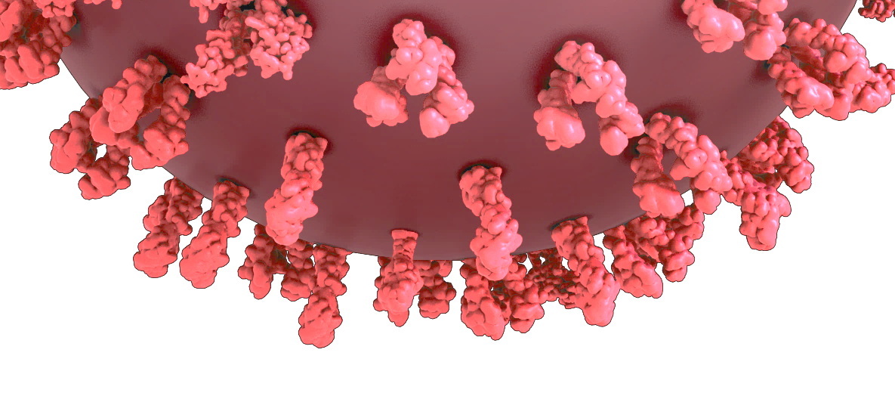
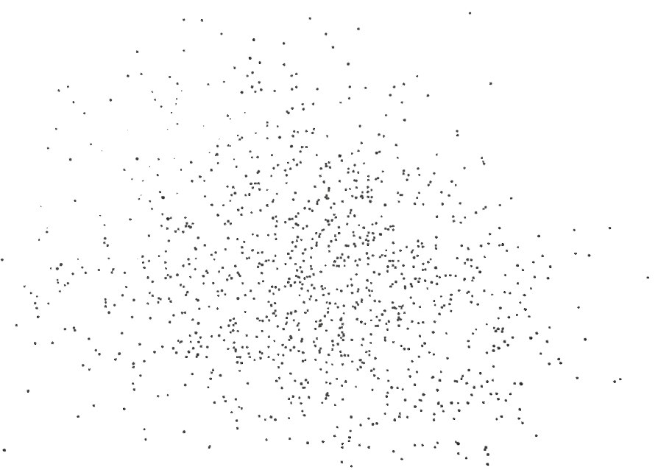
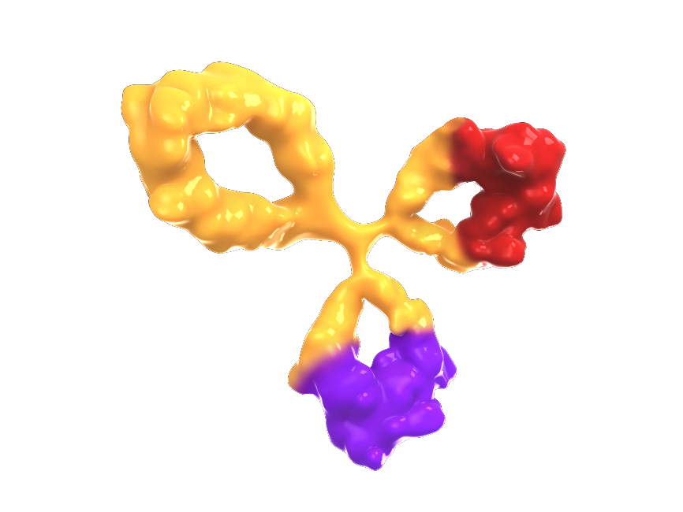

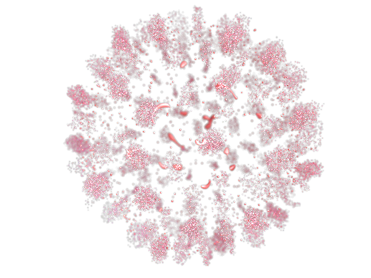

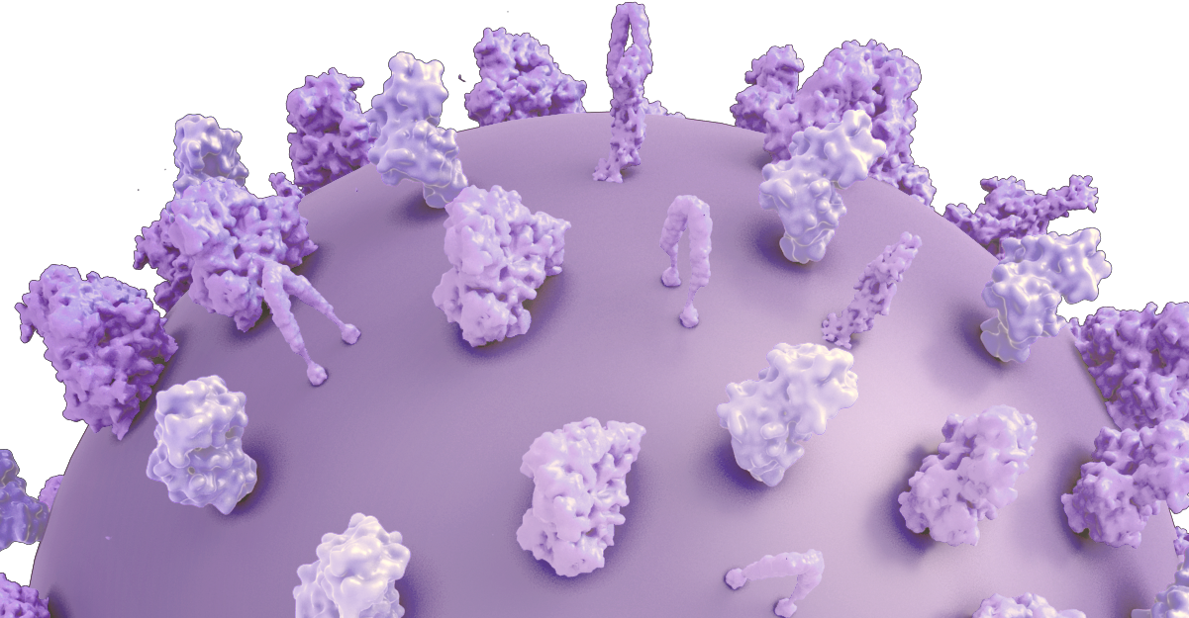
Background
Elranatamab binds BCMA on myeloma cells and CD3 on T cells
Myeloma cell
Elranatamab is a BCMA-CD3 bispecific antibody approved as a monotherapy for patients with RRMM who have received ≥1 IMiD, ≥1 PI, and ≥1 anti-CD38 mAb¹⁻²
  Based on MagnetisMM-3 (NCT04649359), ORR was 61.0%, mPFS was 17.2 months, and mOS was 24.6 months^{3,4}
Combining elranatamab with lenalidomide and daratumumab may enhance immune cell-mediated myeloma cell death as:
  Lenalidomide stimulates the activation of CD4+ and CD8+ T cells and NK cells⁵
  Daratumumab has immunomodulatory effects and multiple actions (ie, ADCC, CDC, and ADCP) against CD38-expressing myeloma^{6,7}
Elranatamab
BCMA-binding arm
BCMA
Myeloma cell death
Cytokines,
perforin, granzymes
CD3
CD3-binding arm
T cell
T cells activated by CD3 binding release cytokines and perforin/granzymes, resulting in myeloma cell lysis
Lenalidomide and daratumumab
Enhance T-cell activation
Deplete immune-suppressive cells
Elranatamab
Promotes T-cell–mediated tumor lysis
Combination proposed to enhance the activation of immune cell–mediated myeloma cell death
1. Elrexfio (elranatamab-bcmm). Prescribing information. Pfizer Inc; 2023. 2. Elrexfio (elranatamab-bcmm). Summary of product characteristics. Pfizer Europe MA EEIG; 2024. 3. Lesokhin AM, et al. Nat Med 2023;29:2259-2267.
4. Tomasson MH, et al. Hemasphere 2024;8:e136. 5. Gandhi AK, et al. Br J Haematol 2014;164:811-821. 6. Krejcik J, et al. Blood 2016;128:384-394. 7. Sanchez L, et al. J Hematol Oncol 2016;9:51.
ADCC=antibody-dependent cell-mediated cytotoxicity; ADCP=antibody-dependent cellular phagocytosis; BCMA=B-cell maturation antigen; CDC=complement-dependent cytotoxicity; IMiD=immunomodulatory drug; mAb: monoclonal antibody; mOS=median overall survival; mPFS=median progression-free survival; NK=natural killer; ORR=objective response rate; PI=proteasome inhibitor; RRMM=relapsed or refractory multiple myeloma

Slide 4
Objectives
MagnetisMM-6 is designed to:
  Evaluate the efficacy and safety of elranatamab + lenalidomide ± daratumumab (EDR or ER) vs
  daratumumab + lenalidomide + dexamethasone (DRd) in patients with transplant-ineligible NDMM
  Part 1 of the study evaluates the optimal dose of EDR or ER in patients with RRMM or NDMM to determine the recommended phase 3 dose for part 2
DRd=daratumumab + lenalidomide + dexamethasone; EDR=elranatamab + daratumumab + lenalidomide; ER=elranatamab + lenalidomide; NDMM=newly diagnosed multiple myeloma; RRMM=relapsed or refractory multiple myeloma

Slide 5
MagnetisMM-6 Part 1 Study Design
Dose level 1, A
EDR (28D cycle): E 76 mg QW
+ Dara 1800 mg + Len 15mg
Primary endpoint
DLTs during DLT observation period^{c}
Dose level B
EDR (28D cycle): E 76 mg QW
+ Dara 1800 mg + Len 25mg
Secondary endpoints
Key eligibility criteria for Part 1
Age ≥18 years with RRMMª and/or TI NDMM^{b}
Measurable disease according to IMWG criteria¹
ECOG PS ≤2
Adequate liver, renal, and bone marrow function
AEs and laboratory abnormalities
ORR and complete response rate^{d}
Time to event endpoints
  Time to response^{d}
  Duration of response^{d}
  Progression-free survival^{d}
  Overall survival
MRD negativity rate^{e}
Pharmacokinetics
Immunogenicity
Dose level C
EDR (28D cycle): E 76 mg Q2W
+ Dara 1800 mg + Len 25mg
Dose level G
EDR (28D cycle): E 76 mg Q4W
+ Dara 1800 mg + Len 25mg
Dose level H
ER (28D cycle): E 76 mg Q2W
+ Len 25mg
MagnetisMM-6 Part 1 dose level G is evaluating the combination of elranatamab 76 mg SC Q4W, daratumumab 1800 mg SC, and lenalidomide 25 mg PO in patients with transplant-ineligible NDMM (Data cutoff: April 1, 2025)
1. Kumar S, et al. Lancet Oncol 2016;17:e328-e346.
ª Must have received 1-2 prior lines of MM therapy including at least 1 IMiD and 1 PI; ^{b} Defined as age ≥65 years or <65 years with comorbidities impacting the possibility of transplant; ^{c} DLTs were not evaluated in DL G because DL C, which evaluated the same dosing regimen except elranatamab is given less frequently (Q4W vs Q2W in DL C), was determined to be tolerable; ^{d} Per IMWG response criteria; ^{e} Per IMWG sequencing criteria
AE=adverse event; DL=dose level; DLT=dose-limiting toxicity; ECOG PS=Eastern Cooperative Oncology Group performance status; EDR=elranatamab + daratumumab + lenalidomide; ER=elranatamab + lenalidomide; IMiD=immunomodulatory drug; IMWG=International Myeloma Working Group; MM=multiple myeloma; MRD=minimal residual disease; NDMM=newly diagnosed MM; ORR=objective response rate; PI=proteasome inhibitor; RRMM=relapsed
or refractory MM; SCT=stem cell transplant; TI=transplant-ineligible; QW=once weekly; Q2W=every 2 weeks; Q4W=every 4 weeks

Slide 6
MagnetisMM-6 Part 1 Dose Level G Dosing Schedule
Cycle 0ª
Cycles 1-2
Cycles 3-6
Cycles ≥7
Step-up doses of
ELRA 12 and 32 mg
ELRA 76 mg
ELRA 76 mg (Q4W) + DARA 1800 mg (QW, Q2W, or Q4W) + lenalidomide 25 mg (QD, D1-21)
D1
D4
D8
D1 D8 D15 D22
D1 D8 D15 D22
D1 D8 D15 D22
Elranatamab 12 mg SC
Elranatamab 32 mg SC
Elranatamab 76 mg SC
Daratumumab 1800 mg SC
Lenalidomide 25 mg PO
Elranatamab premedication
Diphenhydramine 25 mg (or equivalent) PO or IV
Acetaminophen 650 mg (or paracetamol 500 mg) PO
Dexamethasone 20 mg (or equivalent) PO or IV
ª Protocol-required hospitalization for elranatamab
Dose 1: 48 hours
Dose 2: 24 hours
Cycle length
Cycle 0: 14 days
Cyle ≥1: 28 days
Daratumumab premedication
Diphenhydramine 25-50 mg (or equivalent) PO or IV
Acetaminophen 650-1000 mg (or paracetamol 500) PO
Dexamethasone 20 mg (or equivalent) PO or IV
D=day; DARA=daratumumab; ELRA=elranatamab; IV=intravenously; PO=orally; QD=daily; QW=once weekly; Q2W=every 2 weeks; Q4W=every 4 weeks; SC=subcutaneously

Slide 7
Baseline Characteristics
All patients (100%) had NDMM
 | N=37
Age, median (range), years | 75.0 (67-83)
Female, n (%) | 23 (62.2)
Race, n (%)
Asian | 5 (13.5)
Black or African American | 0
White | 32 (86.5)
ECOG PS, n (%)
0 | 22 (59.5)
1 | 14 (37.8)
2 | 1 (2.7)
 | N=37
R-ISS disease stage by investigator, n (%)
I | 9 (24.3)
II | 20 (54.1)
III | 5 (13.5)
Unknown | 3 (8.1)
Extramedullary disease by investigator, n (%)
Yes | 0
No | 37 (100)
Baseline bone marrow plasma cells, n (%)
<50% | 28 (75.7)
≥50% | 9 (24.3)
Frail status, n (%)ª
Yes | 9 (24.3)
No | 28 (75.7)
ª According to the simplified IMWG scale using scores for ECOG PS, Charlson Comorbidity Index, and age
ECOG PS=Eastern Cooperative Oncology Group performance status; IMWG=International Myeloma Working Group; NDMM=newly diagnosed multiple myeloma; R-ISS=Revised International Staging System

Slide 8
Patient Disposition
Patients enrolled in dose level G
N = 37 received at least one dose of elranatamab
(n = 34 received EDR)
37 patients with TI NDMM enrolled and received at least one dose of elranatamab
  34 patients received the EDR regimen
As of the data cutoffª, median (range) duration of follow-up was 7.9 (1.2, 9.5) months
  32 (86.5%) patients were still on treatment
Discontinuations, n = 5
Reasons for discontinuing the last drug
Adverse event n = 3
Death n = 1
Refused further treatment n = 1
Treatment ongoing
n = 32
ª Data cutoff date was April 1, 2025
EDR=elranatamab + daratumumab + lenalidomide; NDMM=newly diagnosed multiple myeloma; TI, transplant-ineligible

Slide 9
Treatment-Emergent Adverse Events ≥15%
Most frequent (≥50%) TEAEs were hematologic (83.8%; grade 3/4 78.4%), infections (70.3%; grade 3/4 18.9%) and CRS (62.2%, grade 3/4 0%)
All CRS events were grade ≤2
One grade 2 ICANS event was reported
 | N=37
TEAE, n (%)ª | Any grade | Grade 3/4
Any | 37 (100) | 35 (94.6)
Hematologic
Neutropenia^{b} | 28 (75.7) | 27 (73.0)
Anemia^{c} | 13 (35.1) | 7 (18.9)
Thrombocytopenia^{d} | 6 (16.2) | 4 (10.8)
Nonhematologic
CRS | 23 (62.2) | 0
Pyrexia | 14 (37.8) | 0
Cough | 11 (29.7) | 0
Injection site reaction | 11 (29.7) | 0
Nausea | 11 (29.7) | 0
Rash | 11 (29.7) | 3 (8.1)
Diarrhea | 9 (24.3) | 1 (2.7)
Hypogammaglobulinemia | 9 (24.3) | 1 (2.7)
Constipation | 8 (21.6) | 0
Decreased appetite | 8 (21.6) | 2 (5.4)
Fatigue | 7 (18.9) | 0
Peripheral sensory neuropathy | 7 (18.9) | 0
Asthenia | 6 (16.2) | 4 (10.8)
Cytomegalovirus test positive | 6 (16.2) | 0
Edema peripheral | 6 (16.2) | 0
1. Lee DW, et al. Biol Blood Marrow Transplant 2019;25:625-638.
ª TEAEs according to the Medical Dictionary for Regulatory Activities v27.1 and Common Terminology Criteria for Adverse Events v5; severity of CRS and ICANS was assessed according to the American Society for Transplantation and Cellular Therapy criteria¹; ^{b} Including neutrophil count decreased, neutrophil percentage decreased, cyclic neutropenia, agranulocytosis, granulocytopenia, granulocyte count decreased; ^{c} Includes hemoglobin decreased, red blood cell count decreased, hematocrit decreased, normochromic anemia, normocytic anemia, normochromic normocytic anemia; ^{d} Includes platelet count decreased
CRS=cytokine release syndrome; ICANS=immune effector cell-associated neurotoxicity syndrome; TEAE=treatment-emergent adverse event

Slide 10
TEAEs: Infections ≥5%
Any grade infections were reported in 70.3% of patients (grade 3/4, 18.9%)
  One case of grade 5 Candida pneumonia was reported
Frequent (any grade >10%) infections included upper respiratory tract infection and Escherichia urinary tract infection
Anti-infective prophylaxis was given and 34 patients (91.9%) received immunoglobulin replacement therapy
 | N=37
TEAE, n (%)ª | Any grade | Grade 3/4
Infections^{b} | 26 (70.3) | 7 (18.9)
Upper respiratory tract infection | 8 (21.6) | 0
Escherichia urinary tract infection | 4 (10.8) | 1 (2.7)
Bronchitis | 3 (8.1) | 0
Cytomegalovirus infection reactivation | 3 (8.1) | 0
Rhinitis | 3 (8.1) | 0
Viral upper respiratory tract infection | 3 (8.1) | 0
Pneumonia | 2 (5.4) | 1 (2.7)
Urinary tract infection | 2 (5.4) | 0
ª TEAEs according to the Medical Dictionary for Regulatory Activities v27.1 and Common Terminology Criteria for Adverse Events v5; ^{b} Infections include preferred terms in the system organ class of infections and infestations
TEAE=treatment-emergent adverse event

Slide 11
Early Emerging Response Data
The confirmed ORR by investigator
was 97.3% (95% CI, 85.8, 99.9)
  94.6% had ≥VGPR
  27.0% had ≥CR
Responses were early with a median (range) time to response of 1.5 (0.3, 4.2) months
Data cutoff | Dec 23, 2024 |  | Apr 1, 2025
Duration of follow-up, median (range) | 4.6 (1.2-6.2) mos |  | 7.9 (1.2-9.5) mos
ORR | 91.9% |  | 97.3%
≥CR
5.4%
≥CR
27.0%
≥VGPR
81.1%
≥VGPR
94.6%
CR=complete response; mos=months; mos=months; ORR=objective response rate; PR=partial response; sCR=stringent complete response; VGPR=very good partial response

Slide 12
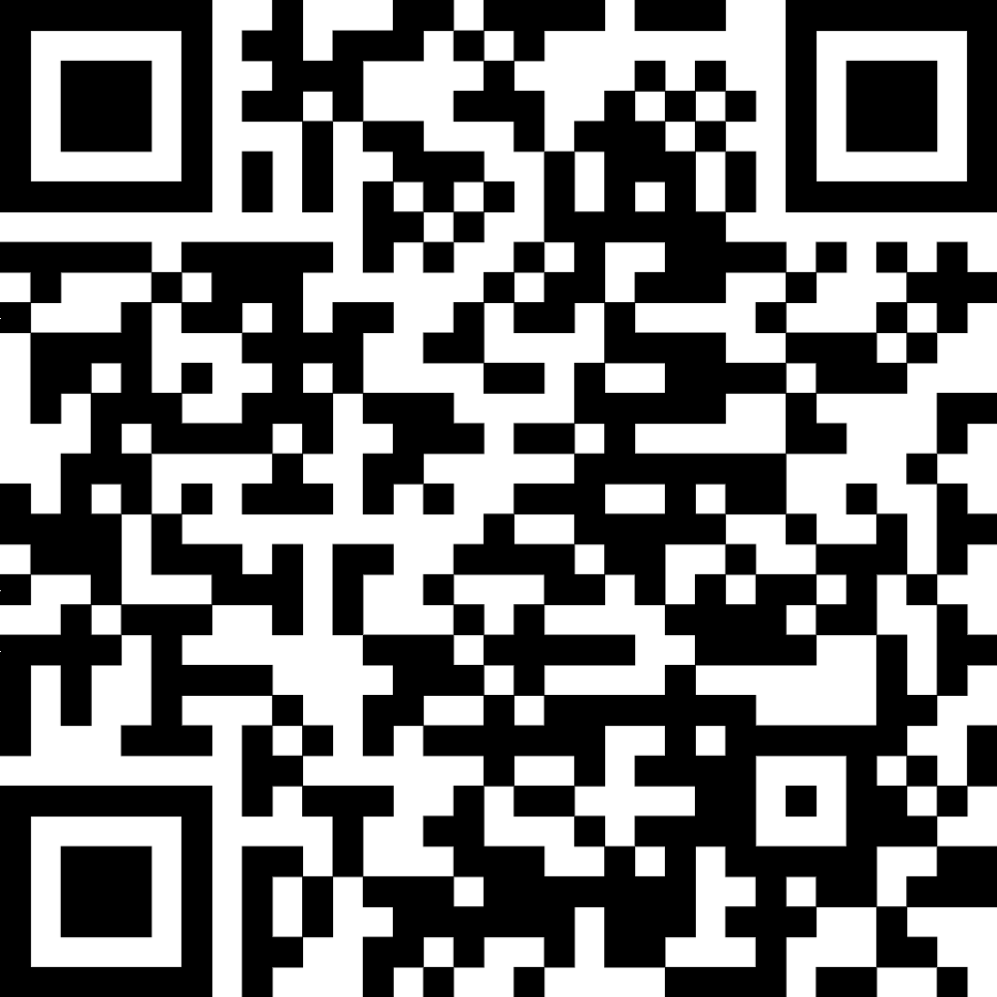
Conclusions
Initial data from MagnetisMM-6 Part 1, dose level G demonstrate that the combination of elranatamab with daratumumab and lenalidomide is effective and manageable in patients with NDMM who are not eligible for transplant
  The safety profile was consistent with the known toxicities of the components
    The most frequent TEAEs were hematologic AEs, infections, and CRS
    All CRS and ICANS events were grade ≤2
    Majority of infections were grade ≤2
  Early and promising efficacy
    Responses deepen over time and are expected to deepen even further with longer follow-up
MagnetisMM-6 Part 1 enrollment in the ER combination cohort is ongoing
MagnetisMM-6 Part 2 will start when the RP3D is determined based on the data from Part 1
Acknowledgments
Presentation slides
Please scan this quick response (QR) code with your smartphone app to view the slides for this presentation. If you do not have a smartphone, you may access this material via the internet at
https://xxx
We thank the MagnetisMM-6 trial patients and their families, as well as the study investigators, nurses, and site staff. This study was sponsored by Pfizer. Medical writing support was provided by William Clafshenkel PharmD, PhD, of Nucleus Global and was funded by Pfizer.
FPO
AE=adverse event; CRS=cytokine release syndrome; ER=elranatamab + lenalidomide; ICANS=immune effector cell-associated neurotoxicity syndrome; NDMM=newly diagnosed multiple myeloma; ORR=objective response rate; RP3D=recommended phase 3 dose; TEAE=treatment-emergent AE; VGPR=very good partial response

