Slide 1
Dose optimization of PF-07248144, a first-in-class KAT6 inhibitor, in patients with ER+/HER2− metastatic breast cancer: results from phase 1 study to support the recommended phase 3 dose
Patricia M. LoRusso,¹ Toru Mukohara,² David Sommerhalder,³ Kan Yonemori,⁴ Erika Hamilton,⁵
Rachel M. Layman,⁶ Sung-Bae Kim,⁷ Seock-Ah Im,⁸ Hope S. Rugo,⁹ Toshinari Yamashita,¹⁰
Fengting Yan,¹¹ Fumikata Hara,¹² Gunmin Kim,¹³ Shusen Wang,¹⁴ Sean Kent,¹⁵ Li Liu,¹⁶
Athanasia Skoura,¹⁷ Karey Kowalski,¹⁶ Meng Li,¹⁸ and Yeon Hee Park¹⁹
¹Yale School of Medicine, New Haven, CT, USA; ²National Cancer Center Hospital East, Kashiwa, Japan; ³NEXT Oncology, San Antonio, TX, USA; ⁴National Cancer Center Hospital, Tokyo, Japan; ⁵Sarah Cannon Research Institute, Nashville, TN, USA; ⁶The University of Texas MD Anderson Cancer Center, Houston, TX, USA; ⁷Asan Medical Center, University of Ulsan College of Medicine, Seoul, Republic of Korea; ⁸Seoul National University Hospital, Seoul National University College of Medicine, Cancer Research Institute, Seoul National University, Seoul, Republic of Korea; ⁹University of California, San Francisco, CA, USA; ¹⁰Kanagawa Cancer Center, Yokohama, Japan; ¹¹Swedish Cancer Institute, First Hill-True Family Women's Cancer Center, Seattle, WA, USA; ¹²The Cancer Institute Hospital of the Japanese Foundation for Cancer Research, Tokyo, Japan; ¹³Yonsei University College of Medicine, Seoul, Republic of Korea; ¹⁴Cancer Center, Sun Yat-sen University, Guangzhou, China; ¹⁵Pfizer Inc, Cambridge, MA, USA; ¹⁶Pfizer Inc, San Diego, CA, USA; ¹⁷Pfizer Inc, Collegeville, PA, USA; ¹⁸Pfizer Inc, San Francisco, CA, USA; ¹⁹Samsung Medical Center, Sungkyunkwan University School of Medicine, Seoul, Republic of Korea
Funding: This study is sponsored by Pfizer Inc.
Acknowledgments: Medical writing support was provided by Diana Avery, PhD, of Oxford PharmaGenesis Inc., funded by Pfizer Inc.
The authors thank all participants and their caregivers, all co-investigators, and clinical research teams at participating sites
Patricia M. LoRusso, DO

Slide 2
Disclosures
Will be displayed automatically based on information provided to ASCO
Patricia M. LoRusso, DO

Slide 3
Background
Histone lysine acetyltransferases KAT6A and KAT6B regulate lineage-specific gene transcription via H3K23 acetylation^{1,2}
KAT6A/B inhibition results in transcriptional downregulation of oncogenic pathways associated with cancer proliferation in ER+ breast cancer (eg, ER, cell cycle, Myc)¹
PF-07248144 is a first-in-class, potent, and selective inhibitor of epigenetic modifiers KAT6A and KAT6B
In an ongoing phase 1 study, PF-07248144 has demonstrated a tolerable safety profile and durable antitumor activity in combination with fulvestrant in patients with ER+/HER2– mBC after prior CDK4/6 inhibitor plus ET^{3,4}
CDK4/6, cyclin-dependent kinase 4/6; ER, estrogen receptor; ET, endocrine therapy; H3K23, histone 3 lysine 23; HER2, human epidermal growth factor receptor 2; mBC, metastatic breast cancer.
1. Sharma S, et al. Cell Chem Biol. 2023;30:1191-1210. 2. Huang F, et al. Mol Cell Biol. 2016;36:1900-7. 3. Mukohara T, et al. Nat Med. 2024;30:2242-50. 4. Mukohara T, et al. SABCS 2024. Poster P4-04-28.
Patricia M. LoRusso, DO

Slide 4
Study Design
Study Design: a first-in-human, phase 1 dose escalation/expansion study of PF-07248144 as monotherapy and in combination with fulvestrant in patients with heavily pretreated ER+/HER2− mBC (NCT04606446)
Dose Optimization: evaluate 2 pharmacokinetically distinguishable doses of PF-07248144 (1 mg and 5 mg) in combination with fulvestrant to inform the recommended phase 3 dose
PF-07248144 Monotherapy
PF-07248144 + FUL 500 mg
Part 1
Dose Escalation
Part 1A: 1–15 mg QD
(n = 29)
Part 1B:
RDE_{c1}: 5 mg QD + FUL (n = 9)
RDE_{c2}:1 mg QD + FUL (n = 11)
Patient Population
Part 1A:
CRPC, NSCLC, or ER+/HER2– mBC
Part 1B, 2A-B
2L+ ER+/HER2– mBC progressed after CDK4/6 inhibitor + ET
Assessments
Safety and tolerability per CTCAE v5.0
Antitumor activity per RECIST v1.1
PK profile
PD biomarkers
RDE_{m}: 5 mg
Part 2
Dose Expansion
Part 2A: 5 mg QD
(n = 35)
Part 2B:
5 mg QD + FUL (n = 34)
1 mg QD + FUL (n = 18)
Dose Optimization Groups:
5 mg QD monotherapy
(n = 35)
5 mg QD
+ FUL
(n = 43)
1 mg QD
+ FUL
(n = 29)
Data cutoff: October 11, 2024.
2L, second line; CDK4/6, cyclin-dependent kinase 4/6; CRPC, castration-resistant prostate cancer; CTCAE, Common Terminology Criteria for Adverse Events; ER, estrogen receptor; ET, endocrine therapy; FUL, fulvestrant; HER2, human epidermal growth factor receptor 2; mBC, metastatic breast cancer; NSCLC, non-small cell lung cancer; PD, pharmacodynamic; PK, pharmacokinetic; RDE_{c}, combination recommended dose for expansion; RDE_{m}, monotherapy recommended dose for expansion; RECIST, Response Evaluation Criteria in Solid Tumors; QD, once daily.
Patricia M. LoRusso, DO

Slide 5
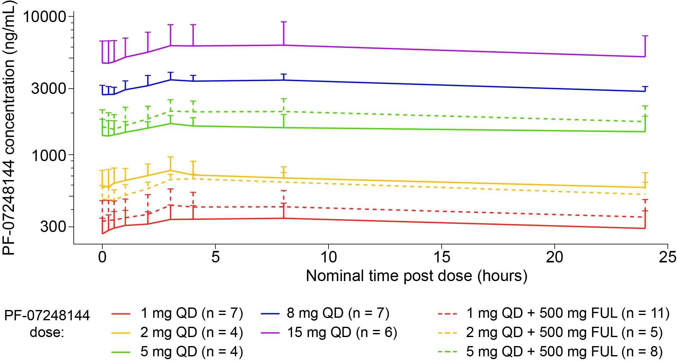
1 and 5 mg QD PF-07248144 Are Pharmacokinetically Distinguishable Doses Pursued for Dose Optimization
Extended half-life of PF-07248144 is supportive of once-daily (QD) dosing
PF-07248144 plasma exposure increased proportionally across the evaluated dose range
Doses ≥ 1 mg QD achieved targeted efficacious concentrations predicted by preclinical models
No apparent PK drug interaction was observed with fulvestrant
Mean (+ SD) Plasma Concentration-Time Profile of PF-07248144 (Cycle 1 Day 15)
FUL, fulvestrant; PK, pharmacokinetic; QD, once daily; RDE, recommended dose for expansion; SD, standard deviation.
Patricia M. LoRusso, DO

Slide 6
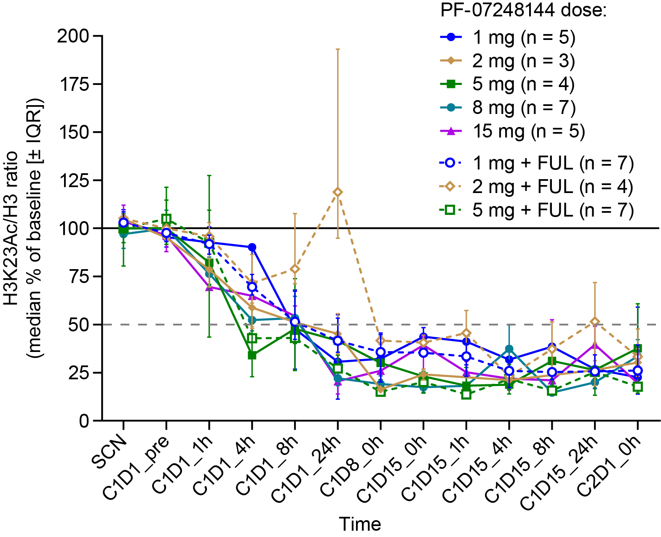
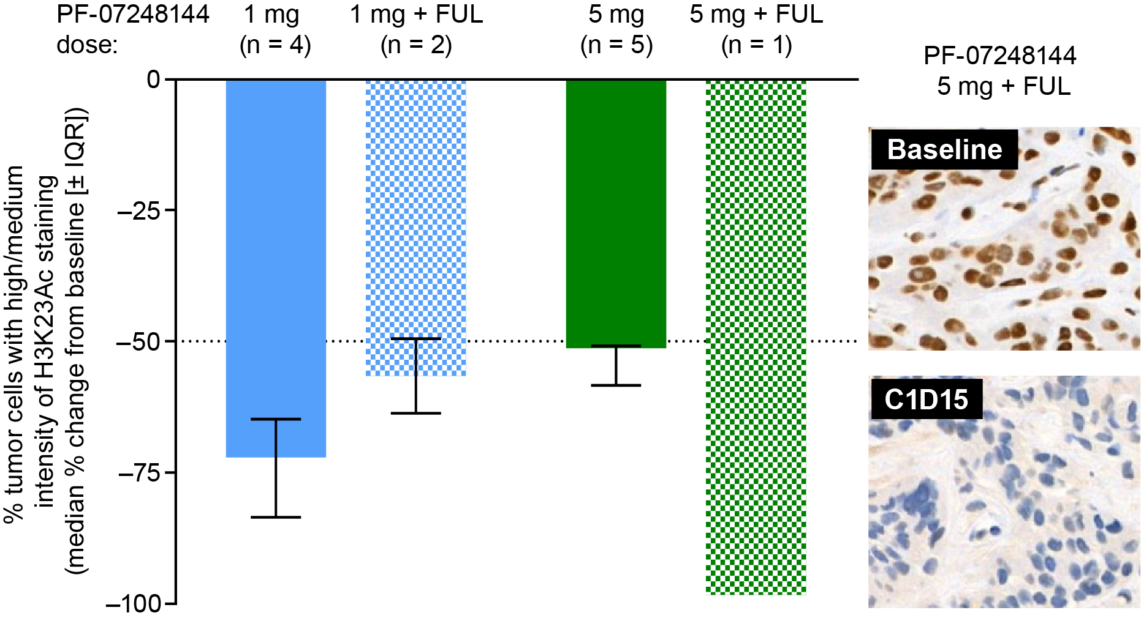
Strong H3K23Ac PD Reduction Achieved With 1 and 5 mg QD PF-07248144 ± Fulvestrant
H3K23Ac Reduction in PBMC
H3K23Ac Reduction at C1D15 in Tumor
PK/PD data supported the dose selection of 1 mg to compare with 5 mg QD PF-07248144,
for optimal dose determination in combination with fulvestrant
C, cycle; D, Day; FUL, fulvestrant; h, hour(s); H3, histone 3; H3K23Ac, histone 3 lysine 23 acetylation; IQR, interquartile range; PBMC, peripheral blood mononuclear cells; PK, pharmacokinetic;
PD, pharmacodynamic; pre, predose; QD, once daily; SCN, screening.
Patricia M. LoRusso, DO

Slide 7
Baseline Characteristics and Prior Therapies
Baseline Characteristic | PF-07248144 5 mg QD (n = 35) | PF-07248144 1 mg QD + FUL 500 mg (n = 29) | PF-07248144 5 mg QD + FUL 500 mg (n = 43)
Median age (range), years | 57.0 (39.0−76.0) | 55.0 (32.0−88.0) | 55.0 (24.0−76.0)
Female, n (%) | 35 (100) | 29 (100) | 42 (97.7)
Race, n (%) White Black or AA Asian | 9 (25.7) 0 26 (74.3) | 3 (10.3) 0 26 (89.7) | 13 (30.2) 1 (2.3) 29 (67.4)
ECOG PS, n (%) 0 1 | 18 (51.4) 17 (48.6) | 24 (82.8) 5 (17.2) | 17 (39.5) 26 (60.5)
Mutation, n (%) ESR1-mut PIK3CA/AKT1/ PTEN-mut | 22 (62.9) 20 (57.1) | 16 (55.2) 14 (48.3) | 24 (55.8) 19 (44.2)
Systemic Therapy in Advanced/ Metastatic Setting | PF-07248144 5 mg QD (n = 35) | PF-07248144 1 mg QD + FUL 500 mg (n = 29) | PF-07248144 5 mg QD + FUL 500 mg (n = 43)
No. prior LOTs, median (range) | 5.0 (1−13) | 2.0 (1−16) | 1.0 (1−6)
Prior therapy, n (%) CDK4/6 inhibitor >12 months | 35 (100) 19 (54.3) | 29 (100) 15 (51.7) | 43 (100) 33 (76.7)
ET AI Fulvestrant | 35 (100) 30 (85.7) 28 (80.0) | 29 (100) 27 (93.1) 5 (17.2) | 43 (100) 38 (88.4) 5 (11.6)
Chemotherapy | 26 (74.3) | 14 (48.3) | 12 (27.9)
Other targeted therapy | 14 (40.0) | 10 (34.5) | 2 (4.7)
Most baseline characteristics were generally comparable across treatment groups
All patients with ER+/HER2− mBC had received a prior CDK4/6 inhibitor plus ET in the advanced/metastatic setting
AA, African-American; AI, aromatase inhibitor; CDK4/6, cyclin-dependent kinase 4/6; ECOG PS, Eastern Cooperative Oncology Group performance status; ER, estrogen receptor; ET, endocrine therapy; FUL, fulvestrant; HER2, human epidermal growth factor receptor 2; LOT, line of therapy; mBC, metastatic breast cancer; mut, mutant; QD, once daily.
Patricia M. LoRusso, DO

Slide 8
PF-07248144 (1 or 5 mg QD) + Fulvestrant Has a Tolerable Safety Profile
TRAEs | PF-07248144 5 mg QD (n = 35) |  | PF-07248144 1 mg QD + FUL 500 mg (n = 29) |  | PF-07248144 5 mg QD + FUL 500 mg (n = 43)
Most frequent TRAEs (≥20%)
TRAE, n (%) | All grade | Grade ≥3 | All grade | Grade ≥3 | All grade | Grade ≥3
Any TRAE | 33 (94.3) | 18 (51.4) | 27 (93.1) | 7 (24.1) | 43 (100) | 27 (62.8)
Dysgeusia | G1: 26 (74.3) G2: 4 (11.4) | 0 | G1: 22 (75.9) G2: 4 (13.8) | 0 | G1: 24 (55.8) G2: 12 (27.9) | 0
Neutropenia | 24 (68.6) | G3: 12 (34.3) G4: 2 (5.7) | 10 (34.5) | G3: 6 (20.7) G4: 0 | 28 (65.1) | G3: 17 (39.5) G4: 3 (7.0)
Anemia | 16 (45.7) | 3 (8.6) | 8 (27.6) | 1 (3.4) | 19 (44.2) | 7 (16.3)
Leukopenia | 16 (45.7) | 4 (11.4) | 6 (20.7) | 2 (6.9) | 14 (32.6) | 5 (11.6)
Thrombocytopenia | 13 (37.1) | 0 | 2 (6.9) | 0 | 7 (16.3) | 1 (2.3)
AST increased | 8 (22.9) | 0 | 2 (6.9) | 0 | 4 (9.3) | 0
Fatigue | 6 (17.1) | 0 | 2 (6.9) | 0 | 19 (44.2) | 1 (2.3)
TRAEs leading to dose reductions or discontinuations, n (%)
Dose reductions | 16 (45.7) |  | 3 (10.3) |  | 24 (55.8^{b})
Discontinuations | 1 (2.9) |  | 1 (3.4) |  | 1 (2.3)
Most frequent TRAE:
Dysgeusia (most G1); no treatment discontinuations due to dysgeusia
Most frequent G3/4 TRAE:
Neutropenia (44% for 5 mg ± FUL), manageable with dose modifications; no febrile neutropenia observed
No G5 TRAEs reported
Majority of dose reductions were due to neutropeniaª
No DDI or overlapping toxicity between PF-07248144
and fulvestrant
ªNeutropenia was the cause of dose reduction in 32 of 40 patients (80%) treated with PF-07248144 5 mg QD ± FUL who had a TRAE leading to dose reduction.
^{b}Dose reductions due to AE (≤ 3 cycles): 27.9%.
AE, adverse event; AST, aspartate aminotransferase; DDI, drug-drug interactions; FUL, fulvestrant; G, grade; TRAE, treatment-related adverse event; QD, once daily.
Patricia M. LoRusso, DO

Slide 9
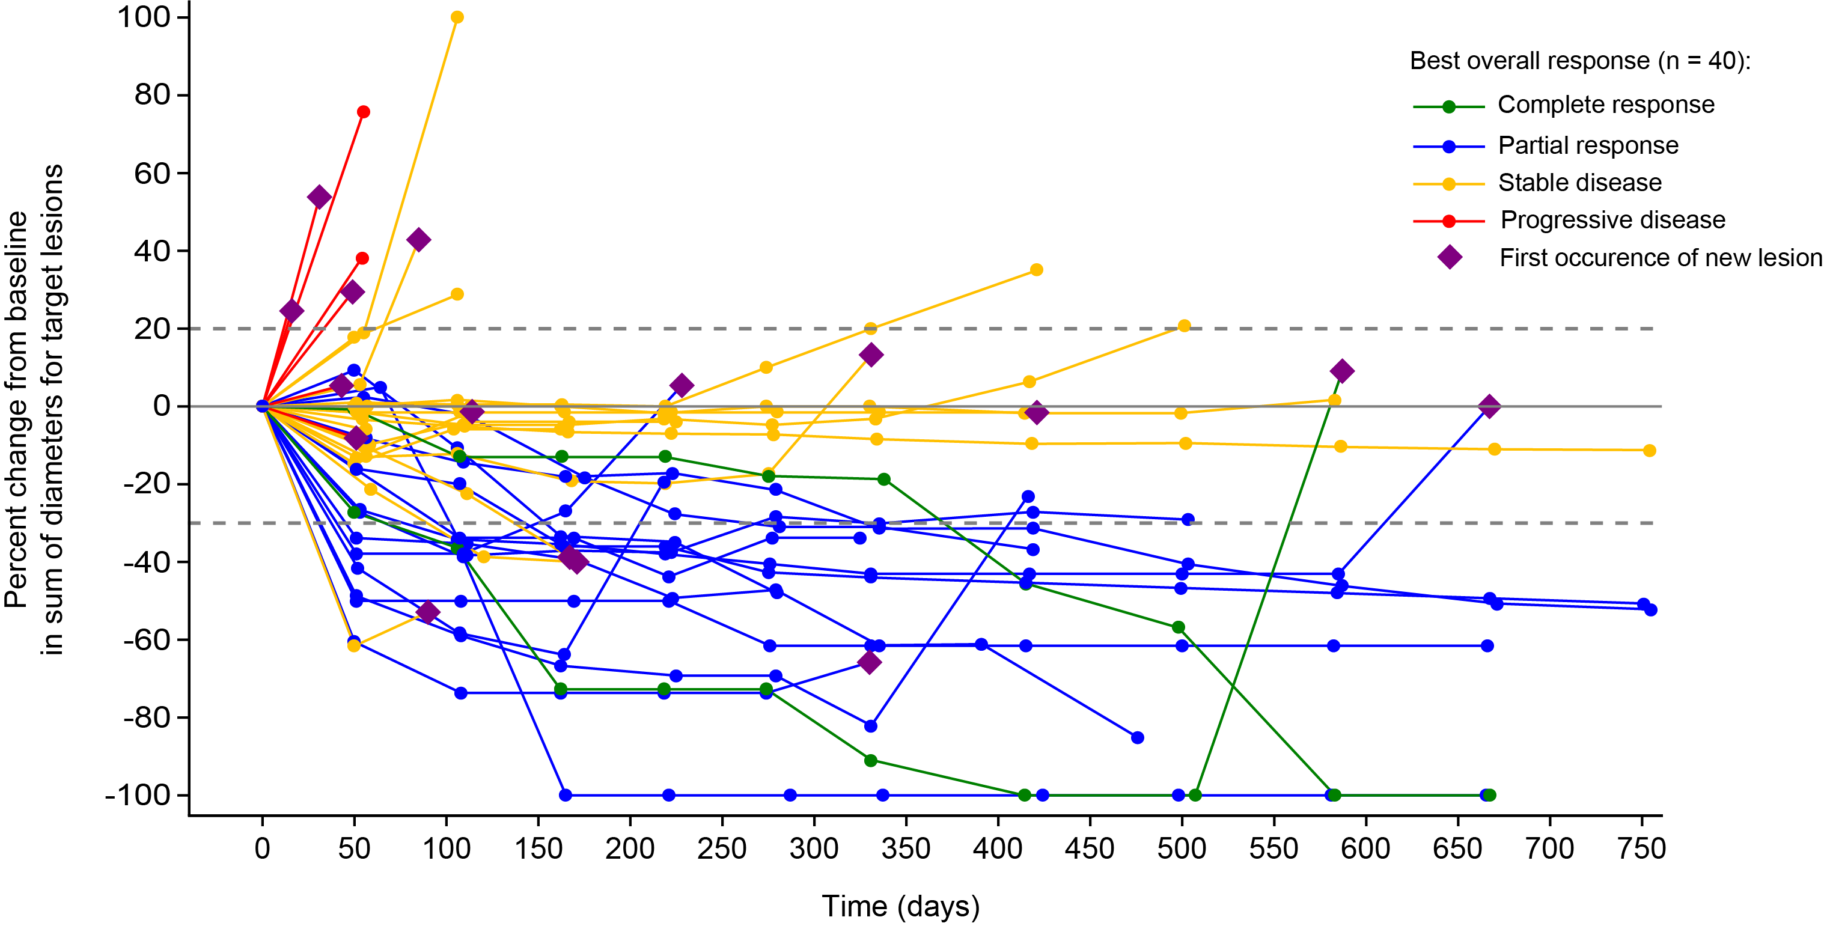
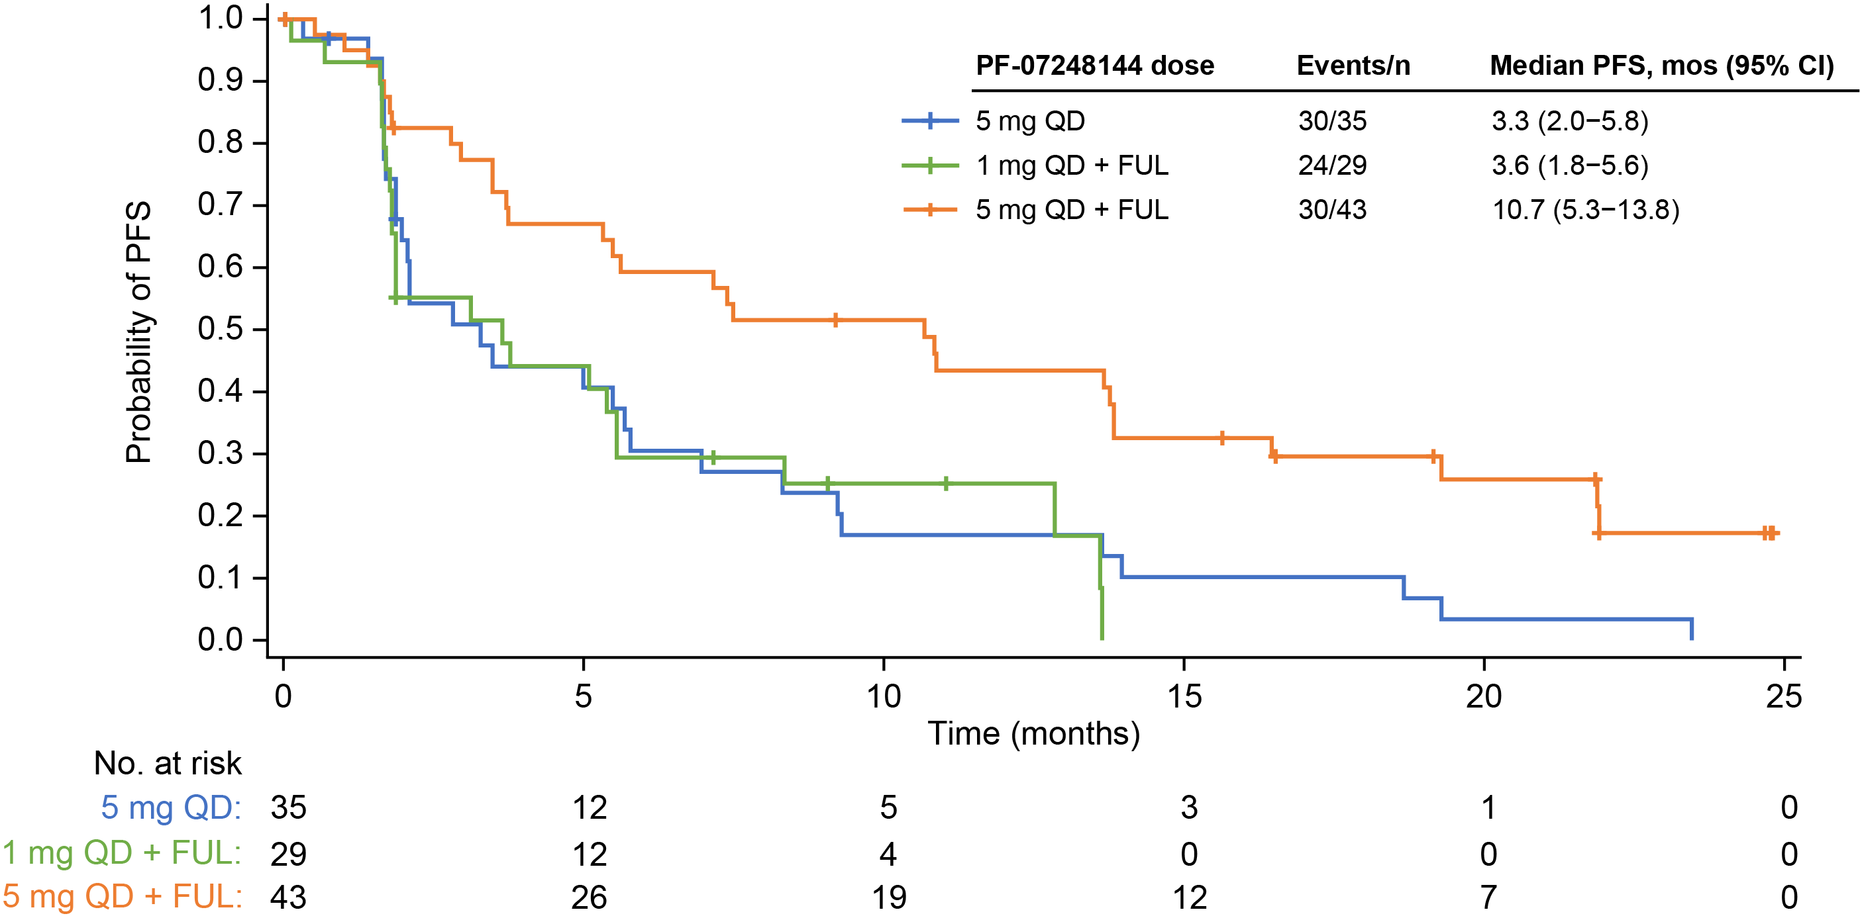
PF-07248144 5 mg QD + Fulvestrant Shows Deep and Durable Antitumor Activity
Tumor Size Change from Baseline (5 mg QD + FUL)
PFS per Investigator Assessment
Tumor Response | PF-07248144 5 mg QD (n = 35) | PF-07248144 1 mg QD + FUL 500 mg (n = 29) | PF-07248144 5 mg QD + FUL 500 mg (n = 43)
Median follow-up (95% CI), months | NE (NE–NE) | 11.0 (9.1–NE) | 21.9 (16.5–24.8)
ORR, % (95% CI) | 11.4 (3.2–26.7) | 24.1 (10.3–43.5) | 37.2 (23.0–53.3)
Median DOR (95% CI), months | 12.0 (7.4–NE) | 4.6 (3.4–NE) | 15.8 (9.2–NE)
CBR, % (95% CI) | 31.4 (16.9–49.3) | 37.9 (20.7–57.7) | 55.8 (39.9−70.9)
Median PFS (95% CI), months | 3.3 (2.0–5.8) | 3.6 (1.8–5.6) | 10.7 (5.3–13.8)
CBR, clinical benefit rate; DOR, duration of response; FUL, fulvestrant; NE, not estimable; ORR, objective response rate; PFS, progression-free survival; QD, once daily.
Patricia M. LoRusso, DO

Slide 10
Conclusions
To inform the RP3D of PF-07248144 (KAT6 inhibitor), we performed a thorough benefit–risk assessment of two pharmacokinetically distinguishable doses with sufficient number of patients and follow-up (5 mg QD, n = 78; 1 mg QD, n = 29)
5 mg QD PF-07248144 was identified as the RP3D in combination with fulvestrant based on PK exposure, maximal blood & tumor PD inhibition, tolerable safety, and encouraging antitumor activity (n = 43)
  ORR: 37.2% (95% CI, 23.0–53.3), with a median DOR of 15.8 months (95% CI, 9.2–NE)
  Median PFS: 10.7 months (95% CI, 5.3–13.8)
A pivotal phase 3 trial of PF-07248144 plus fulvestrant is planned to address the high unmet medical need in HR+/HER2− mBC after progression on a CDK4/6 inhibitor plus ET
CDK4/6, cyclin-dependent kinase 4/6; DOR, duration of response; ET, endocrine therapy; HER2, human epidermal growth factor receptor 2; HR, hormone receptor; mBC, metastatic breast cancer; NE, not estimable; ORR, objective response rate; PD, pharmacodynamic; PFS, progression-free survival; PK, pharmacokinetic; QD, once daily; RP3D, recommended phase 3 dose.
Patricia M. LoRusso, DO

