Slide 1


Efficacy and safety of tucatinib vs placebo combined with trastuzumab and pertuzumab as maintenance therapy for HER2+ metastatic breast cancer by stratified subgroups
Erika P. Hamilton, Giuseppe Curigliano, Miguel Martin, Florence Lerebours, Junji Tsurutani,
Marie-France Savard, Xichun Hu, Luciana Carla Martins de Aquino Pimentel, Ciara C. O'Sullivan,
Eriko Tokunaga, Alicia Okines, Chiun-Sheng Huang, William Jacot, Joohyuk Sohn, Volkmar Mueller,
Helene Viala, Sherry Tan, Wentao Feng, Qi Shen, Veronique Dieras
Slide
deck
Plain language summary
Copies of the slide deck and plain language summary obtained through Quick Response (QR) code are for personal use only and may not be reproduced without permission from ASCO® or the authors.
Erika Hamilton, MD, Medical Oncology, Sarah Cannon Research Institute, Nashville, TN, USA
Notes:
Temporary Abstract Submission ID: 530076
Abstract Number for Publication: 1005
Abstract Title: Efficacy and safety of tucatinib (TUC) vs placebo (PBO) combined with trastuzumab and pertuzumab (HP) as maintenance therapy for HER2+ metastatic breast cancer by stratified subgroups.
Session Type/Title: Oral Abstract Session - Breast Cancer—Metastatic
Session: June 2, 2026, 9:45−12:45 PM CDT
Time: 11:09 AM−11:21 AM CDT
Location: Hall D1
Presentation Time: You will have 12 minutes to present your abstract. This does not include Q&A, which will be done at the end of each abstract grouping.

Slide 2
Key takeaways
In this analysis of the HER2CLIMB-05 study, we examined additional efficacy outcomes, including PFS, cORR, and DOR, as well as safety outcomes by stratified subgroups.
Tucatinib (TUC) + 1L maintenance therapy with trastuzumab (H) and pertuzumab (P) demonstrated clinically meaningful efficacy vs placebo + HP in patients with HR+ or HR− disease, ± baseline BM, and de novo or recurrent disease, with a similar safety profile seen across subgroups.
Results were consistent with the overall population and support TUC + HP as a potential new maintenance therapy across patients with HER2+ MBC.
1L = first-line; BM = brain metastases; cORR, confirmed objective response rate; DOR, duration of response; HER2+ = human epidermal growth factor receptor 2-positive;
HR = hormone receptor; MBC = metastatic breast cancer; PFS, progression-free survival.
Erika Hamilton, MD

Slide 3
Background
The standard 1L treatment of HER2+ MBC has been induction chemotherapy with a taxane in combination with dual anti-HER2 mAbs, trastuzumab (H) and pertuzumab (P), followed by maintenance therapy with HP.¹
  Unfortunately, most patients treated with this regimen experience disease progression in < 2 years.^{2,3}
Optimizing 1L maintenance therapy by targeting HER2 both extracellularly, with dual blockade mAbs, and intracellularly, with TUC may further improve patient outcomes.⁴
1L = first-line; CI = confidence interval; HER2+ = human epidermal growth factor receptor 2-positive; HR = hazard ratio; mAb = monoclonal antibody; MBC = metastatic breast cancer;
mos, months; NR, not reached; PBO = placebo; PFS = progression-free survival; TUC = tucatinib.
Gion M, et al. Am Soc Clin Oncol Educ Book. 2022;42:1-11. 2. Baselga J, et al. N Engl J Med. 2012;366:109-119. 3. Swain SM, et al. N Engl J Med. 2015;372:724-734. 4. Pernas S and
Tolaney SM. Ther Adv Med Oncol. 2019;11:1758835919833519.
3
Erika Hamilton, MD

Slide 4
HER2CLIMB-05 design
HER2CLIMB-05 is a randomized, double-blind, placebo-controlled, international, phase 3 trial (NCT05132582)
Key Eligibility Criteria
1L Maintenance Therapy
Endpoints
Centrally confirmed HER2+ MBC
No evidence of progression after THP (4 to 8 cycles)
ECOG PS of 0 or 1
No or asymptomatic BM confirmed by contrast-enhanced MRI at screening
TUC 300 mg PO BID
+ HP*
Once every 21 days
(n = 326)
Primary
Investigator-assessed PFS per RECIST v1.1
Secondary
OS (key secondary)
PFS per BICR
CNS-PFS
Safety, HRQoL, pharmacokinetics
R
1:1
PBO PO BID
+ HP*
Once every 21 days
(n = 328)
Randomization was stratified by:
HR status: positive or negative
Presence or history of BM: yes or no
Diagnosis: de novo or recurrent
Study treatment continues until unacceptable toxicity, disease progression, or consent withdrawal. No crossover from PBO to TUC was allowed.
Additional measured outcomes
cORR
DOR
*H (6 mg/kg IV or 600 mg SC) and P (420 mg IV) or fixed-dose combination (SC) of H (600 mg), P (600 mg), and hyaluronidase (20,000 units). Concomitant ET was permitted during the study.
1L = first-line; BICR = blinded independent central review; BM = brain metastases; CNS = central nervous system; cORR = confirmed objective response rate; DOR = duration of response; ECOG PS = Eastern Cooperative Oncology Group performance status; ET = endocrine therapy; H = trastuzumab; HER2+ = human epidermal growth factor receptor 2-positive; HRQoL = health-related quality of life; IV = intravenous;
MBC, metastatic breast cancer; MRI = magnetic resonance imaging; OS = overall survival; P = pertuzumab; PBO = placebo; PFS = progression-free survival; PO BID = orally twice a day; R = randomization;
RECIST = Response Evaluation Criteria in Solid Tumors; SC = subcutaneous; T = taxane; TUC = tucatinib.
4
Erika Hamilton, MD

Slide 5
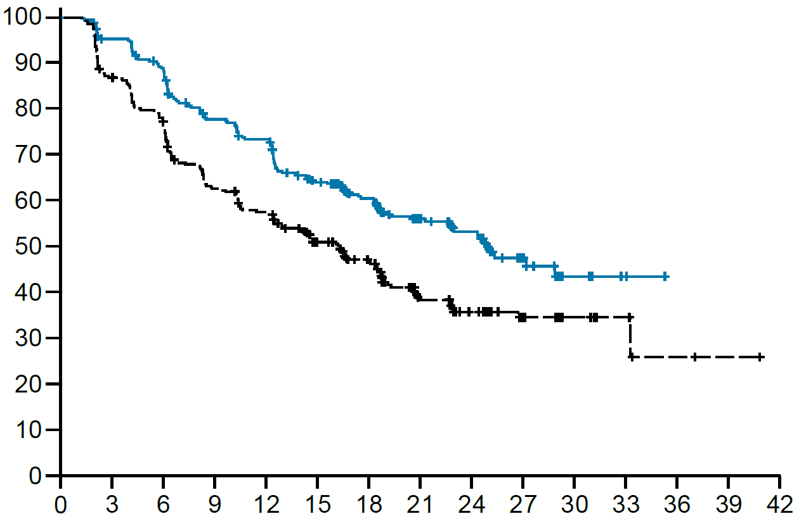
Investigator-assessed PFS in the overall population
 | TUC + HP (n = 326) | PBO + HP (n = 328)
Events | 141 | 191
Median PFS, mos (95% CI) | 24.9 (21.3−NE) | 16.3 (12.6−18.7)
HR (95% CI) P−value* | 0.641 (0.514−0.799); < 0.0001
 | Δ of 8.6 months
 | n = 296 | n = 297
cORR,† % (95% CI) | 22.6 (18.0−27.8) | 15.2 (11.3−19.7)
 | n = 67 | n = 45
Median DOR,† mos (95% CI) | 20.9 (16.4−NE) | 16.9 (12.3−NE)
PFS probability, %
No. at risk
Time, mos
TUC arm
326 296 274 236 222 178 143 95 67 31 10 3 0 0 0
PBO arm
328 283 249 200 182 142 109 65 46 24 9 6 2 1 0
In the primary HER2CLIMB-05 analysis with a median follow-up of ~23 months,
addition of TUC to 1L maintenance HP vs control treatment extended PFS by nearly 9 months.¹
Data cutoff of date: September 5, 2025. *Two-sided P-value based on stratified log-rank test.
*Two-sided nominal P-value based on stratified log-rank test. †cORR and DOR were assessed in patients with target or non-target lesions at baseline. CI = confidence interval; cORR, confirmed objective response rate;
DOR, duration of response; H = trastuzumab; HR = hazard ratio; P = pertuzumab; NE, not estimable; PBO = placebo; PFS = progression-free survival; TUC = tucatinib.
1. Dieras, V, et al. J Clin Oncol. Dec 2025. doi: 10.1200/JCO-25-02600.
Erika Hamilton, MD

Slide 6
Patient characteristics
Subgroup | HR– (n = 310, 47.4%) |  | HR+ (n = 344, 52.6%) |  | With BM (n = 81, 12.4%) |  | Without BM (n = 573, 87.6%) |  | De novo (n = 453, 69.3%) |  | Recurrent (n = 201, 30.7%)
Characteristics | TUC n = 158 | PBO n = 152 | TUC n = 168 | PBO n = 176 | TUC n = 41 | PBO n = 40 | TUC n = 285 | PBO n = 288 | TUC n = 227 | PBO n = 226 | TUC n = 99 | PBO n = 102
Age, years, median (range) | 54.0 (29−82) | 54.0 (29−80) | 53.0 (24−79) | 53.0 (29−83) | 54.0 (42−73) | 51.5 (33−71) | 54.0 (24−82) | 54.0 (29−83) | 52.0 (24−82) | 54.0 (29−80) | 56.0 (34−81) | 54.0 (35−83)
Race, %
White | 43.0 | 40.1 | 47.0 | 48.9 | 51.2 | 50.0 | 44.2 | 44.1 | 44.5 | 46.0 | 46.5 | 42.2
Asian | 41.8 | 39.5 | 31.5 | 29.0 | 39.0 | 25.0 | 36.1 | 35.1 | 36.1 | 33.6 | 37.4 | 34.3
Black | 2.5 | 3.3 | 3.6 | 2.3 | 2.4 | 2.5 | 3.2 | 2.8 | 3.5 | 2.7 | 2.0 | 2.9
ECOG PS = 0, % | 69.0 | 57.9 | 63.1 | 65.9 | 53.7 | 62.5 | 67.7 | 62.2 | 68.3 | 64.6 | 60.6 | 56.9
HR status, %
Positive | 0 | 0 | 100 | 100 | 53.7 | 57.5 | 51.2 | 53.1 | 49.3 | 51.8 | 56.6 | 57.8
Negative | 100 | 100 | 0 | 0 | 46.3 | 42.5 | 48.8 | 46.9 | 50.7 | 48.2 | 43.4 | 42.2
Presence or history of BM, % | 12.0 | 11.2 | 13.1 | 13.1 | 100 | 100 | 0 | 0 | 9.7 | 10.2 | 19.2 | 16.7
De novo disease, % | 72.8 | 71.7 | 66.7 | 66.5 | 53.7 | 57.5 | 71.9 | 70.5 | 100 | 100 | 0 | 0
Recurrent disease, % | 27.2 | 28.3 | 33.3 | 33.5 | 46.3 | 42.5 | 28.1 | 29.5 | 0 | 0 | 100 | 100
Visceral disease, % | 63.9 | 52.0 | 55.4 | 52.8 | 53.7 | 42.5 | 60.4 | 53.8 | 63.0 | 56.2 | 51.5 | 44.1
BM = brain metastases; ECOG PS = Eastern Cooperative Oncology Group performance status; HR = hormone receptor; PBO = placebo; TUC = tucatinib.
6
Erika Hamilton, MD

Slide 7
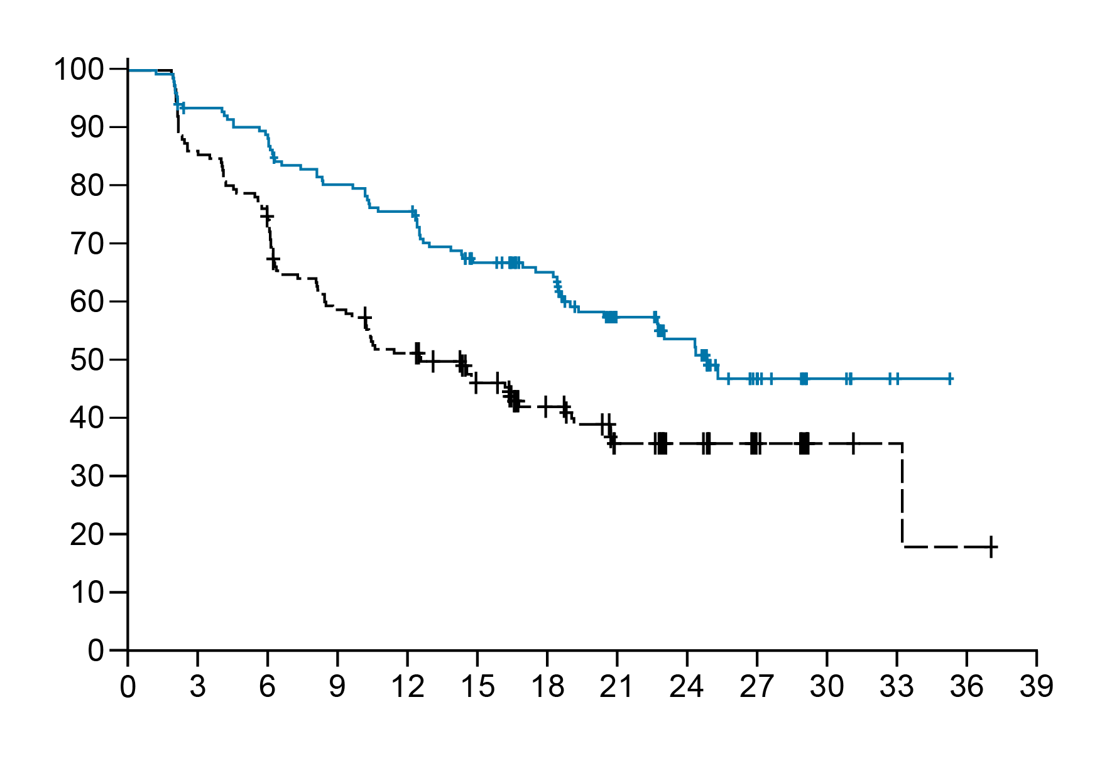
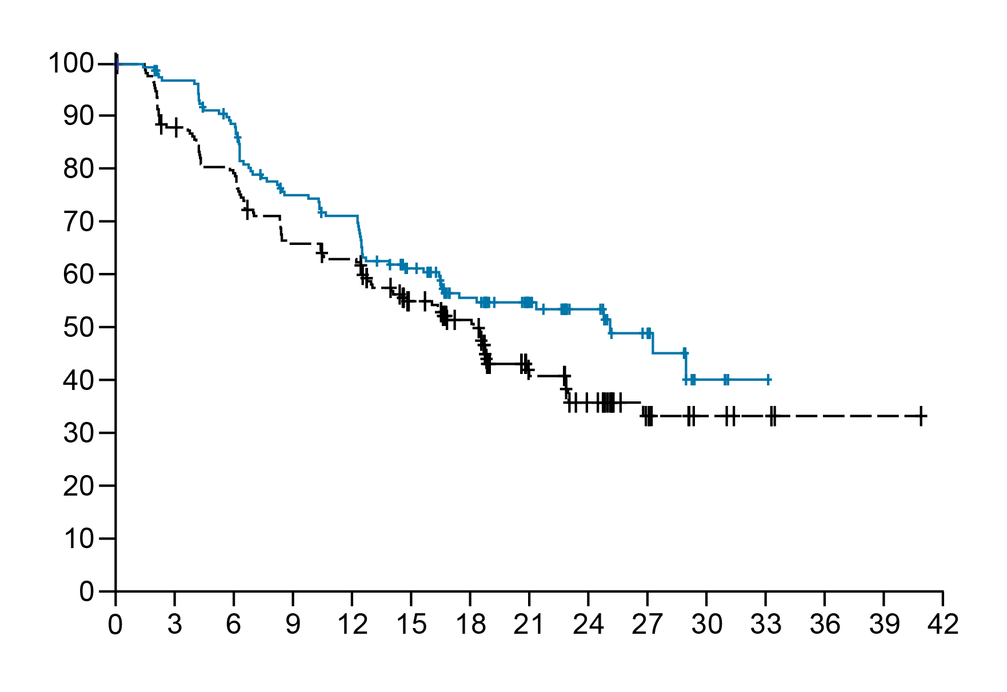
Efficacy by hormone receptor status
Hormone receptor –
(47.4%)
 | TUC + HP (n = 158) | PBO + HP (n = 152)
Events | 68 | 92
Median PFS, mos (95% CI) | 24.9 (19.4−NE) | 12.6 (9.4−16.8)
HR (95% CI) P−value* | 0.554 (0.403−0.761); 0.0002
 | Δ of 12.3 months
 | n = 147 | n = 134
cORR,† % (95% CI) | 25.2 (18.4−33.0) | 17.9 (11.8−25.5)
 | n = 37 | n = 24
Median DOR,† mos (95% CI) | NR (8.6−NE) | 14.5 (10.4−NE)
Hormone receptor +
(52.6%)
 | TUC + HP (n = 168) | PBO + HP (n = 176)
Events | 73 | 99
Median PFS, mos (95% CI) | 25.0 (16.5−NE) | 18.1 (13.0−20.8)
HR (95% CI); P−value* | 0.725 (0.535−0.983); 0.0389
 | Δ of 6.9 months
 | n = 149 | n = 163
cORR,† % (95% CI) | 20.1 (14.0−27.5) | 12.9 (8.2−19.0)
 | n = 30 | n = 21
Median DOR,† mos (95% CI) | 20.9 (12.6−NE) | 18.7 (7.8−NE)
PFS probability, %
PFS probability, %
No. at risk
Time, mos
No. at risk
Time, mos
TUC arm
158 142 135 121 114 94 79 52 38 16 6 2 0 0
TUC arm
168 154 139 115 108 84 64 43 29 15 4 1 0 0 0
PBO arm
152 130 112 87 75 61 43 30 21 12 3 2 1 0
PBO arm
176 153 137 113 107 81 66 35 25 12 6 4 1 1 0
*Two-sided nominal P-value based on stratified log-rank test. †cORR and DOR were assessed in patients with target or non-target lesions at baseline. CI = confidence interval; cORR = confirmed objective response rate;
DOR = duration of response; H = trastuzumab; HR = hazard ratio; mos = months; NE, not estimable; NR, not reached; P = pertuzumab; PBO = placebo; PFS = progression-free survival; TUC = tucatinib.
Erika Hamilton, MD

Slide 8
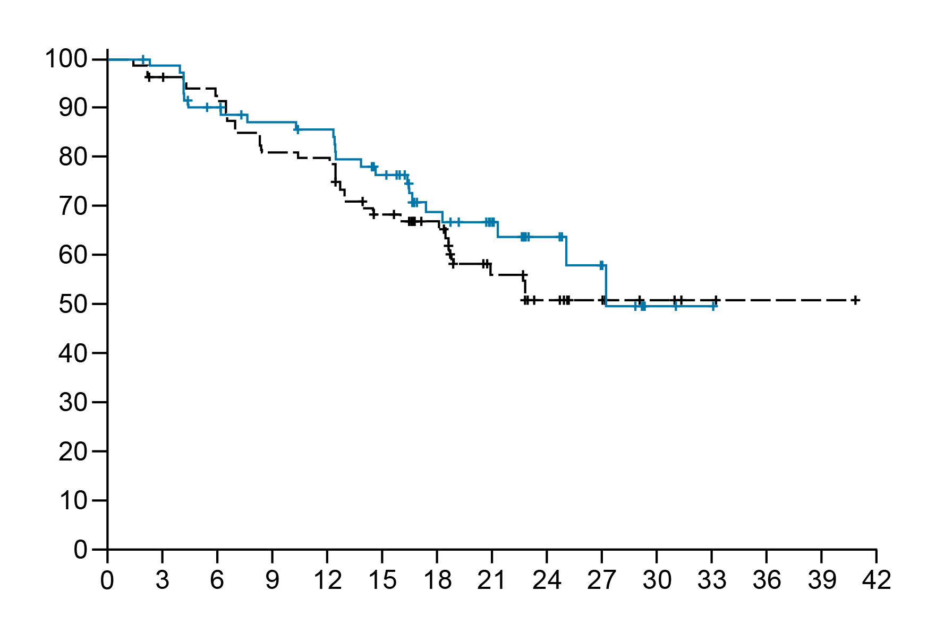
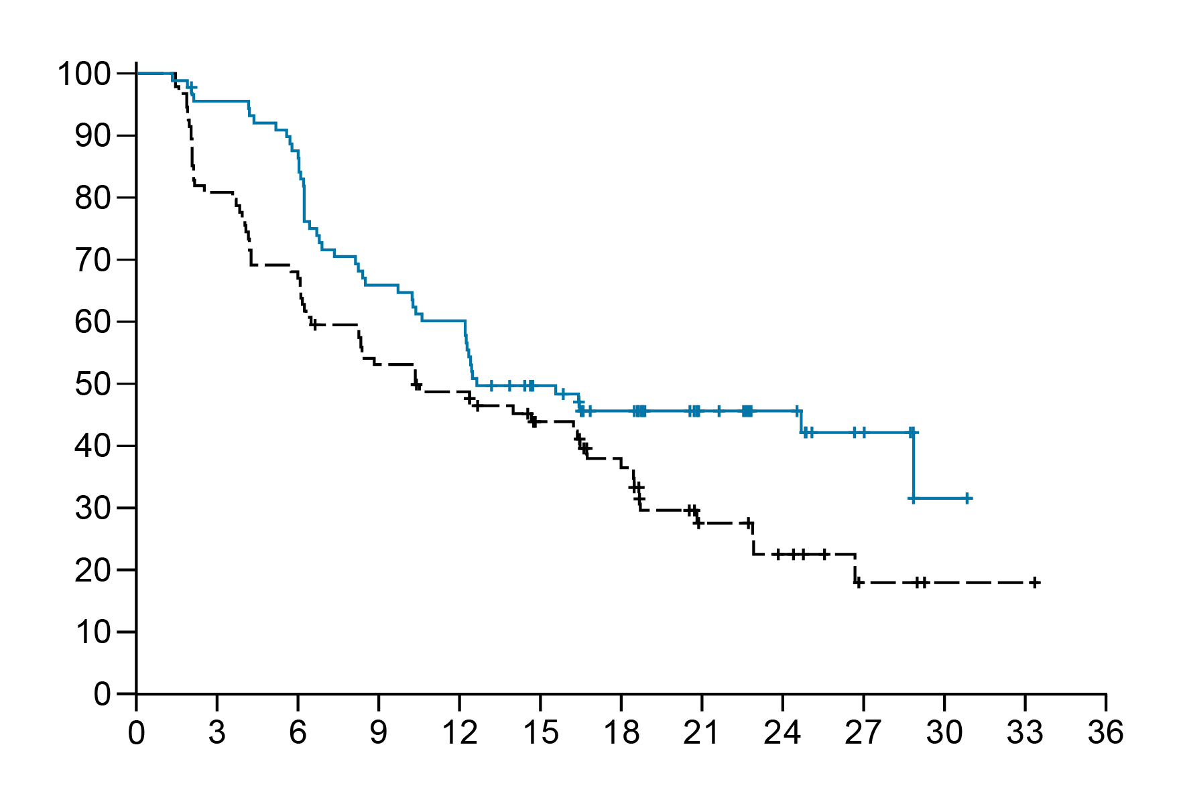
Efficacy in hormone receptor-positive by ET use
Hormone receptor +
and ET use (45.1%)
 | TUC + HP (n = 74) | PBO + HP (n = 81)
Events | 24 | 34
Median PFS, mos (95% CI) | 27.2 (21.3−NE) | NR (18.6−NE)
HR (95% CI); P−value* | 0.724 (0.420−1.245); 0.2449
 | n = 61 | n = 72
cORR,† % (95% CI) | 26.2 (15.8−39.1) | 15.3 (7.9−25.7)
 | n = 16 | n = 11
Median DOR,† mos (95% CI) | NR (12.6−NE) | NR (4.2−NE)
Hormone receptor +
and no ET use (54.9%)
 | TUC + HP (n = 94) | PBO + HP (n = 95)
Events | 49 | 65
Median PFS, mos (95% CI) | 12.6 (10.6−NE) | 10.4 (6.5−16.5)
HR (95% CI): P−value* | 0.658 (0.450−0.962); 0.0300
 | Δ of 2.2 months
 | n = 88 | n = 91
cORR,† % (95% CI) | 15.9 (9.0−25.2) | 11.0 (5.4−19.3)
 | n = 14 | n = 10
Median DOR,† mos (95% CI) | 16.4 (8.3−NE) | 10.4 (6.2−NE)
PFS probability, %
PFS probability, %
No. at risk
Time, mos
No. at risk
Time, mos
TUC arm
74 70 62 58 56 46 34 23 15 8 2 1 0 0 0
TUC arm
94 84 77 57 52 38 30 20 14 7 2 0 0
PBO arm
81 77 73 64 63 50 42 23 17 9 5 3 1 1 0
PBO arm
95 76 64 49 44 31 24 12 8 3 1 1 0
*Two-sided nominal P-value based on stratified log-rank test. †cORR and DOR were assessed in patients with target or non-target lesions at baseline. CI = confidence interval; cORR = confirmed objective response rate;
DOR = duration of response; ET = endocrine therapy; H = trastuzumab; HR = hazard ratio; mos = months; NE, not estimable; NR, not reached; P = pertuzumab; PBO = placebo; PFS = progression-free survival; TUC = tucatinib.
Erika Hamilton, MD

Slide 9
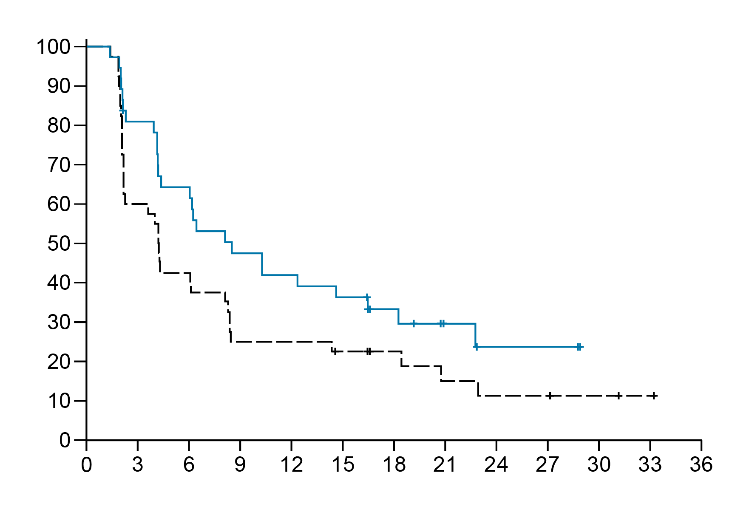
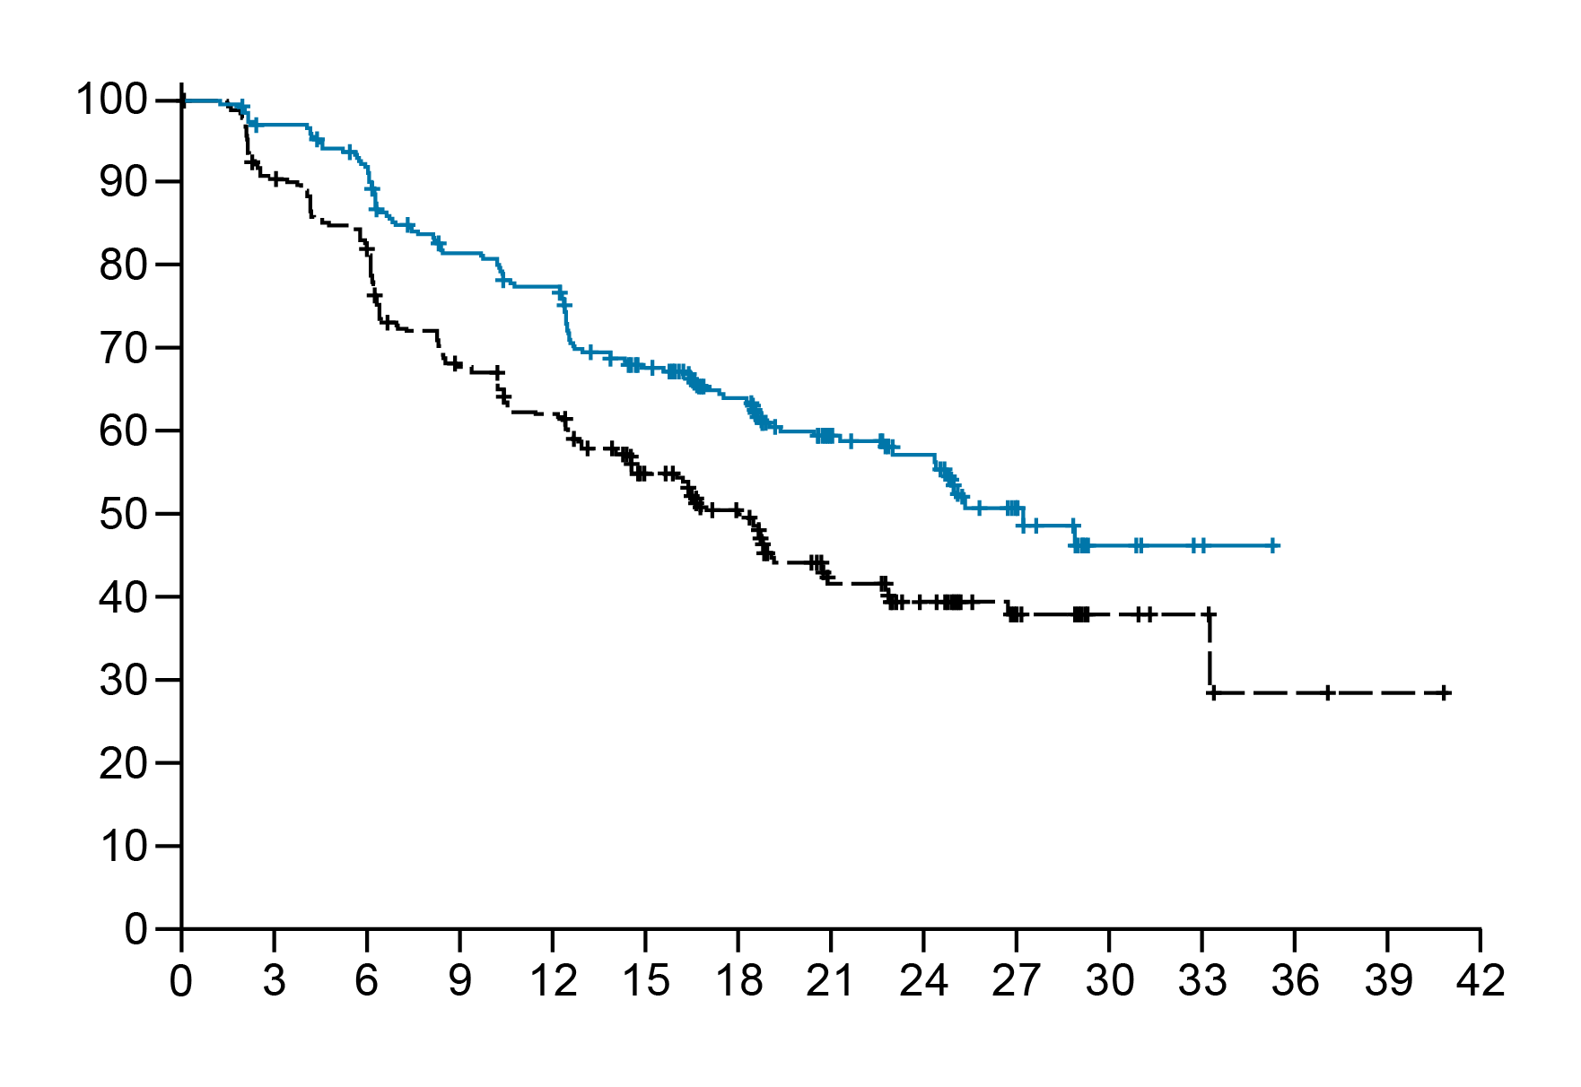
Efficacy by presence/history of brain metastases at baseline
With baseline BM
(12.4%)
 | TUC + HP (n = 41) | PBO + HP (n = 40)
Events | 26 | 34
Median PFS, mos (95% CI) | 8.5 (4.2−16.5) | 4.2 (2.2−8.1)
HR (95% CI); P−value* | 0.640 (0.373−1.097); 0.1058
 | Δ of 4.3 months
 | n = 40 | n = 36
cORR,† % (95% CI) | 15.0 (5.7−29.8) | 8.3 (1.8−22.5)
 | n = 6 | n = 3
Median DOR,† mos (95% CI) | 12.6 (8.1−NE) | 16.3 (12.5−NE)
Without baseline BM
(87.6%)
 | TUC + HP (n = 285) | PBO + HP (n = 288)
Events | 115 | 157
Median PFS, mos (95% CI) | 27.2 (24.3−NE) | 18.1 (14.8−20.7)
HR (95% CI); P−value* | 0.640 (0.503−0.816); 0.0003
 | Δ of 9.1 months
 | n = 256 | n = 261
cORR,† % (95% CI) | 23.8 (18.7−29.5 | 16.1 (11.9−21.1)
 | n = 61 | n = 42
Median DOR,† mos (95% CI) | 20.9 (16.4−NE) | 18.7 (10.4−NE)
PFS probability, %
PFS probability, %
No. at risk
Time, mos
No. at risk
Time, mos
TUC arm
41 29 23 17 15 13 9 5 2 2 0 0 0
TUC arm
285 267 251 219 207 165 134 90 65 29 10 3 0 0 0
PBO arm
40 24 17 10 10 8 6 4 3 3 2 1 0
PBO arm
288 259 232 190 172 134 103 61 43 21 7 5 2 1 0
*Two-sided nominal P-value based on stratified log-rank test. †cORR and DOR were assessed in patients with target or non-target lesions at baseline. BM = brain metastases; CI = confidence interval; cORR = confirmed objective response rate; DOR = duration of response; H = trastuzumab; HR = hazard ratio; mos = months; NE, not estimable; P = pertuzumab; PBO = placebo; PFS = progression-free survival; TUC = tucatinib.
Erika Hamilton, MD

Slide 10
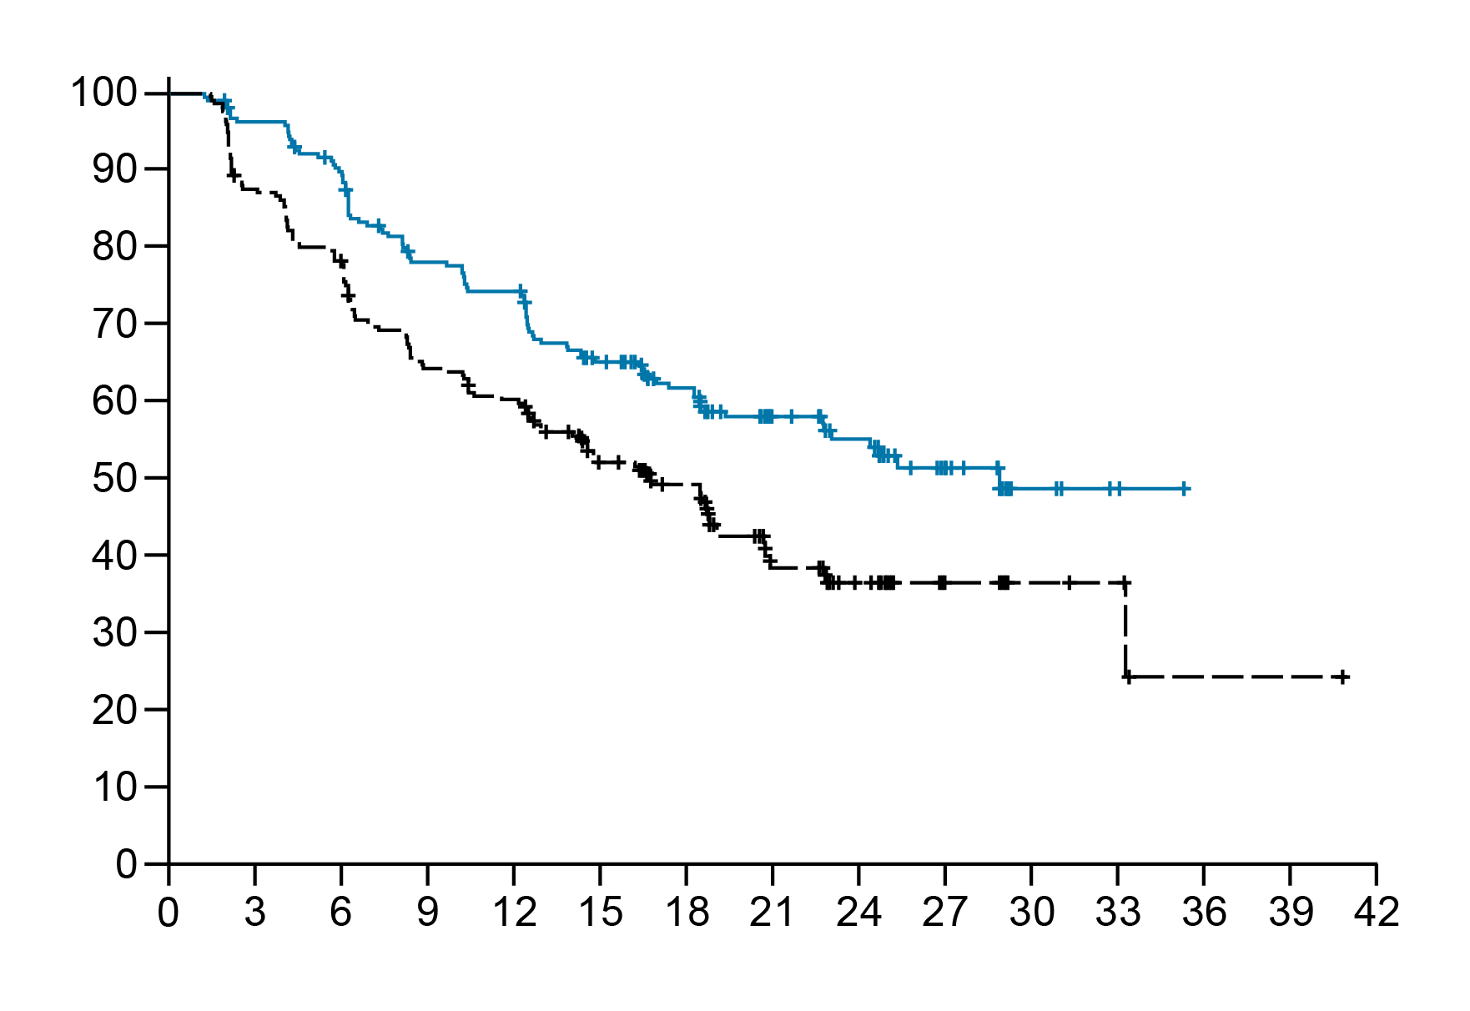
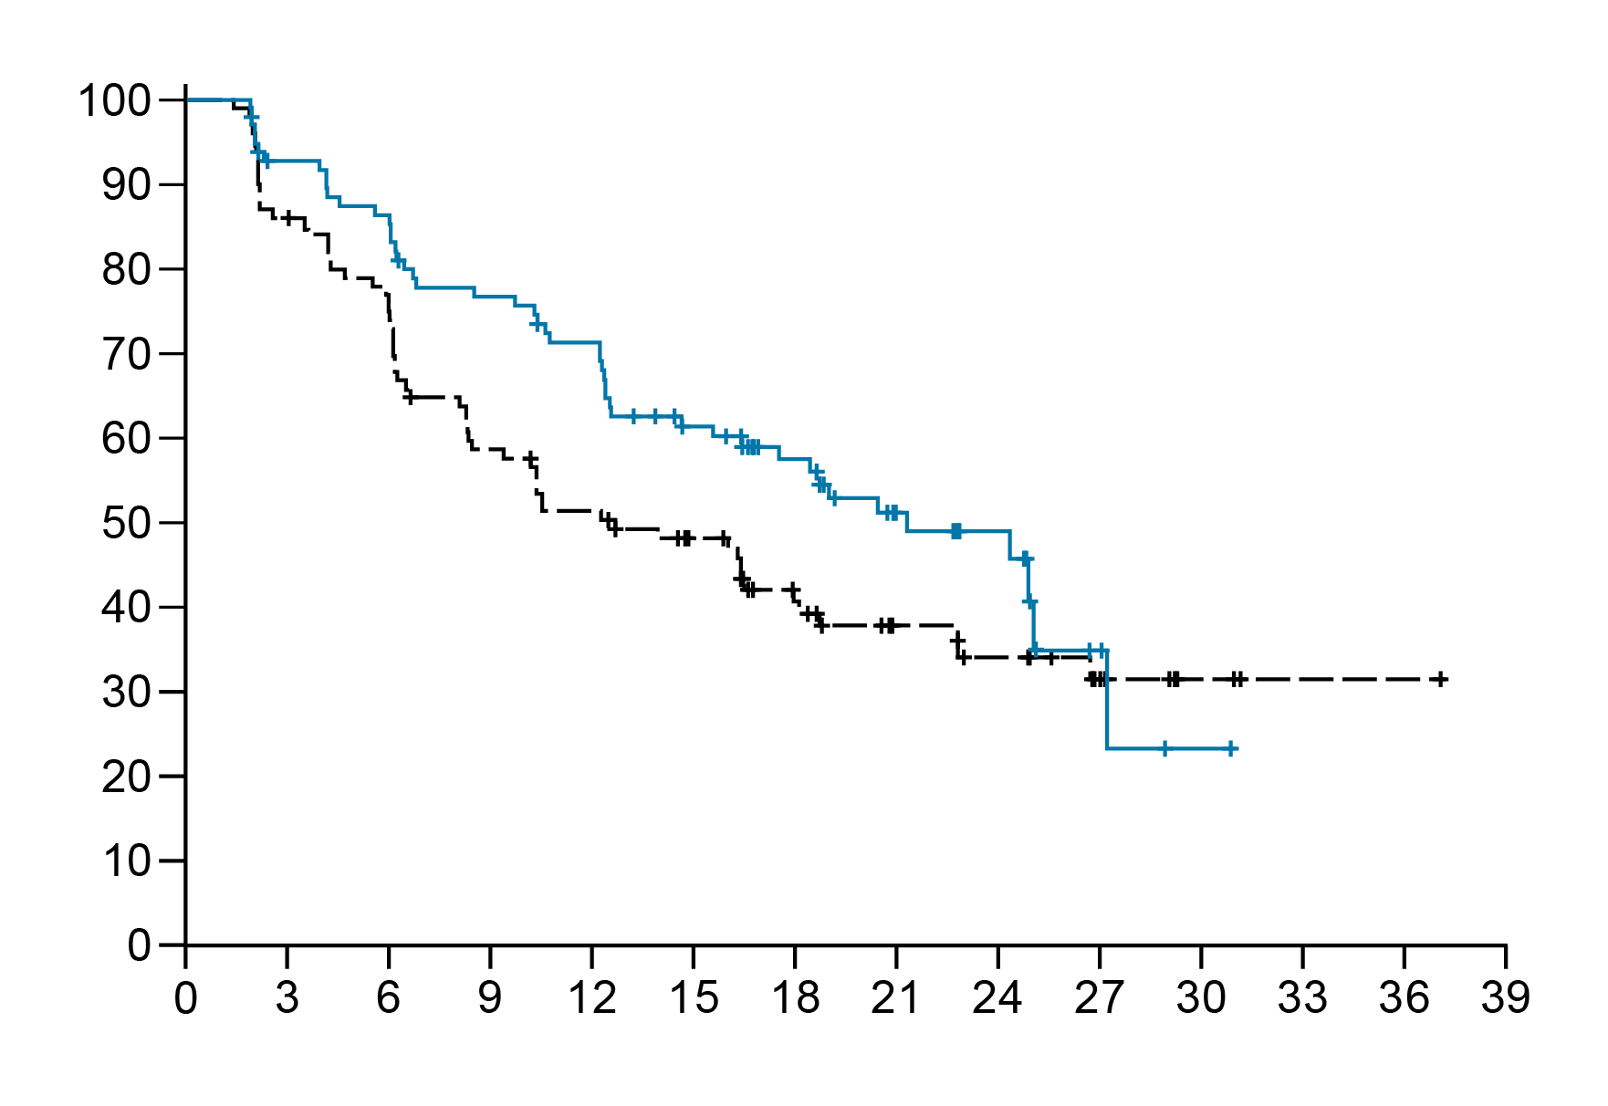
Efficacy by diagnosis of de novo or recurrent disease
De novo
(69.3%)
 | TUC + HP (n = 227) | PBO + HP (n = 226)
Events | 93 | 129
Median PFS, mos (95% CI) | 28.9 (22.7−NE) | 16.8 (12.9−19.2)
HR (95% CI); P−value* | 0.621 (0.475−0.813); 0.0005
 | Δ of 12.1 months
 | n = 203 | n = 211
cORR,† % (95% CI) | 26.1 (20.2−32.7) | 18.5 (13.5−24.4)
 | n = 53 | n = 39
Median DOR,† mos (95% CI) | NR (16.4−NE) | 16.3 (10.4−NE)
Recurrent
(30.7%)
 | TUC + HP (n = 99) | PBO + HP (n = 102)
Events | 48 | 62
Median PFS, mos (95% CI) | 21.3 (15.6−27.2) | 12.7 (8.3−18.1)
HR (95% CI); P−value* | 0.671 (0.457−0.986); 0.0410
 | Δ of 8.6 months
 | n = 93 | n = 86
cORR,† % (95% CI) | 15.1 (8.5−24.0) | 7.0 (2.6−14.6)
 | n = 14 | n = 6
Median DOR,† mos (95% CI) | 17.9 (8.3−NE) | NR (7.2−NE)
PFS probability, %
PFS probability, %
No. at risk
Time, mos
No. at risk
Time, mos
TUC arm
227 209 193 165 157 126 104 70 52 27 9 3 0 0 0
TUC arm
99 87 81 71 65 52 39 25 15 4 1 0 0 0
PBO arm
226 197 175 143 133 101 79 44 29 14 6 5 1 1 0
PBO arm
102 86 74 57 49 41 30 21 17 10 3 1 1 0
*Two-sided nominal P-value based on stratified log-rank test. †cORR and DOR were assessed in patients with target or non-target lesions at baseline. CI = confidence interval; cORR = confirmed objective response rate;
DOR = duration of response; H = trastuzumab; HR = hazard ratio; mos = months; NE, not estimable; NR, not reached; P = pertuzumab; PBO = placebo; PFS = progression-free survival; TUC = tucatinib.
Erika Hamilton, MD

Slide 11
Safety profile across subgroups
Any TEAE
TUC
PBO
Patients, %
Grade ≥3 TEAE
Patients, %
BM = brain metastases; ET = endocrine therapy; HR = hormone receptor; PBO = placebo; TEAE = treatment-emergent adverse event; TUC = tucatinib.
Erika Hamilton, MD

Slide 12
Safety profile across subgroups
Serious TEAE
TUC
PBO
Patients, %
Discontinuation of TUC/PBO due to TEAE
Patients, %
BM = brain metastases; ET = endocrine therapy; HR = hormone receptor; PBO = placebo; TEAE = treatment-emergent adverse event; TUC = tucatinib.
Erika Hamilton, MD

Slide 13
Conclusions
In the phase 3 HER2CLIMB-05 trial, TUC + HP demonstrated clinically meaningful efficacy vs PBO + HP in patients with HR+ or HR− disease, with or without baseline BM, and de novo or recurrent disease, with a similar safety profile seen across subgroups.
Results were consistent with the overall population and support TUC + HP as a potential new maintenance therapy across patients with HER2+ MBC.
BM = brain metastases; H = trastuzumab; HER2+ = human epidermal growth factor receptor 2-positive; MBC = metastatic breast cancer; P = pertuzumab; PBO = placebo; TUC = tucatinib.
Erika Hamilton, MD

Slide 14


HER2CLIMB-05 publication
Veronique Dieras, Giuseppe Curigliano, Miguel Martin, Florence Lerebours, Junji Tsurutani, Marie-France Savard, Katarzyna J. Jerzak, Xichun Hu, Luciana Carla Martins de Aquino Pimentel, Ciara C. O'Sullivan, Eriko Tokunaga, Alicia Okines, Chiun-Sheng Huang, William Jacot, Joohyuk Sohn, Eduardo Cronemberger Silva, Volkmar Mueller, Shan Yang, Giovanna Granata, Qi Shen, Libero Santarpia, Erika Hamilton;
on behalf of the HER2CLIMB-05 investigators
HER2CLIMB-05: A phase 3 study of tucatinib versus placebo in combination with trastuzumab and pertuzumab as first-line maintenance therapy for HER2+ metastatic breast cancer
J Clin Oncol. 2025 Dec 10:JCO2502600. doi: 10.1200/JCO-25-02600
The Journal of Clinical Oncology
Publication
Erika Hamilton, MD

Slide 15
Acknowledgments
We thank the patients and their families and caregivers, as well as the investigators and site staff who participated in this study.
Slide deck
Plain language summary
Copies of the slide deck and plain language summary obtained through Quick Response (QR) code are for personal use only and may not be reproduced without permission from ASCO® or the authors.
Enrollment at 219 sites in 23 countries
Erika Hamilton, MD

Slide 16
Lay summary
  What did this research tell us?
    In the HER2CLIMB-05 study, patients treated with tucatinib plus maintenance therapy compared with those treated with placebo plus maintenance therapy had improved tumor responses and a longer time of survival without their cancer getting worse.
    These findings were true in the overall study population and in patients with hormone receptor positive or negative disease, with or without baseline brain metastases, and those whose breast cancer was first diagnosed after it spread and in patients who had breast cancer before.
    The safety profile of tucatinib plus maintenance therapy in patients with these differing characteristics was similar to that seen in the overall study population.
  What does this mean for patients right now?
    The results of the HER2CLIMB-05 study support the addition of tucatinib to maintenance therapy as a potential new treatment across patients with HER2+ metastatic breast cancer.
Erika Hamilton, MD

