Slide 1
1024
Efficacy of elranatamab in Combination with Carfilzomib and Dexamethasone in the Phase 1b MagnetisMM-20 Trial in Relapsed or Refractory Multiple Myeloma (RRMM)
Michael H. Tomasson,¹ Eli Gabayan,² Syed Abbas Ali,³ Gabriel Afram,⁴ Sona Ghorashi,⁵ Trish Creel,⁵ Luisa Paccagnella,⁶ Carolyn Lou,⁵ Ola Landgren ⁷
¹Department of Internal Medicine, University of Iowa, Iowa City, IA, USA; ²Beverley Hills Cancer Center, Beverley Hills, CA, USA; ³Department of Oncology, The Sydney Kimmel Comprehensive Cancer Center, Johns Hopkins University School of Medicine, Baltimore, MD, USA; ⁴Pfizer Inc, Solna, Sweden; ⁵Pfizer Inc, New York, NY, USA; ⁶Pfizer Inc, Cambridge, MA, USA; ⁷Sylvester Comprehensive Cancer Center, Miami, FL, USA
Presented at the 66th ASH Annual Meeting and Exposition | December 7-10 | San Diego, California

Slide 2
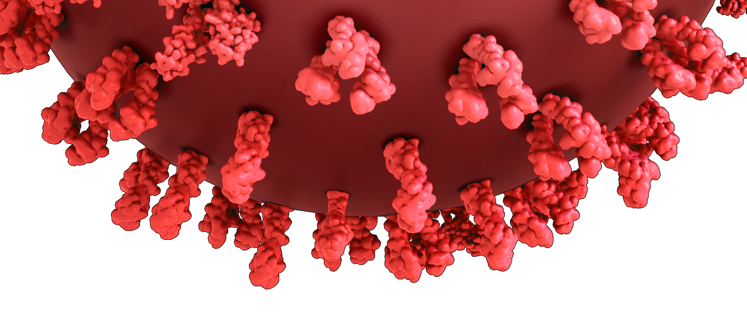
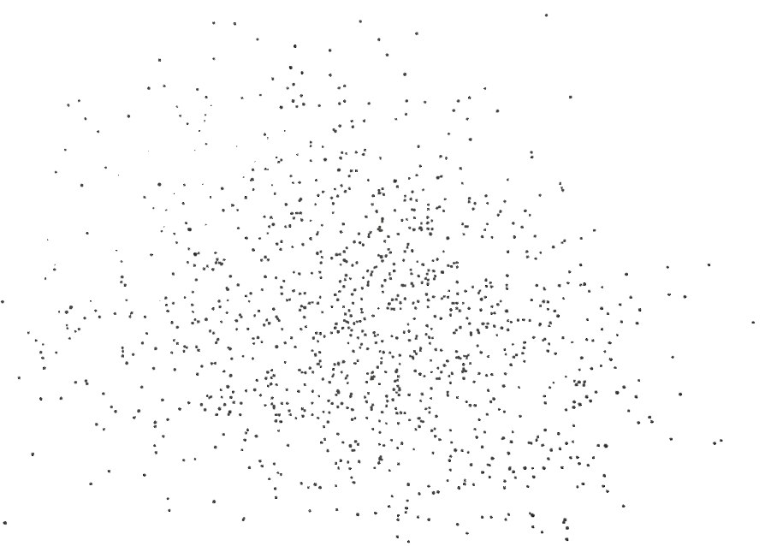
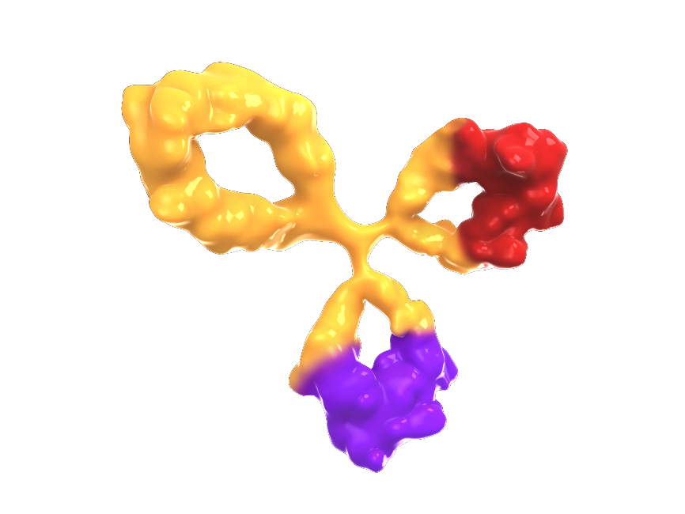


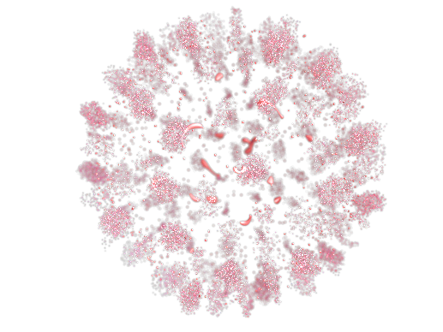
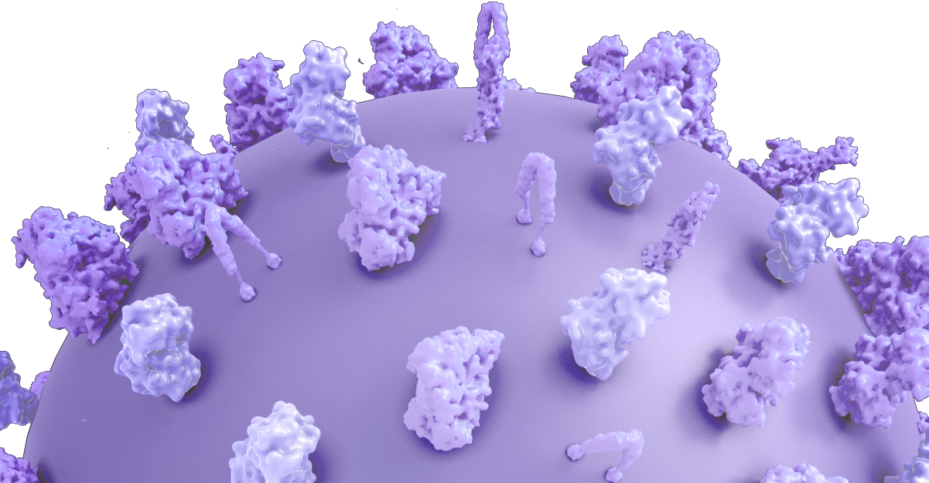
Background
Elranatamab binds BCMA on myeloma cells and CD3 on T cells
Elranatamab: BCMA-CD3 bispecific antibody¹⁻²
  Approved as a monotherapy for patients with RRMM who have received ≥1 IMiD, ≥1 PI, and ≥1 anti-CD38 mAb¹⁻²
Based on MagnetisMM-3 (NCT04649359): ORR 61.0%, mPFS 17.2 months, mOS 24.6 months^{3,4}
Carfilzomib: SOC proteasome inhibitor
  Inhibits myeloma cell proliferation and survival^{5,6}
  Induces myeloma cell apoptosis⁴
  Significant activity as monotherapy and in combination⁶
Myeloma cell
Elranatamab
(PF-06863135)
BCMA
Myeloma cell death
BCMA-binding arm
Cytokines,
perforin, granzymes
CD3-binding arm
CD3
T-cells activated by CD3 binding, release cytokines and perforin/granzymes resulting in myeloma cell lysis
T cell
  The combination is proposed to enhance the activation of immune cell mediated death, with carfilzomib inducing immunogenic cell death and elranatamab promoting
  T-cell mediated tumor lysis.
1. ELREXFIO (elranatamab-bcmm). Prescribing information. Pfizer; 2023. 2. ELREXFIO (elranatamab-bcmm). Summary of product characteristics. Pfizer; 2024. 3. Lesokhin AM, et al. Nat Med 2023;29:2259-2267.
4. Tomasson MH, et al. Hemasphere 2024;8:e136. 5. He S, et al. Trans Cancer Res 2022;11:206-216. 6. Yee AJ. Ther Adv hematol 2021;12:1-13.
BCMA=B-cell maturation antigen; BICR=blinded independent central review; IMiD=immunomodulatory drug; mAb: monoclonal antibody; ORR=objective response rate; PI=proteasome inhibitor; RRMM=relapsed or refractory multiple myeloma; SOC=standard of care

Slide 3
Rationale and Objectives
Although novel treatments have improved outcomes, RRMM remains challenging to treat, with high rates of relapse. This highlights the need for new agents and combinations which may provide synergistic activity
MagnetisMM-20 was designed to
  Assess safety and tolerability of elranatamab in combination with carfilzomib and dexamethasone, and select a RP2D
  Evaluate efficacy of elranatamab in combination with carfilzomib and dexamethasone
BCMA=B-cell maturation antigen; RP2D=recommended phase 2 dose; RRMM=relapsed or refractory multiple myeloma

Slide 4
MagnetisMM-20
MagnetisMM-20 (NCT05675449) is an open-label, multicenter, non-randomized phase 1b study
Part 1 primary objective was to assess the tolerability and safety of elranatamab in combination with carfilzomib and dexamethasone to determine the RP2D of the combination
Patients with RRMM
Primary endpoint
Key inclusion criteria
1-3 prior lines of therapy
Relapsed or refractory to last line of therapyª
ECOG PS 0-1
Prior therapy with carfilzomib allowed if:
  ≥PR to most recent therapy with carfilzomib
  Did not relapse within 60 days from discontinuation of carfilzomib
  ≥6 months carfilzomib-treatment free interval
      Key exclusion criteria
    Any previous anti-BCMA directed therapy
DLTs during DLT observation period
Elranatamab step-up doses^{b}
followed by:
Elranatamab
44 mg QW +
Carfilzomib
70 mg/m² QW^{c}
+ dexamethasone
Dose Level 1
Elranatamab step-up doses^{b}
followed by:
Elranatamab
76 mg QW +
Carfilzomib
70 mg/m² QW^{c}
+ dexamethasone
Dose Level 2
Secondary endpoints
AEs and laboratory abnormalities
Best overall response^{d}
ORR^{d}
CR rate^{d}
Time to event endpoints
TTR^{d}
  DOR^{d}
  PFS^{d}
  OS
ª Relapsed MM is the recurrence of disease after a prior response, as defined by IMWG criteria for clinical relapse. Refractory was defined as disease progression while on therapy or within 60 days of last dose in any line, regardless of response; ^{b} 12 mg and 32 mg SC; ^{c} Carfilzomib dose on C1D1 is 20 mg/m² and, if tolerated, is increased to 70 mg/m²; ^{d} By investigator assessment per IMWG response criteria (Kumar S, et al. Lancet Oncol 2016;17:e328-e346)
AE=adverse event; BCMA=B-cell maturation antigen; CR=complete response; DLT=dose-limiting toxicity; DOR=duration of response; ECOG PS=Eastern Cooperative Oncology Group performance status; IMWG=International Myeloma Working Group; C=cycle; D=day; MM=multiple myeloma; ORR=objective response rate; OS=overall survival; PFS=progression-free survival; PR=partial response; QW=weekly; RP2D=recommended phase 2 dose; RRMM=relapsed or refractory multiple myeloma; SC=subcutaneous; TTR=time to response

Slide 5
MagnetisMM-20 Part 1 dosing schedule
Cycle 0*
Cycle 1-6
Cycle ≥7^{c}
Step-up doses of 12 and 32 mg ELRA SC
44 mg (DL1) or 76 mg (DL2) ELRA SC
44 mg (DL1) or 76 mg (DL2) ELRA SC
44 mg (DL1) or 76 mg (DL2) ELRA SC
D1
D4
D8
D1
D8
D15
D22
D1
D8
D15
D22
Premedication
Diphenhydramine 25 mg (or equivalent), oral or IV
Acetaminophen 650 mg (or paracetamol 500 mg), oral
Dexamethasone 20 mg (or equivalent), oral or IV
*Protocol-required hospitalization for elranatamab
Dose 1: 48 hours
Dose 2: 24 hours
Cycle length
Cycle 0: 14 days
Cyle ≥1: 28 days
If patients received ≥6 months of QW ELRA and achieved ≥PR [lasting ≥2 months] they could change to Q2W dosing at the same DL
Elranatamab 12 mg
Elranatamab 32 mg
Elranatamab 44 mg or 76 mg
Carfilzomib 70 mg/m^{2a}
Dexamethasone 40 mg^{b}
ª Cycle 1 D1 20 mg/m² IV, thereafter 70 mg/m² for all subsequent doses; ^{b} 40 mg oral or IV QW. For patients ≥75 years of age, initial dose is 40 mg, and all subsequent doses are 20 mg; ^{c} Only for patients meeting the criteria
for less frequent dosing
D=day; DL=dose level; ELRA=elranatamab; IV=intravenous; PR=partial response QW=once weekly; Q2W=once every 2 weeks; SC=subcutaneous

Slide 6
Baseline characteristics
 | N=12
Age, median (range), years | 66.0 (45.0-80.0)
Male, n (%) | 8 (66.7)
Race, n (%)
Black or African American | 3 (25.0)
White | 7 (58.3)
Unknown | 1 (8.3)
Not reported | 1 (8.3)
ECOG PS, n (%)
0 | 9 (75.0)
1 | 3 (25.0)
R-ISS disease stage, n (%)
I | 4 (33.3)
II | 6 (50.0)
III | 2 (16.7)
ISS disease stage, n (%)
I | 5 (41.7)
II | 2 (16.7)
III | 4 (33.3)
Missing | 1 (8.3)
 | N=12
Cytogenic risk, n (%)
Standard | 9 (75.0)
Highª | 3 (25.0)
Prior lines of therapy, median (range) | 2.0 (1-3)
Number of prior lines of therapy, n (%)
1 LOT | 4 (33.3)
2 LOTs | 6 (50)
3 LOTs | 2 (16.7)
Prior stem cell transplant, n (%) | 8 (66.7)
Exposure status, n (%)
IMiDs | 11 (91.7)
PIs | 10 (83.3)
Carfilzomib | 1 (8.3)
Anti-CD38 antibody | 7 (58.3)
Triple-class^{b} | 6 (50.0)
Refractory status, n (%)
Triple-class^{b} | 5 (41.7)
Refractory to last line of therapy, n (%) | 12 (100)
ª Includes t(4;14), t(14;16), and del(17p) chromosomal abnormalities; ^{b} Triple-class refers to ≥1 proteasome inhibitor, ≥1 immunomodulatory drug, and ≥1 anti-CD38 antibody
ECOG PS=Eastern Cooperative Oncology Group performance status; EMD=extramedullary disease; IMiD=immunomodulatory drug; ISS=International Staging System; LOT=line of therapy; PI=proteasome inhibitor; R-ISS=Revised International Staging System

Slide 7
Patient Disposition
Patients
N = 12
12 patients enrolled at centers in the US
  4 patients received elranatamab DL1
  8 patients received elranatamab DL2
Median duration of treatment was 8.4 months (range, 0.6-20.1)
At the data cutoff date of September 13, 2024, 5 patients (41.7%) were still receiving elranatamab and carfilzomib
Dose level 1
n = 4
Dose level 2
n = 8
Discontinued treatment
n = 3
Adverse event n = 1
Progressive disease n = 1
Withdrawal of consent/ n = 1
unacceptable toxicity
Discontinued treatment
n = 4
Adverse event n = 2
Death n = 1
Withdrawal of consent n = 1
Ongoing
n = 1
Ongoing
n = 4
DL=dose level

Slide 8
Safety
 | N=12
TEAE, n (%)ª | Any grade | Grade 3/4
Nonhematologic
Fatigue | 10 (83.3) | 2 (16.7)
CRS | 9 (75.0) | 0
Cough | 7 (58.3) | 0
Diarrhea | 6 (50.0) | 1 (8.3)
CMV infection reactivation | 6 (50.0) | 1 (8.3)
Injection site reaction | 6 (50.0) | 0
Chills | 5 (41.7) | 0
Skin exfoliation | 5 (41.7) | 0
Nausea | 5 (41.7) | 0
Dizziness | 5 (41.7) | 0
Dry skin | 5 (41.7) | 0
Peripheral edema | 4 (33.3) | 2 (16.7)
Vomiting | 4 (33.3) | 0
Hypophosphatemia | 4 (33.3) | 0
Headache | 4 (33.3) | 0
Blood alkaline phosphatase increase | 3 (25.0) | 2 (16.7)
Pulmonary embolism | 2 (16.7) | 2 (16.7)
In 10 evaluable patients, no DLTs were observed at either dose level
Infections were reported in 11 patients (91.7%);
2 patients (16.7%) with grade 3/4
No grade 3/4 CRS was reported
No ICANS was reported
 | N=12
TEAE, n (%)ª | Any grade | Grade 3/4
Any | 12 (100) | 11 (91.7)
Hematologic
Neutropenia | 9 (75.0) | 9 (75.0)
Thrombocytopenia | 9 (75.0) | 5 (41.7)
Leukopenia | 8 (66.7) | 4 (33.3)
Anemia | 8 (66.7) | 4 (33.3)
Lymphopenia | 4 (33.3) | 3 (25.0)
1. Lee DW, et al. Biol Blood Marrow Transplant 2019;25:625-638.
ª TEAEs according to the Medical Dictionary for Regulatory Activities v26.0 and Common Terminology Criteria for Adverse Events v5. Any-grade TEAE reported in >25% of patients; grade 3/4 TEAE reported in ≥10% of patients; severity of CRS and ICANS was assessed according to the American Society for Transplantation and Cellular Therapy criteria¹
CMV=cytomegalovirus; CRS=cytokine release syndrome; DLT=dose-limiting toxicity; ICANS=immune effector cell–associated neurotoxicity syndrome; TEAE=treatment-emergent adverse event

Slide 9
ORR
ORR 100%
The confirmed ORR by investigator was 100%
  ≥CR 75.0% (95% CI, 42.8-94.5)
  Median time to response was 1.5 months
  (range, 0.5-3.4)
≥CR
75.0%
≥VGPR
91.7%
CR=complete response; ORR=objective response rate; PR=partial response; sCR=stringent complete response; VGPR=very good partial response

Slide 10
DOR
First quartile DOR was not reached with a median duration of follow-up of 8.9 months (95% CI, 7.9-13.7; reverse Kaplan-Meier estimate)
  The probability of maintaining a response at 6 months was 83.3%
100
90
80
70
60
Probability, %
50
40
30
20
10
Median DOR, NR (95% CI 5.1 months – NE)
0
0
5
10
15
20
Months
No. at risk
12
11
3
1
0
DOR=duration of response; NE=not evaluable; NR=not reached

Slide 11
Swimmer’s plot of response per investigator
ISS disease stage
DL-1 (n=4)
ISS disease stage
DL-2 (n=8)
I
I
Patients
I
III
III
I
Missing
II
Patients
III
0
5
10
15
20
III
Time from initial dose (months)
Confirmed Response (per IMWG)
I
sCR
MR
EOT
II
CR
SD
Ongoing treatment
0
2
4
6
8
10
VGPR
NE
Confirmed PD
Time from initial dose (months)
PR
Death
Last Dose Administered
DL=dose level; EOT=end of treatment; CR=complete response; IMWG=International Myeloma Working Group; ISS=International Staging System MR=minimal response; NE=not evaluable; sCR=stringent CR; SD=stable disease; VGPR=very good PR; PR=partial response

Slide 12
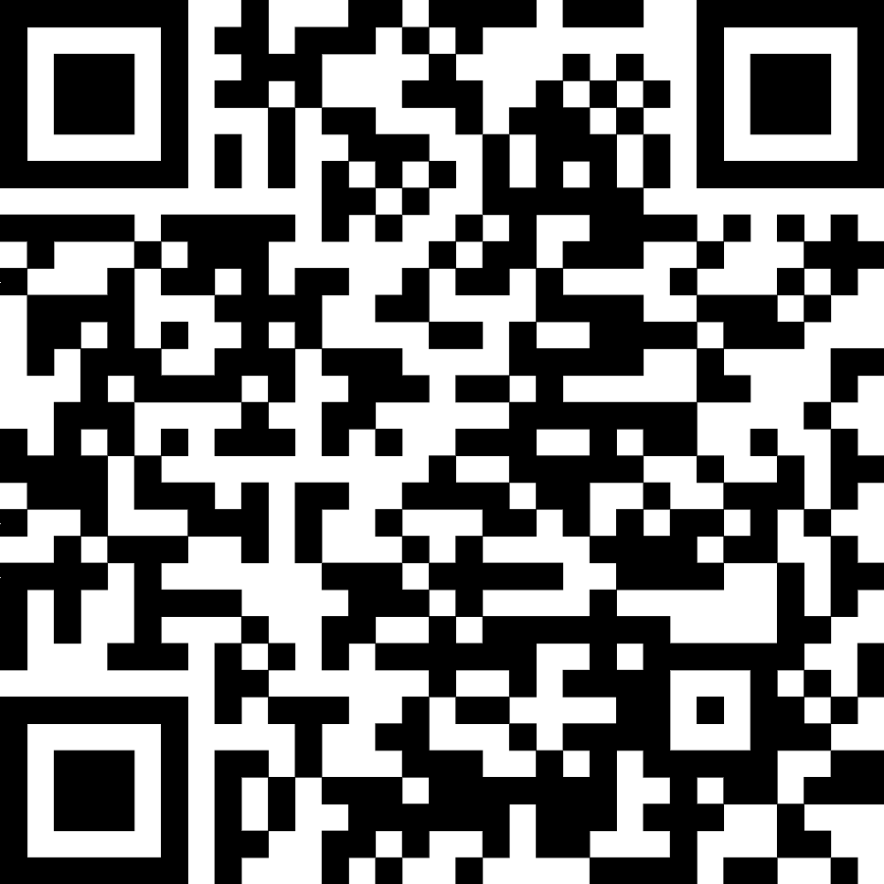
Conclusions
In BCMA-naive RRMM patients, with a median of 2 prior lines of therapy,​ elranatamab in combination with carfilzomib and dexamethasone has demonstrated:
  An acceptable safety profile
    No DLTs were observed
    Hematological TEAEs were predominantly low grade
    Most infections were Grade ≤2 (75.0%)
  Clinical efficacy
    At the time of data cutoff, ORR was 100% (confirmed by investigator) and ≥CR 75.0% (95% CI, 42.8-94.5)
    Median DOR has not been reached
    Responses deepened over time and some responses persisted even after treatment discontinuation
The study is ongoing and will continue to explore the combination of elranatamab, carfilzomib and dexamethasone in a larger group of patients with RRMM
Acknowledgments
We thank the MagnetisMM-20 trial patients and their families, as well as the study investigators, nurses, and site staff. This study was sponsored by Pfizer. Medical writing support was provided by Robyn Roth, PhD, of Nucleus Global and was funded by Pfizer.
Related ASH 2024 presentations:
Poster #4738 MagnetisMM-3
Poster #4743 MagnetisMM-9
Monday, December 9, 2024, 6PM - 8PM
Supplementary Materials
Please scan this quick response (QR) code with your smartphone app to view additional information for this presentation. If you do not have a smartphone, you may access this material via the internet at https://scientificpubs.congressposter.com/p/xcs2n3jipvcj8h6z.
BCMA=B-cell maturation antigen; CR=complete response; DLT=dose-limiting toxicity; DOR=duration of response; ORR=objective response rate; Q4W=every 4 weeks; RRMM=relapsed or refractory multiple myeloma; TEAE=treatment-emergent adverse effect

