Slide 1
411
Long-term survival after elranatamab monotherapy in patients with relapsed or refractory multiple myeloma (RRMM): MagnetisMM-3
H. Miles Prince¹, Mohamad Mohty², Shinsuke Iida³, Nizar J Bahlis⁴, Sharon T Sullivan⁵, Umberto Conte⁶, Eric Leip⁵, Andrea Viqueira⁷, Alexander M. Lesokhin⁸
¹Epworth Healthcare, Melbourne, VIC, Australia; ²Sorbonne University, Hôpital Saint-Antoine, and INSERM UMRS938, Paris, France; ³Department of Hematology and Oncology, Nagoya City University Graduate School of Medical Sciences, Nagoya, Japan; ⁴Arnie Charbonneau Cancer Institute, University of Calgary, Calgary, AB, Canada; ⁵Pfizer Inc, Cambridge, MA, USA; ⁶Pfizer Inc, New York, NY, USA; ⁷Pfizer SLU, Madrid, Spain; ⁸Division of Hematology and Oncology, Memorial Sloan Kettering Cancer Center/Weill Cornell Medical College, New York, NY, USA
Presented at the Blood 2024 Annual Meeting | October 27-30 | Brisbane, Australia
Previously presented at the EHA2024 Hybrid Congress | June 13-16, 2024 | Madrid, Spain & Online

Slide 2
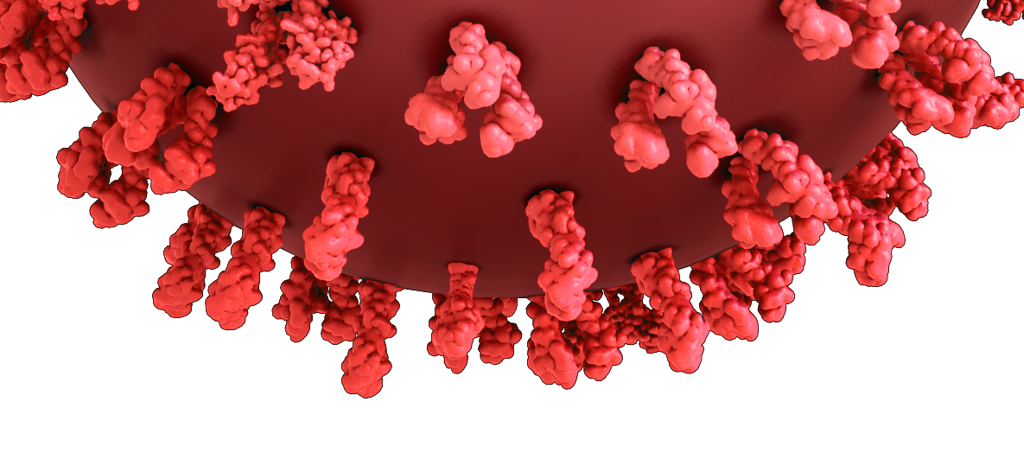
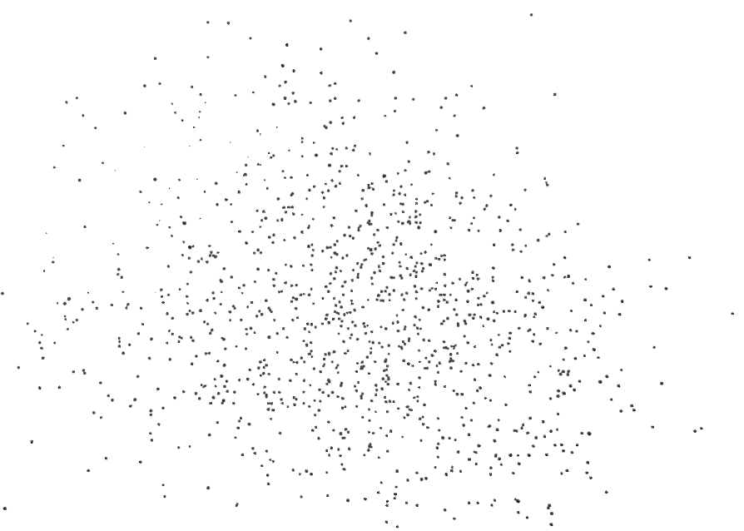
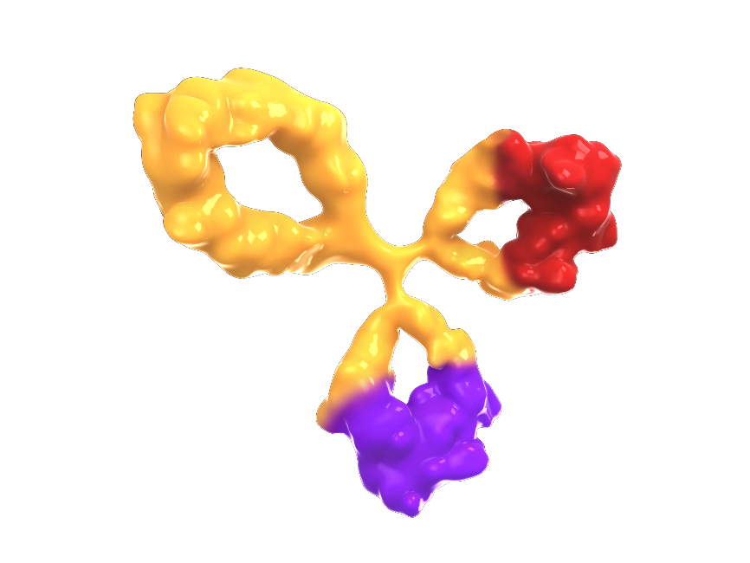


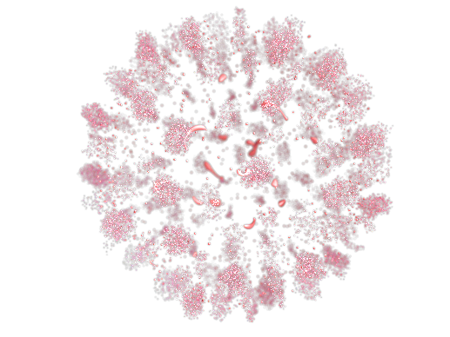
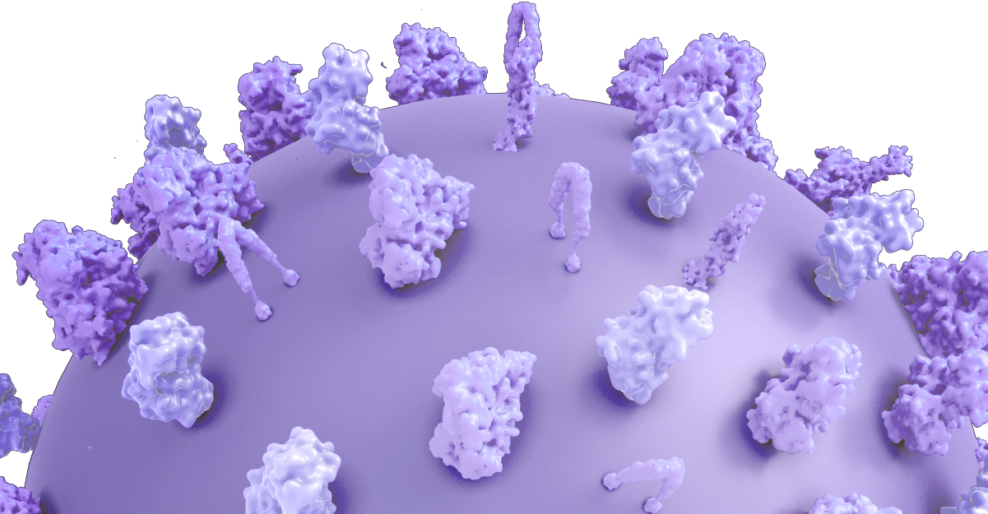
Background
Elranatamab is a BCMA-CD3 bispecific antibody approved for the treatment of patients with RRMM who have received
≥1 IMiD, ≥1 PI, and ≥1 anti-CD38 monoclonal antibody¹⁻³
Data from the phase 2, registrational MagnetisMM-3 (NCT04649359) trial demonstrated the efficacy and safety of elranatamab monotherapy in patients with RRMM and no prior BCMA-directed therapy (BCMA naive)¹
At the last data cut (September 11, 2023), OS data were not yet mature, with >50% of patients censored, after a median follow-up (by reverse Kaplan-Meier) of 22.0 (95% CI, 21.6-22.6) months⁴
Elranatamab binds BCMA on myeloma cells and CD3 on T cells
Myeloma cell
Elranatamab
(PF-06863135)
BCMA
Myeloma cell death
BCMA-binding arm
Cytokines,
perforin, granzymes
CD3-binding arm
CD3
T cell
T-cells activated by CD3 binding, release cytokines and perforin/granzymes resulting in myeloma cell lysis
1. Lesokhin AM, et al. Nat Med 2023;29:2259-2267. 2. ELREXFIO (elranatamab-bcmm). Prescribing information. Pfizer; 2023. 3. ELREXFIO (elranatamab-bcmm). Summary of product characteristics. Pfizer; 2024.
4.Tomason M, et al. Blood 2023;142(suppl 1):3385
BCMA=B-cell maturation antigen; IMiD=immunomodulatory drug; PI=proteasome inhibitor; RRMM=relapsed or refractory multiple myeloma

Slide 3
Objectives
To report updated results in BCMA-naive patients >2 years after the last patient was initially dosed in MagnetisMM-3 on January 7, 2022
BCMA=B-cell maturation antigen

Slide 4
MagnetisMM-3 Study
MagnetisMM-3 is an open-label, multicenter, nonrandomized, phase 2 study
Primary endpoint
Patients with RRMM
ORR by BICR^{b}
Key inclusion criteria
Refractory to ≥1 each of the following: proteasome inhibitor, immunomodulatory drug, and anti-CD38 antibodyª
ECOG PS ≤2
Creatinine clearance ≥30 mL/min
Platelets ≥25 × 10⁹/L
ANC ≥1.0 × 10⁹/L
Hemoglobin ≥8 g/dL
Secondary endpoints
Cohort A (N=123)
No prior BCMA-directed treatment
Duration of response^{b,c}
CR rate^{b,c}
ORR^{c}
ORR by baseline extramedullary disease status^{b}
Duration of CR^{b,c}
Time to response^{b,c}
PFS^{b,c}
MRD negativity rate
OS
Safety
Pharmacokinetics
Elranatamab 76 mg SC QW on a 28-day cycle
Cohort B (N=64)
Prior BCMA-directed ADC or CAR-T
Patients will be followed for
≈2 years from enrollment
ª Refractory was defined as disease progression while on therapy or within 60 days of last dose in any line, regardless of response; ^{b} By BICR assessment per IMWG response criteria (Kumar S, et al. Lancet Oncol 2016;17:e328-e346);
^{c} By investigator assessment per IMWG response criteria
ADC=antibody drug conjugate; ANC=absolute neutrophil count; BCMA=B-cell maturation antigen; BICR=blinded independent central review; CAR-T=chimeric antigen receptor T cell; CR=complete response; ECOG PS=Eastern Cooperative Oncology Group performance status; IMWG=International Myeloma Working Group; MRD=minimal residual disease; ORR=objective response rate; OS=overall survival; PFS=progression-free survival; QW=once weekly; RRMM=relapsed or refractory multiple myeloma; SC=subcutaneous

Slide 5
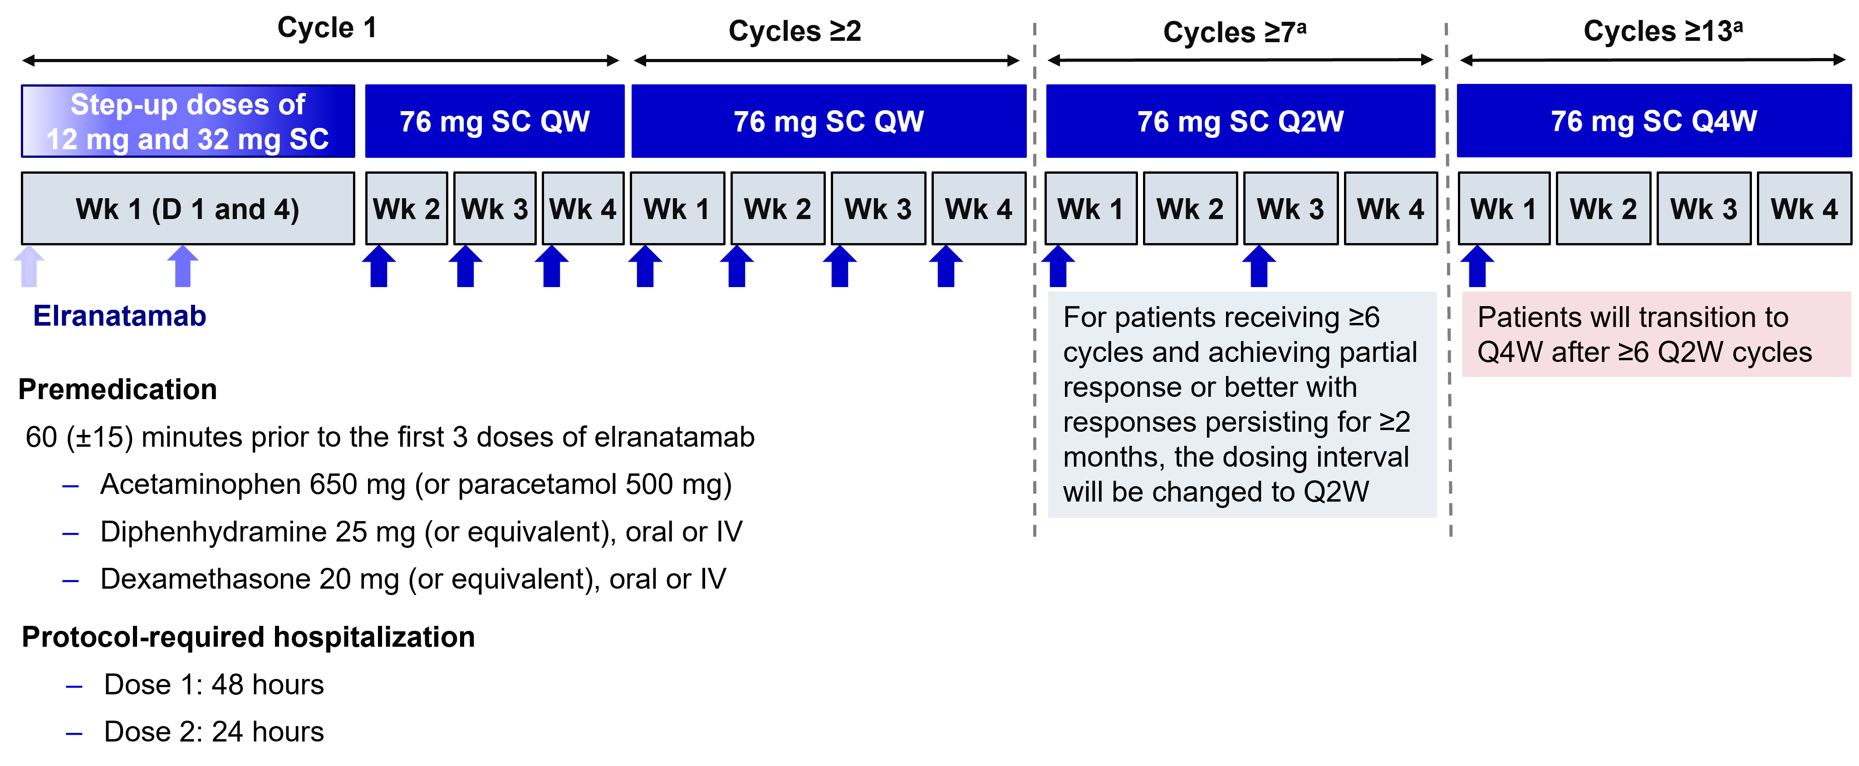
MagnetisMM-3: Elranatamab Dosing Schedule
ª Only for patients meeting the criteria for less frequent dosing.
IV=intravenous; QW=once weekly; Q2W=once every 2 weeks; Q4W=once every 4 weeks; SC=subcutaneous

Slide 6
Baseline characteristics
 | N=123
Age, median (range), years | 68.0 (36.0-89.0)
Male, n (%) | 68 (55.3)
Race, n (%)
African American or Black | 9 (7.3)
Asian | 16 (13.0)
White | 72 (58.5)
Unknown | 1 (0.8)
Not reportedª | 25 (20.3)
ECOG PS, n (%)
0 | 45 (36.6)
1 | 71 (57.7)
2 | 7 (5.7)
R-ISS disease stage, n (%)
I | 28 (22.8)
II | 68 (55.3)
III | 19 (15.4)
Unknown/missing | 8 (6.5)
Cytogenic risk, n (%)
Standard | 83 (67.5)
High^{b} | 31 (25.2)
Missing | 9 (7.3)
 | N=123
EMD by BICR, n (%)^{c}
Yes | 39 (31.7)
No | 84 (68.3)
Missing | 0
Bone marrow plasma cells, n (%)
<50% | 89 (72.4)
≥50% | 26 (21.1)
Missing | 8 (6.5)
Patients with ≥1 poor prognosis feature, n (%)^{d} | 94 (76.4)
Prior lines of therapy, median (range) | 5.0 (2.0-22.0)
Prior stem cell transplant, n (%) | 87 (70.7)
Exposure status, n (%)
Triple-class^{e} | 123 (100)
Penta-drug^{f} | 87 (70.7)
Refractory status, n (%)
Triple-class^{e} | 119 (96.7)
Penta-drug^{f} | 52 (42.3)
Refractory to last line of therapy, n (%) | 118 (95.9)
ª Includes patients recruited in countries where the collection of race is prohibited; ^{b} Includes t(4;14), t(14;16), and del(17p) chromosomal abnormalities; ^{c} EMD was defined as any plasmacytoma (extramedullary and/or paramedullary with a soft-tissue component); ^{d} Poor prognosis feature refers to ≥1 of the following: ECOG performance status of 2, R-ISS stage III, high cytogenetic risk, EMD at baseline by BICR, bone marrow plasma cells ≥50% or penta-refractory disease; ^{e} Triple-class refers to ≥1 proteasome inhibitor, ≥1 immunomodulatory drug, and ≥1 anti-CD38 antibody; ^{f} Penta-drug refers to ≥2 proteasome inhibitors, ≥2 immunomodulatory drugs, and ≥1 anti-CD38 antibody
BICR=blinded-independent central review; ECOG PS=Eastern Cooperative Oncology Group performance status; EMD=extramedullary disease; R-ISS=Revised International Staging System

Slide 7

Efficacy: ORR and DOR
Data cutoff date was March 26, 2024. The median duration of follow-up by reverse Kaplan-Meier was
28.4 (95% CI, 28.0-29.0) months
With extended follow-up, ORR per BICR remained at 61.0% (≥CR rate, 37.4%); median DOR not reached
MRD negativity rate at a sensitivity of 10⁻⁵ was 90.3% in patients with ≥CR who were evaluable for MRD (n=31)
Objective response rate
Duration of Response
100
24-month rate for patients
with ≥CR (95% CI): 87.9% (73.1-94.8)
90
80
ORR
61.0%
70
60
24-month rate for patients
with OR (95% CI): 66.9% (54.4-76.7)
Probability, %
50
≥CR
37.4%
40
≥VGPR
56.1%
30
20
10
Median DOR, months (95% CI)
Patients with OR NR (NE-NE)
0
Patients with ≥CR NR (NE-NE)
0
3
6
9
12
15
18
21
24
27
30
33
36
No. at risk
Patients with OR | 75 | 70 | 65 | 57 | 50 | 45 | 41 | 38 | 35 | 18 | 3 | 1 | 0
Patients with ≥CR | 46 | 46 | 46 | 43 | 40 | 36 | 35 | 34 | 31 | 18 | 3 | 1 | 0
Months
BICR=blinded-independent central review; CR=complete response; DOR=duration of response; MRD=minimal residual disease; NE=not evaluable; NR=not reached; OR=objective response; ORR=objective response rate; PR=partial response; sCR=stringent complete response; VGPR=very good partial response;

Slide 8
Efficacy: PFS and OS
After >2 years of follow-up, median PFS and OS were was reached
4 new deaths had occurred since the last data cutoff (September 11, 2023 )
  2 patients with disease under study and 1 patient each with unknown reason and septic shock
Progression-free survival
Overall Survival
100
Median PFS, 17.2 months (95% CI, 9.8-NE)
100
Median OS, 24.6 months (95% CI, 13.4-NE)
90
90
80
80
70
70
60
60
Probability, %
50
50
Probability, %
40
40
30
30
20
20
10
10
0
0
0
3
6
9
12
15
18
21
24
27
30
33
36
0
3
6
9
12
15
18
21
24
27
30
33
36
39
Months
Months
No. at risk
123
78
67
63
54
48
44
42
39
32
7
1
0
No. at risk
123
106
92
84
74
67
61
60
56
47
13
3
2
0
NE=not evaluable; OS=overall survival; PFS=progression-free survival

Slide 9
Safety
 | N=123
TEAE, n (%)ª | Any grade | Grade 3/4
Any | 123 (100) | 89 (72.4)
Hematologic
Neutropenia | 61 (49.6) | 61 (49.6)
Anemia | 60 (48.8) | 46 (37.4)
Thrombocytopenia | 39 (31.7) | 29 (23.6)
Lymphopenia | 33 (26.8) | 31 (25.2)
Leukopenia | 21 (17.1) | 17 (13.8)
Nonhematologic
Infections^{b} | 87 (70.7) | 52 (42.3)
CRS | 71 (57.7) | 0
Diarrhea | 56 (45.5) | 5 (4.1)
Fatigue | 46 (37.4) | 5 (4.1)
Decreased appetite | 42 (34.1) | 1 (0.8)
Pyrexia | 40 (32.5) | 5 (4.1)
Nausea | 33 (26.8) | 0
Injection site reaction | 33 (26.8) | 0
Hypokalemia | 34 (27.6) | 15 (12.2)
Cough | 35 (28.5) | 1 (0.8)
COVID-19 pneumonia | 18 (14.6%) | 14 (11.4)
No new safety signals were observed with extended follow-up
5 (4.1%) had SPMs; all were squamous cell carcinomas of the skin
  No hematologic SPMs were observed
  All 5 patients with an SPM had received prior lenalidomide and a stem cell transplant
ª TEAEs according to the Medical Dictionary for Regulatory Activities v26.0 and Common Terminology Criteria for Adverse Events v5. Any-grade TEAE reported in ≥25% of patients; grade 3/4 TEAE reported in ≥10% of patients; severity of CRS and ICANS was assessed according to the American Society for Transplantation and Cellular Therapy criteria; ^{b} Infections include preferred terms in the system organ class of infections and infestations
CRS=cytokine release syndrome; ICANS=immune effector cell–associated neurotoxicity syndrome; TEAE=treatment-emergent adverse event; SPM=secondary primary malignancies

Slide 10
Conclusions
Elranatamab continued to demonstrate deep and durable responses in heavily pretreated (median of 5 prior LOTs; 96.7%, triple-class refractory), BCMA-naive patients with RRMM
  MRD negativity rate was 90.3% in evaluable patients with ≥CR
  Median DOR was not reached (2-year rate, 66.9% [95% CI, 54.4-76.7])
  Median PFS was 17.2 (95% CI, 9.8-NE) months
  Median OS was 24.6 (95% CI, 13.4-NE) months
No new safety signals were observed
  Although longer follow-up is needed, few SPMs were seen (<5%; all squamous cell carcinomas)
  No hematologic SPMs were reported
BCMA=B-cell maturation antigen; CR=complete response; DOR=duration of response; LOT=line of therapy; MRD=minimal residual disease; NE=not evaluable; OS=overall survival; PFS=progression-free survival; RRMM=relapsed or refractory multiple myeloma; SPM=secondary primary malignancy

Slide 11
Acknowledgments
We thank the MagnetisMM-3 trial patients and their families, as well as the study investigators, nurses, and site staff. This study was sponsored by Pfizer. Medical writing support was provided by Brittany Woodby, PhD, of Nucleus Global and was funded by Pfizer.

