Slide 1
RANDOMIZED PHASE 2 STUDY TO EVALUATE PALBOCICLIB (IBRANCE®) IN COMBINATION WITH IRINOTECAN AND TEMOZOLOMIDE IN PEDIATRIC PATIENTS WITH RECURRENT OR REFRACTORY EWING SARCOMA
Theodore W. Laetsch,¹ Mustafa Tezer Kutluk,² Sameer Rastogi,³ Hyoung Jin Kang,⁴
Daniel Morgenstern,⁵ Katarzyna Alicja Juszczak-Kosela,⁶ Jodi A. Muscal,⁷ Zhe Zhang,⁸
Ariadna Holynskyj,⁷ Neslihan Aslan,⁹ Brenda J. Weigel,¹⁰ Katherine A. Janeway,¹¹
Douglas S. Hawkins,¹² Anderson B. Collier III¹³
¹Division of Oncology, Children’s Hospital of Philadelphia, and Abramson Cancer Center, University of Pennsylvania, Philadelphia, PA; ² Department of Pediatric Oncology, Hacettepe University Faculty of Medicine & Cancer Institute, Ankara, Turkey; ³All India Institute of Medical Sciences, New Delhi, India; ⁴ Department of Pediatrics, Seoul National University College of Medicine, Seoul National University Cancer Research Institute, Seoul National University Children’s Hospital, Seoul, South Korea; ⁵The Hospital for Sick Children and University of Toronto, Toronto, Canada; ⁶Pfizer Inc, Warsaw, Poland; ⁷Pfizer Inc, New York, NY; ⁸Pfizer Inc, San Diego CA; ⁹Pfizer Inc, Istanbul, Turkey; ¹⁰Department of Pediatrics, University of Minnesota, Minneapolis, MN; ¹¹Dana-Farber / Boston Children’s Cancer and Blood Disorders Center, Boston, MA; ¹²Seattle Children’s Hospital, University of Washington, Seattle, W; ¹³Nemours Children’s Health, Jacksonville, FL.
Notes:
On behalf of my fellow investigators, I am presenting the results of a randomized phase 2 study evaluating palbociclib in combination with irinotecan and temozolomide in pediatric patients with recurrent or refractory Ewing sarcoma

Slide 2
Disclosure
Consulting/advisory: Advanced Microbubbles, AI Therapeutics, Bayer, GSK, ITM Oncologics, Jazz Pharmaceuticals and Massive Bio
Research funding: Pfizer, Bayer and Cellectis
This study was sponsored by Pfizer
Notes:
Listed here are my disclosures
This study was sponsored by Pfizer

Slide 3
Introduction
Ewing sarcoma (EWS) cells express high levels of CDK4 and cyclin D1 downstream of the canonical EWS:FLI1 fusion protein¹
    Proliferation of EWS cell lines and tumor xenografts have been shown to be dependent on both CDK4 and cyclin D1
Palbociclib is an oral, highly selective, reversible, small molecule CDK4/6 inhibitor²
The antitumor activity of palbociclib combined with irinotecan (IRN) + temozolomide (TEM), was investigated in 3 different patient-derived EWS xenograft models grown subcutaneously in immunocompromised mice³
        In 2 models, the addition of palbociclib to IRN+TEM resulted in similar tumor growth inhibition to IRN+TEM, while in the third model, the triple combination demonstrated significantly increased antitumor activity
        We investigated the addition of palbociclib to IRN+TEM versus IRN+TEM in a global open-label, randomized, phase 2 study in pediatric and young adult patients with recurrent or refractory EWS (NCT03709680)
CDK4, cyclin-dependent kinase 4.
1. Kennedy AL, et al. Oncotarget. 6:30178-93. 2. George MA, et al. Front Oncol. 2021;11:693104. 3. Pfizer. Unpublished data. Apr 9, 2020.
Notes:
Ewing sarcoma cells express high levels of CDK4 and cyclin D1 downstream of the canonical EWS:FLI1 fusion protein
Proliferation of Ewing sarcoma cell lines and tumor xenografts have been shown to be dependent on both CDK4 and cyclin D1
Palbociclib is an oral, highly selective, reversible, small molecule CDK4/6 inhibitor
The antitumor activity of palbociclib combined with irinotecan plus temozolomide, was investigated in 3 different patient-derived Ewing sarcoma xenograft models grown subcutaneously in immunocompromised mice
In 2 models, the addition of palbociclib to IRN+TEM resulted in similar tumor growth inhibition to IRN+TEM alone, while in the third model, the triple combination demonstrated significantly increased antitumor activity
Today, I’ll be presenting results from a randomized phase 2 study evaluating palbociclib in combination with IRN+TEM in pediatric and young adult patients with recurrent or refractory Ewing sarcoma

Slide 4
Primary Objective and Study Design
To determine whether the addition of palbociclib to IRN and TEM would prolong event-free survival (EFS)
in pediatric and young adult patients with recurrent or refractory EWS
Study design
PAL 75 mg/m² QD
14 days on, 7 days off
+
IRN 50 mg/m² QD day 1−5
+
TEM 100 mg/m² QD days 1−5
Inclusion criteria
Recurrent / refractory EWS
Age ≥ 2 and < 21 years
Preplanned
N = 75
Randomization
2 : 1
IRN 50 mg/m² QD day 1−5
+
TEM 100 mg/m² QD days 1−5
Stratification factor: type and time of current disease recurrence
Primary refractory or 1st recurrence < 2 years
1st recurrence ≥ 2 years or 2nd or greater recurrence
Treatment continued until disease progression, patient and/or legal guardian refusal, unacceptable toxicity, or up to 24 months of treatment, whichever occurred first
EWS, Ewing sarcoma; IRN, irinotecan; PAL, palbociclib; QD, once daily; TEM, temozolomide.
Notes:
The primary objective of this global, open-label, randomized, phase 2 study was to determine whether the addition of palbociclib to IRN+TEM would prolong event-free survival or EFS in pediatric and young adult patients with recurrent or refractory Ewing sarcoma.
Patients were between 2 and 21 years old
A total of 75 patients were to be randomized 2:1 to either:
Palbociclib 75 mg/m² once daily (14 days on, 7 days off) + IRN 50 mg/m² once daily + TEM 100 mg/m² once daily (days 1−5) or
IRN+TEM alone at the same dosing regimen as the other arm
Patients were stratified by the type and time of disease recurrence
Primary refractory or 1st recurrence < 2 years, or
1st recurrence ≥ 2 years or 2nd or greater recurrence
Treatment continued until disease progression, patient and/or legal guardian refusal, unacceptable toxicity, or up to 24 months of treatment, whichever occurred first

Slide 5
Study Endpoints
Endpoints | Assessments
Primary | Investigator-assessed EFS
Secondary | BICR-assessed EFS OR PFS OS Safety Pharmacokinetics Quality of life
    Tumor response assessment per RECIST v1.1
    criteria every 2 cycles (6 weeks ± 7 days) for the first 4 assessments, and then every 4 cycles
    (12 weeks ± 7 days)
    Adverse events graded by NCI CTCAE v 4.03
An interim futility analysis was planned to allow for early stopping of the study due to futility/no signal of activity based on the primary endpoint of EFS
  The analysis was planned after approximately 30 documented investigator-assessed EFS events (or about 60% of the total events expected)ª
ª A total of approximately 50 EFS events based on investigator assessment were required in the 2 treatment arms of the study based on a 2:1 randomization to have at least 80% power to detect a hazard ratio of 0.58 in favor of palbociclib plus IRN and TEM arm using a 1-sided
log-rank test at a significance level of 0.20.
BIRC, blinded independent review committee; EFS, event-free survival; IRN, irinotecan; NCI CTCAE, National Cancer Institute Common Terminology Criteria for Adverse Events; OR, objective response; OS, overall survival; PFS, progression-free survival; RECIST, response evaluation criteria in solid tumors; TEM, temozolomide.
Notes:
The primary endpoint was investigator-assessed EFS
Secondary endpoints included blinded independent review committee-assessed EFS, objective response, progression-free survival or PFS, overall survival, safety, pharmacokinetics and quality of life
Tumor response assessment was per RECIST criteria every 2 cycles for the first 4 assessments, and then every 4 cycles
An interim futility analysis was planned to allow for early stopping of the study due to futility/no signal of activity based on the primary endpoint of EFS
The analysis was planned after approximately 30 documented investigator-assessed EFS events (or about 60% of the total expected events)

Slide 6
Patient Baseline Characteristics
54 patients were randomized to the study between 17 December 2021 and 25 July 2023
Treatments | PAL+ IRN+TEM (n=35) | IRN+TEM (n=19) | Total (N=54)
Age (years), median (range) | 13.0 (5−19) | 15.0 (9−20) | 14.5 (5−20)
Sex, n (%)
Male | 27 (77.1) | 11 (57.9) | 38 (70.4)
Female | 8 (22.9) | 8 (42.1) | 16 (29.6)
Race, n (%)
White | 19 (54.3) | 11 (57.9) | 30 (55.6)
Asian | 10 (28.6) | 6 (31.6) | 16 (29.6)
Not reported | 6 (17.1) | 2 (10.5) | 8 (14.8)
Ethnicity, n (%)
Hispanic or Latino | 2 (5.7) | 2 (10.5) | 4 (7.4)
Not Hispanic or Latino | 28 (80.0) | 15 (78.9) | 43 (79.6)
Not reported | 5 (14.3) | 2 (10.5) | 7 (13.0)
Geographic region, n (%)
North America | 14 (40.0) | 8 (42.1) | 22 (40.7)
Europe and Israel | 8 (22.9) | 2 (10.5) | 10 (18.5)
Rest of world | 13 (37.1) | 9 (47.4) | 22 (40.7)
Treatments | PAL+ IRN+TEM (n=35) | IRN+TEM (n=19) | Total (N=54)
Type and time of current disease recurrence, n (%)
Primary refractory or 1st recurrence < 2 yearsª | 25 (71.4) | 13 (68.4) | 38 (70.4)
1st recurrence ≥ 2 years* or ≥ 2 recurrence | 10 (28.6) | 6 (31.6) | 16 (29.6)
Site of recurrence, n (%)
Locally advanced | 6 (17.1) | 3 (15.8) | 9 (16.7)
Metastatic | 26 (74.3) | 14 (73.7) | 40 (74.1)
Not reported | 3 (8.6) | 2 (10.5) | 5 (9.3)
Measurable disease, n (%) | 25 (71.4) | 18 (94.7) | 43 (79.6)
ECOG performance status (> 16 years), n (%)
0 | 3 (8.6) | 3 (15.8) | 6 (11.1)
1 | 4 (11.4) | 3 (15.8) | 7 (13.0)
2 | 1 (2.9) | 0 | 1 (1.9)
Not applicable | 27 (77.1) | 13 (68.4) | 40 (74.1)
Lansky performance status (≤ 16 years), n (%)
90−100% | 15 (42.9) | 10 (52.6) | 25 (46.3)
70−80% | 11 (31.4) | 3 (15.8) | 14 (25.9)
50−60% | 0 | 0 | 0
Not applicable | 9 (25.7) | 6 (31.6) | 15 (27.8)
Prior anticancer drug therapy, n (%) | 34 (97.1) | 19 (100) | 53 (98.1)
median (range) | 1 (1−6) | 1 (1−5) | 1 (1−6)
ª Time of 1st recurrence defined since completion of 1st line treatment.
ECOG, Eastern Cooperative Oncology Group; IRN, irinotecan; PAL, palbociclib; TEM, temozolomide.
Notes:
54 patients were randomized between December 17, 2021 and July 25, 2023; 35 to the palbociclib+IRN+TEM arm and 19 to the IRN+TEM alone arm
The median age of all trial patients was 14.5 years, with a range of 5 to 20 years
38 patients had primary refractory or 1st disease recurrence < 2 years
40 patients had metastatic recurrence
The median number of prior lines of prior anticancer therapies was 1, with a range of 1 to 6

Slide 7
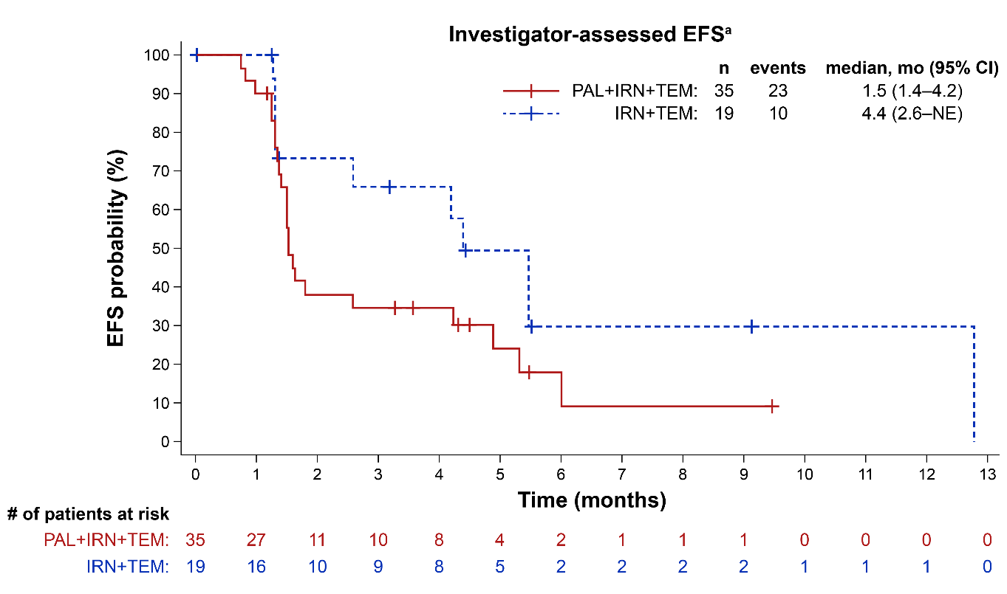
Event-Free Survival (EFS)
As of the data cutoff date of July 31, 2023, 33 events had occurred (or 66% of the total expected events)
  The study crossed the prespecified futility boundary at the planned interim analysis, and therefore did not meet its primary endpoint of improving EFS with PAL+IRN+TEM compared with IRN+TEM alone
Treatments | PAL+ IRN+TEM (n=35) | IRN+TEM (n=19)
Median duration of follow-up, mo (95% CI) | 4.5 (3.6−NE) | 5.5 (3.2−9.1)
Investigator-assessed Median EFS, mo | 1.5 | 4.4
HR (95% CI) P-value (1-sided) | 2.03 (0.90−4.57) 0.962
BIRC-assessed Median EFS, mo | 1.5 | 4.1
HR (95% CI) P-value (1-sided) | 1.54 (0.74−3.20) 0.877
ªPFS results were identical to those of EFS given that no participants developed a secondary malignancy as of the data cutoff date.
BIRC, blinded independent review committee; CI, confidence interval; EFS, event-free survival; HR, hazard ratio; IRN, irinotecan; mo, months; NE, not estimable; PAL, palbociclib; PFS, progression-free survival; TEM, temozolomide.
Notes:
As of the data cutoff date of July 31, 2023, 33 events had occurred (or 66% of the total expected events)
The study crossed the prespecified futility boundary at the planned interim analysis, and therefore did not meet its primary endpoint of improving EFS with palbociclib+IRN+TEM compared with IRN+TEM alone
As seen in the Kaplan-Meier graph, median investigator-assessed EFS was 1.5 months in the palbociclib arm versus 4.4 months in the IRN+TEM arm with an estimated hazard ratio of 2.03; showing no improvement in EFS when palbociclib was added to the chemotherapy regimen
Similar results were observed for BIRC-assessed EFS
PFS results were identical to those of EFS given that no participants developed a secondary malignancy as of the data cutoff date

Slide 8
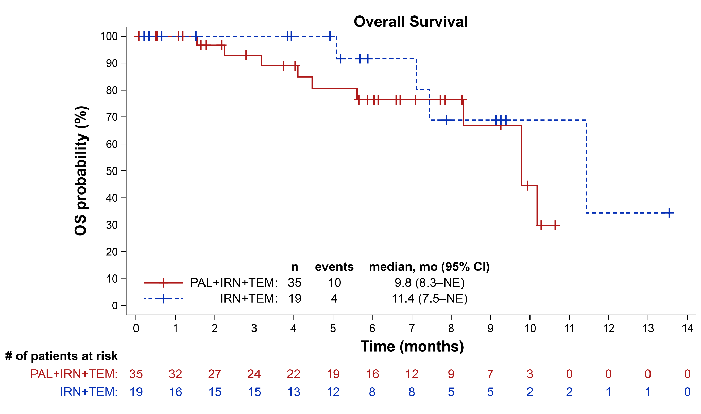
Overall Survival (OS)
Overall, 14 (26% of 54 patients) deaths occurred as of the data cutoff date of 31 July 2023
PAL+IRN+TEM: 10 (29%) deaths
IRN+TEM: 4 (21%) deaths
Treatments | PAL+ IRN+TEM (n=35) | IRN+TEM (n=19)
Median duration of follow-up, mo (95% CI) | 6.6 (5.7−8.3) | 5.9 (3.9−9.3)
Median OS, mo | 9.8 | 11.4
HR (95% CI) | 1.87 (0.50−6.97)
CI, confidence interval; HR, hazard ratio; IRN, irinotecan; mo, months; NE, not estimable; OS, overall survival; PAL, palbociclib; TEM, temozolomide.
Notes:
Overall, there were 14 deaths (29%); 10 in the palbociclib+IRN+TEM arm and 4 (21%) in the IRN+TEM arm
Median overall survival was 9.8 months in the palbociclib+IRN+TEM arm and 11.4 months in the IRN+TEM arm; showing no improvement in OS when palbociclib was added to the chemotherapy regimen

Slide 9
Confirmed Objective Response Rate (ORR)
Confirmed ORR based on investigator assessment was 14.3% in the PAL+IRN+TEM and 15.8% in the IRN+TEM arm
Response based on investigator assessment | PAL+ IRN+TEM (n=35) | IRN+TEM (n=19)
Confirmed ORR,ª n (%) | 5 (14.3) | 3 (15.8)
95% CI^{b} | 6.3−29.4 | 5.5−37.6
Stratified analysis of ORR^{c} PAL+IRN+TEM vs IRN+TEM
Odds ratio (95% CI)^{d} | 0.882 (0.15−6.35)
P-value (1-sided)^{e} | 0.583
ª Confirmed CR or PR based on RECIST v1.1; ^{b} Based on the Wilson method; ^{c} Stratified by type and time of current disease recurrence (primary refractory
or 1st recurrence < 2 years vs 1st recurrence ≥ 2 years or 2nd or greater recurrence) at randomization from interactive response technology stratification values;
^{d} Odds ratio was estimated using Cochran-Mantel-Haenszel method. Exact CI was calculated; ^{e} based on exact Cochran-Mantel-Haenszel test.
CI, confidence interval; CR, complete response; IRN, irinotecan; PAL, palbociclib; PR, partial response; TEM, temozolomide.
Notes:
Confirmed objective response rate based on investigator assessment was 14.3% in the palbociclib+IRN+TEM arm and 15.8% in the IRN+TEM arm; again, with no improvement in objective response rate observed when palbociclib was added to the chemotherapy regimen

Slide 10
Safety
PAL+IRN+TEM
IRN+TEM
Overall, there were similar rates of TRAES across arms
  There were greater proportions of patients with neutropenia, lymphocyte count decreased, leukopenia and febrile neutropenia in the PAL+IRN+TEM arm
    TRAEs were generally consistent with the known safety profile in adults
85.3%
89.5%
64.7%
42.1%
38.2%
26.3%
32.4%
31.6%
26.5%
21.1%
26.5%
21.1%
23.5%
21.1%
17.6%
26.3%
14.7%
11.8%
100 | 80 | 60 | 40 | 20 | 0 | 20 | 40 | 60 | 80 | 100
Includes all data collected since the first dose of study drug up to 35 days after last dose of study treatment.
IRN, irinotecan; PAL, palbociclib; TEM, temozolomide; TRAE, treatment-related adverse event.
Notes:
Across treatment arms, there were similar rates of treatment-related AEs; 85% in the palbociclib+IRN+TEM arm and 90% in the IRN+TEM arm
There were greater proportions of patients with neutropenia, lymphocyte count decreased, leukopenia and febrile neutropenia in the palbociclib+IRN+TEM arm
Treatment-related AEs were generally consistent with the known safety profile in adults

Slide 11
Tolerability
Proportions of patients with and durations of cycle delays were similar across trial arms, but delays were more common in cycle 2 in the PAL+IRN+TEM arm
TRAEs resulting in discontinuation were rare
Dose interruptions and cycle delays were common across both arms, although more frequent in the PAL+IRN+TEM arm, while dose reduction was more common in the IRN+TEM arm
The median relative dose intensity was
  94% for PAL
  95% for both IRN and TEM in the PAL+IRN+TEM arm
  100% for both in the IRN+TEM arm
Treatment exposure and TRAEs leading to treatment modifications | PAL+ IRN+TEM (n=34) | IRN+TEM (n=19)
Treatment exposure:
Duration of treatment (months), median (range) | 1.4 (0.3−7.9) | 1.5 (0.2−8.4)
Patients w/ ≥ 1 cycle delay, n (%) | 16 (47.1) | 8 (42.1)
Maximum duration of cycle delay (days), median (range) | 6.5 (4.0−17.0) | 7.5 (4.0−11.0)
Median duration of cycle delay (days), (range) | 5.2 (3.0−11.0) | 6.5 (3.3−11.0)
First delay on cycle 2, n (%) | 14 (41.2) | 5 (26.3)
TRAEs leading to: n (%)
Permanent discontinuation of all treatments | 1 (2.9) | 1 (5.3)
Dose interruption/cycle delayª of any study treatment | 22 (64.7) | 8 (42.1)
Dose reduction of any study treatment | 1 (2.9) | 4 (21.1)
ª Includes intracycle palbociclib dosing interruptions.
IRN, irinotecan; NA, not applicable; PAL, palbociclib; TEM, temozolomide; TRAE, treatment-related adverse event.
Notes:
Palbociclib with IRN+TEM was generally well tolerated
Proportions of patients with and durations of cycle delays were similar across trial arms, but delays were more common in cycle 2 in the palbociclib+IRN+TEM arm
Treatment-related AEs resulting in discontinuation were rare, with one patient in each arm
Dose interruptions and cycle delays were common across both arms, although more frequent in the palbociclib+IRN+TEM arm, while dose reduction was more common in the IRN+TEM arm
The median relative dose intensity was high for all study treatments

Slide 12
Conclusions
This study did not meet its primary objective of improving EFS when palbociclib was added to IRN+TEM
in pediatric and young adult patients with recurrent / refractory EWS, crossing the prespecified futility boundary for EFS at the planned interim analysis
Additional analyses are needed to evaluate potential confounders in this study with a small sample size and/or mechanisms of antagonism
The combination of palbociclib with IRN+TEM was associated with increased myelosuppression but otherwise generally well tolerated with no new safety signals identified beyond what have been described for palbociclib as a single agent and IRN+TEM chemotherapy
EFS, event-free survival; EWS, Ewing sarcoma; IRN, irinotecan; TEM, temozolomide.
Notes:
In conclusion, this study did not meet its primary objective of improving EFS when palbociclib was added to IRN+TEM in pediatric and young adult patients with recurrent / refractory Ewing sarcoma, crossing the prespecified futility boundary for EFS at the planned interim analysis
Additional analyses are needed to evaluate potential confounders in this study with a small sample size and/or mechanisms of antagonism
The combination of palbociclib with IRN+TEM was associated with increased myelosuppression but otherwise generally well tolerated with no new safety signals identified beyond what have been described for palbociclib as a single agent and IRN+TEM chemotherapy

Slide 13
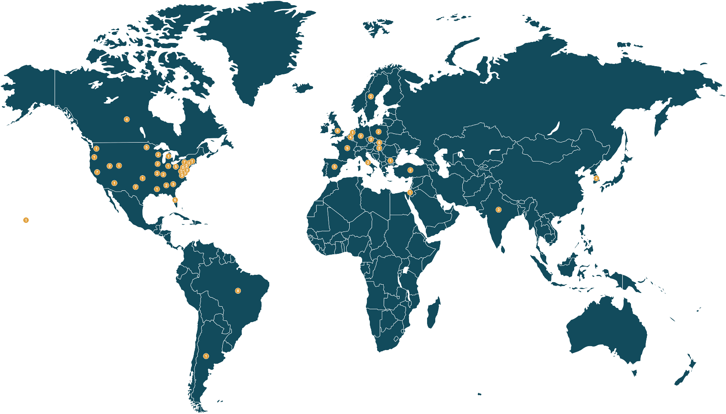
Acknowledgments
On behalf of my coauthors, I would
like to thank and acknowledge the patients who participated in this
trial and their families
I would also like to thank the investigators and research staff at all clinical sites for their participation
and contributions
to this trial
Notes:
On behalf of my coauthors, I would like to thank and acknowledge the patients who participated in this trial and their families
I would also like to thank the investigators and research staff at all clinical sites for their participation and contributions to this trial

