Slide 1
TUCATINIB AND TRASTUZUMAB
FOR PATIENTS WITH PREVIOUSLY TREATED, HER2-ALTERED
SOLID TUMORS (SGNTUC-019):
A PHASE 2 BASKET STUDY
Yoshiaki Nakamura
National Cancer Center Hospital East, Kashiwa, Japan
Tanios Bekaii-Saab, Erika Hamilton, Hidetoshi Hayashi, Nobumasa Mizuno, Bradley J. Monk, Danny Nguyen, Alicia Okines, David M. O’Malley, Paula R. Pohlmann, Bhavana Pothuri, Martin Reck, Kazuki Sudo, Yu Sunakawa, Shunji Takahashi, Evan Y. Yu, Amanda Drees, Sherry Tan, Thomas E. Stinchcombe

Slide 2
Disclosures
Yoshiaki Nakamura: Advisory role for Guardant Health Pte Ltd., Natera, Inc., Roche Ltd., Seagen, Inc., Premo Partners, Inc., Daiichi Sankyo Co., Ltd., Takeda Pharmaceutical Co., Ltd., Exact Sciences Corporation, and Gilead Sciences, Inc.; speakers’ bureau for Guardant Health Pte Ltd., MSD K.K., Eisai Co., Ltd., Zeria Pharmaceutical Co., Ltd., Miyarisan Pharmaceutical Co., Ltd., Merck Biopharma Co., Ltd., CareNet, Inc., Hisamitsu Pharmaceutical Co., Inc., Taiho Pharmaceutical Co., Ltd., Daiichi Sankyo Co., Ltd., Chugai Pharmaceutical Co., Ltd., Becton, Dickinson and Company, and Guardant Health Japan Corp; research funding from Seagen, Inc. (Inst), Genomedia Inc. (Inst), Guardant Health AMEA, Inc. (Inst), Guardant Health, Inc. (Inst), Tempus Labs, Inc. (Inst), Roche Diagnostics K.K. (Inst), Daiichi Sankyo Co., Ltd. (Inst), and Chugai Pharmaceutical Co., Ltd. (Inst).
This study was sponsored by Seagen Inc. (Bothell, WA, USA), which was acquired by Pfizer Inc. (New York, NY, USA) in December 2023, in collaboration with Merck Sharp & Dohme LLC, a subsidiary of Merck & Co., Inc. (Rahway, NJ, USA).

Slide 3
Background
Tucatinib is a highly selective HER2-directed tyrosine kinase inhibitor¹
Tucatinib-containing regimens are currently approved to treat HER2+ mBC and mCRC²
  Tucatinib + trastuzumab + capecitabine: previously treated, HER2+ locally advanced or mBC^{2,3}
  Tucatinib + trastuzumab: previously treated, HER2+ unresectable or mCRC²
Actionable HER2 alterations (overexpression/amplification or mutations) also occur in various other solid tumor types⁴
Here, we report results from all cohorts of a phase 2 basket study evaluating tucatinib in combination with trastuzumabª in patients with HER2-altered solid tumors

Slide 4
Study Design
SGNTUC-019 (NCT04579380) is an open-label phase 2 basket study evaluating antitumor activity and safety of tucatinib with trastuzumab^{a,b} in patients with HER2-altered solid tumors
Key eligibility criteria
HER2 overexpression (IHC),
amplification (ISH or NGS), or mutation (NGS) per local or central testing
Locally advanced unresectable or metastatic solid tumor
Baseline measurable disease
Previously treated with ≥1 prior systemic treatment for advanced disease
No prior HER2-directed therapy^{c}
Cohort 1: Cervical (overexpression or amplification)
Outcomes
Primary endpoint:
Confirmed ORR per RECIST v1.1 by investigator
Secondary endpoints:
Safety, DCR, DOR, PFS, and OS
Cohort 2: Uterine (overexpression or amplification)
Cohort 3: Biliary tract (overexpression or amplification)
Cohort 4: Urothelial (overexpression or amplification)
Cohort 5: Nonsquamous NSCLC (overexpression or amplification)
Cohort 6: Other solid tumors (overexpression or amplification)
Cohort 7: Nonsquamous NSCLC (mutation)
Cohort 8: Breast (mutation)^{b}
Cohort 9: Other solid tumors (mutation)

Slide 5
Efficacy Per Investigator Assessment
 | HER2+ Tumorsª |  |  |  |  |  | HER2-mut Tumorsª
 | Cervical (n=11) | Uterine (n=30) | Biliary Tract (n=30) | Urothelial (n=25) | Nonsquamous NSCLC (n=12) | Other (n=31) | Nonsquamous NSCLC (n=13) | mBC^{b} (n=31) | Other (n=29)
cORR, % (90% CI) | 27.3 (7.9–56.4) | 13.3 (4.7–28.0) | 46.7 (30.8–63.0) | 8.0 (1.4–23.1) | 8.3 (0.4–33.9) | 22.6 (11.1–38.3) | 0 (0–20.6) | 41.9 (26.9–58.2) | 10.3 (2.9–24.6)
Median DOR, months (90% CI) | 9.5 (5.8–NE) | 4.9 (2.8–NE) | 6.4 (5.6–9.4) | 9.7 (NE–NE) | 9.7 (NE–NE) | NR (2.7–NE) | NA | 12.6 (4.7–NE) | 5.8 (3.9–NE)
DCR, % (90% CI) | 81.8 (53.0–96.7) | 70.0 (53.5–83.4) | 76.7 (60.6–88.5) | 60.0 (41.7–76.4) | 75.0 (47.3–92.8) | 67.7 (51.5–81.3) | 76.9 (50.5–93.4) | 80.6 (65.3–91.2) | 51.7 (35.2–68.0)
Median PFS^{c}, months (90% CI) | 5.2 (2.6–7.0) | 2.8 (2.6–3.9) | 5.5 (3.9–8.1) | 2.6 (1.5–3.0) | 3.4 (1.4–6.4) | 5.3 (2.3–5.9) | 4.1 (2.3–5.7) | 9.5 (5.4–13.8) | 1.5 (1.3–2.8)
cORR was 22.2% in response-evaluable patients (n=212)
cORR was 22.3% in HER2+ tumors (n=139) and 21.9% in HER2-mut tumors (n=73)

Slide 6
Safety Summary
TEAE, n (%) | Total (n=217)
Any TEAE | 212 (97.7)
Grade ≥3 TEAE | 119 (54.8)
Any serious TEAE | 78 (35.9)
TEAE leading to death | 6 (2.8)
Treatment-related | 0
TEAE leading to discontinuation of all study treatments | 9 (4.1)
TEAE leading to discontinuation of any study treatment | 17 (7.8)
Discontinued tucatinib | 14 (6.5)
Discontinued trastuzumab | 11 (5.1)
TEAE leading to tucatinib dose modification | 108 (49.8)
Held | 103 (47.5)
Reduced | 45 (20.7)
Overall, the combination of tucatinib and trastuzumab was well tolerated
Treatment discontinuations
due to TEAEs were uncommon
There were no treatment-related TEAEs leading to death

Slide 7
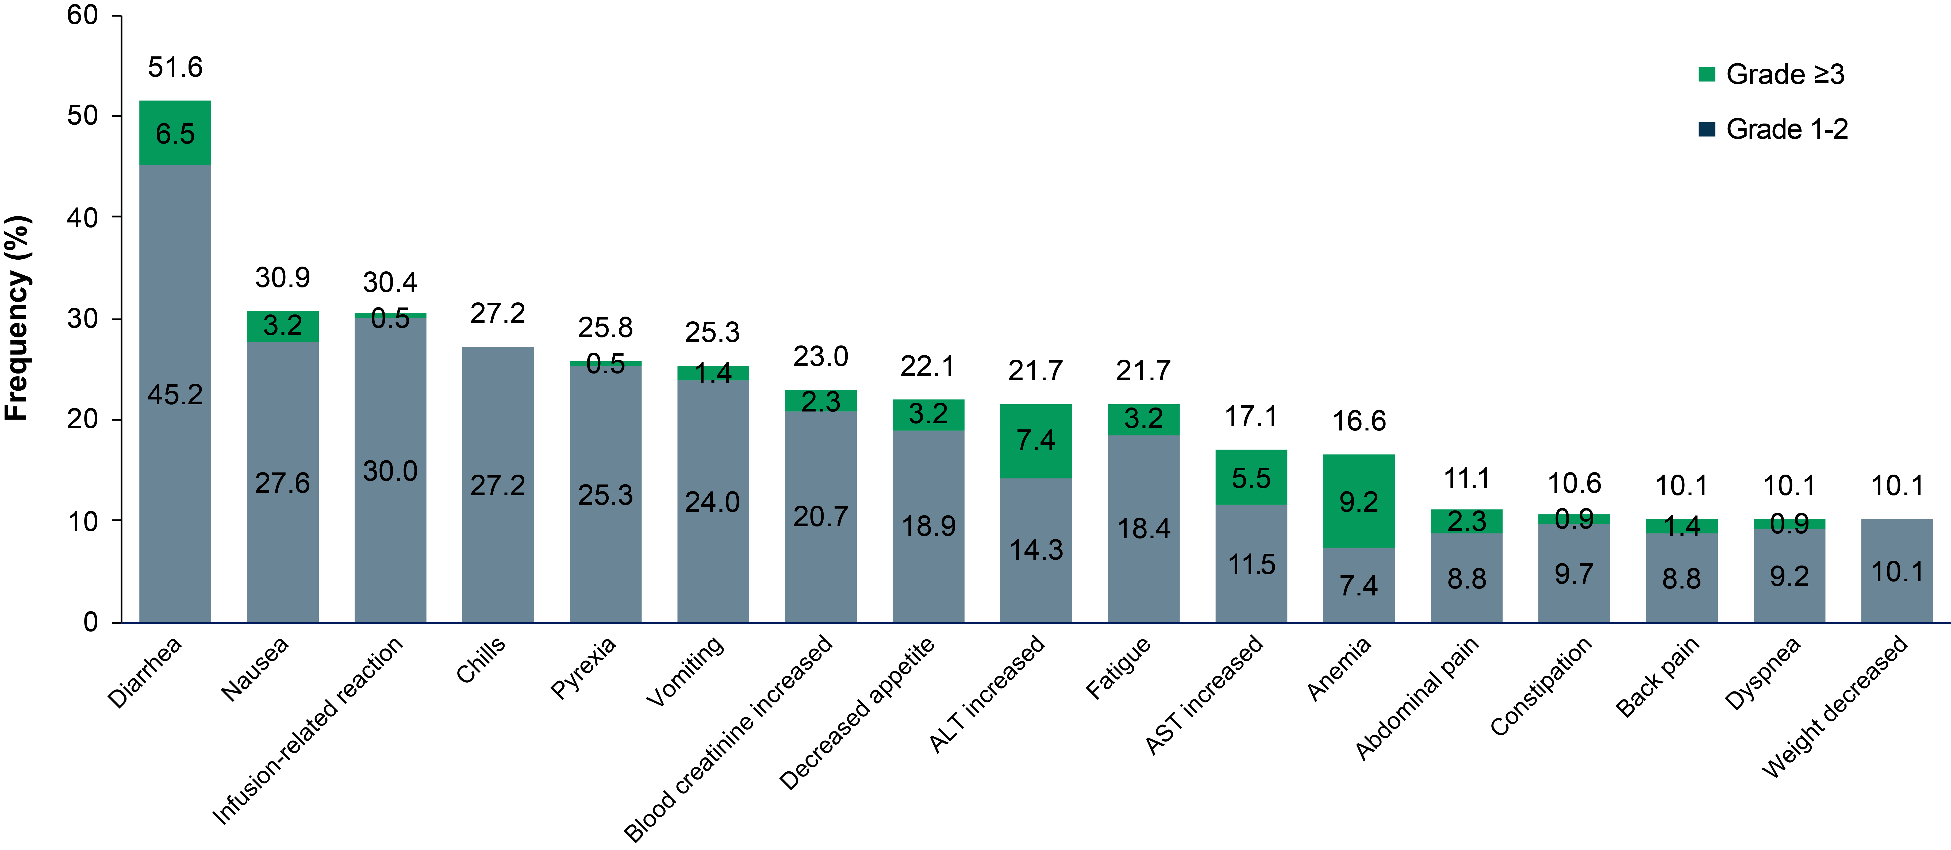
Most Common TEAEs (≥10%)ª
n=217
No new safety signals were identified, and the majority of TEAEs were low grade
Most common TEAEs were diarrhea (51.6%), nausea (30.9%), and infusion-related reactions (30.4%)
Most common grade ≥3 TEAEs were anemia (9.2%) and ALT increased (7.4%)

Slide 8
Exploratory Biomarker Analyses
Exploratory
biomarker dataª
Exploratory Biomarker Objectives
Agreement between local
and central HER2 testing
Agreement between
tissue and blood-based HER2 testing
Clinical response for different testing modalities
Characterization of
co-occurring alterations
and impact on response
Baseline
Tumor tissue
Blood
HER2 status
(IHC^{b}, FISH^{b},
tissue NGS^{c})
Genomic alterations
(tissue NGS^{c})
HER2 status
amplification/
mutation
(blood ctDNA^{d})
Genomic alterations
(blood ctDNA^{d})

Slide 9
Agreement Between HER2 Testing Modalities
HER2+ Cohorts
HER2-Mutated Cohorts
HER2+ cancer type | Local vs blood ctDNA | Local vs central IHC/FISH | Central IHC/FISH vs blood ctDNA
 | % agreement (n/N) | % agreement (n/N) | % agreement (n/N)
Cervical | 72.7% (8/11) | 75.0% (6/8) | 75.0% (6/8)
Uterine | 55.2% (16/29) | 76.9% (20/26) | 57.7% (15/26)
Biliary tract | 75.9% (22/29) | 87.5% (21/24) | 83.3% (20/24)
Urothelial | 34.8% (8/23) | 68.8% (11/16) | 58.8% (10/17)
Nonsquamous NSCLC | 45.5% (5/11) | 85.7% (6/7) | 57.1% (4/7)
Other | 50.0% (15/30) | 74.2% (23/31) | 70% (21/30)
HER2-mut cancer type | Local vs blood ctDNA | Local vs central tissue NGS | Blood ctDNA vs central tissue NGS
 | % agreement (n/N) | % agreement (n/N) | % agreement (n/N)
Nonsquamous NSCLC | 75.0% (9/12) | 100% (9/9) | 88.9% (8/9)
mBC | 76.9% (20/26) | 85.7% (18/21) | 68.2% (15/22)
Other | 66.7% (18/27) | 85.7% (18/21) | 80.0% (16/20)
Agreement
Lower
Higher
HER2+ Cohorts | Variable agreement across testing modalities, with the highest agreement between local and central HER2 IHC/FISH
HER2-mut Cohorts | Moderate to high agreement in detecting HER2 mutations between local and central testing, with tissue-based testing demonstrating high agreement and consistency across cohorts

Slide 10
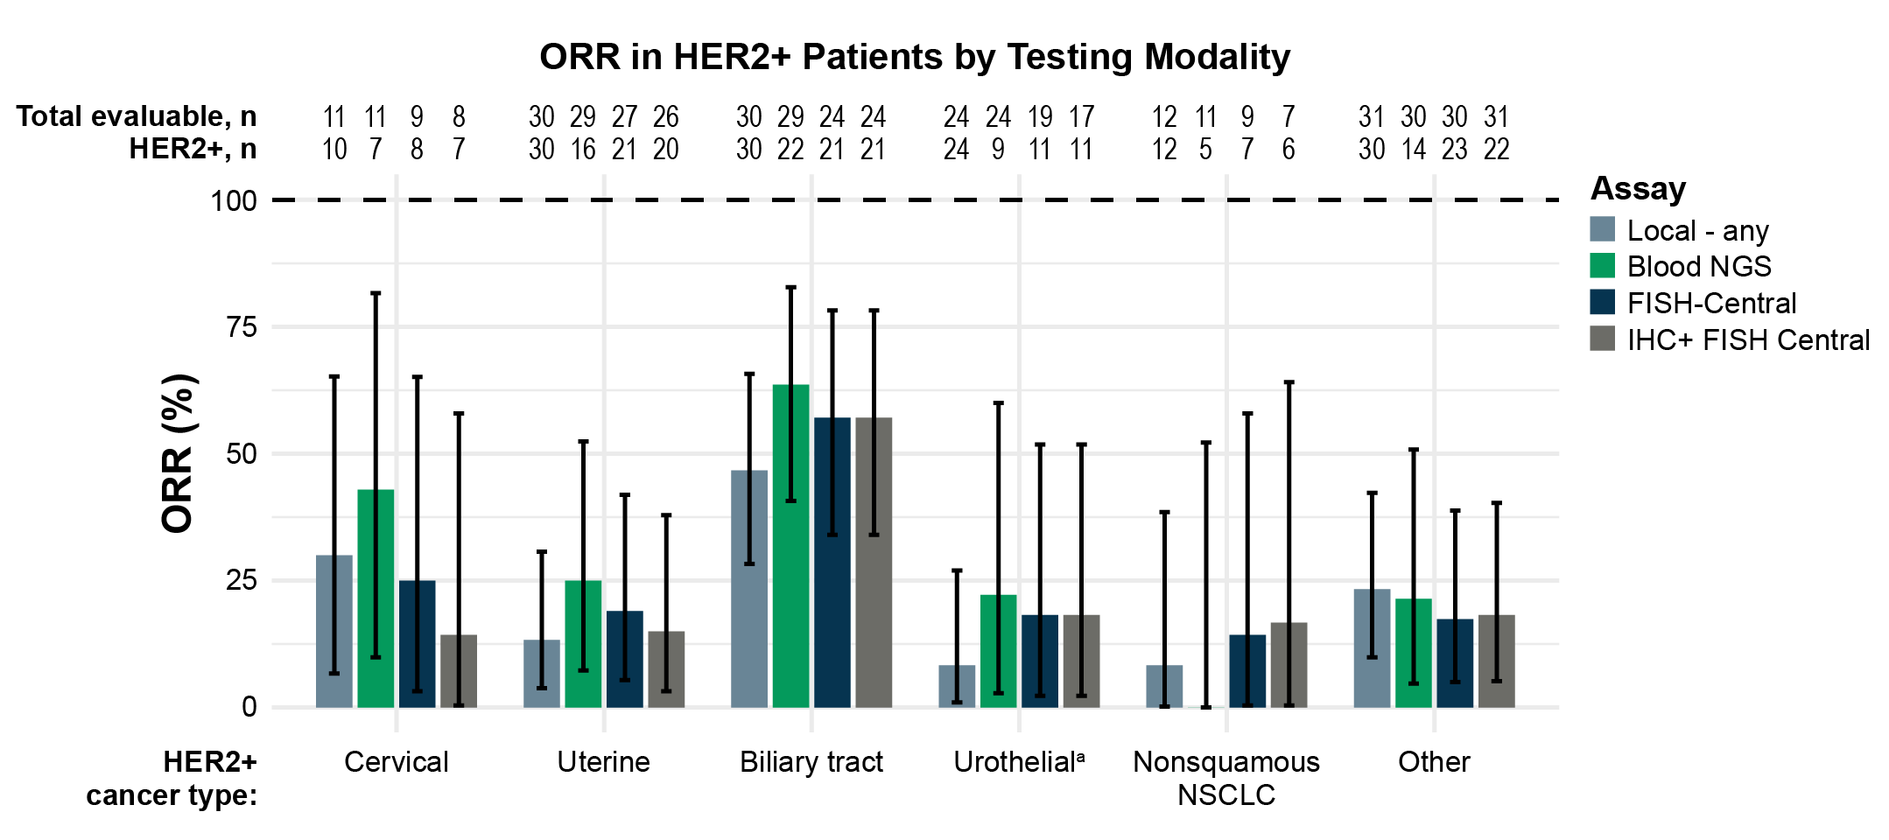
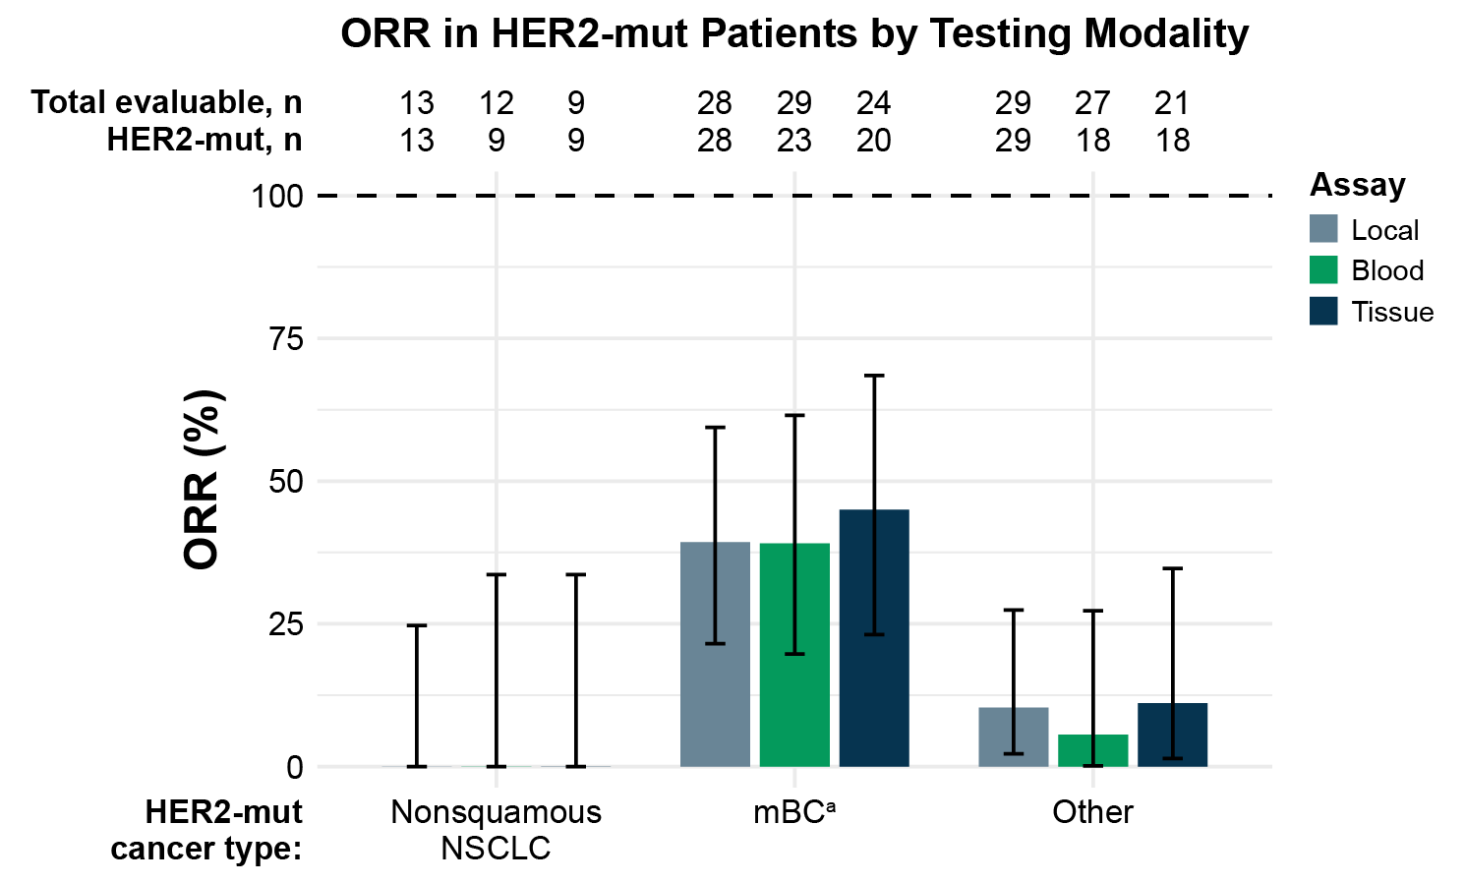
Response by HER2 Testing Modalities
HER2+ Cohorts | ORR varies by tumor type and testing modality Despite lower agreement between local testing and ctDNA, patients who were HER2+ by ctDNA had a similar ORR to those identified by local testing
HER2-mut Cohorts | High consistency in the response rates across different testing methodologies

Slide 11
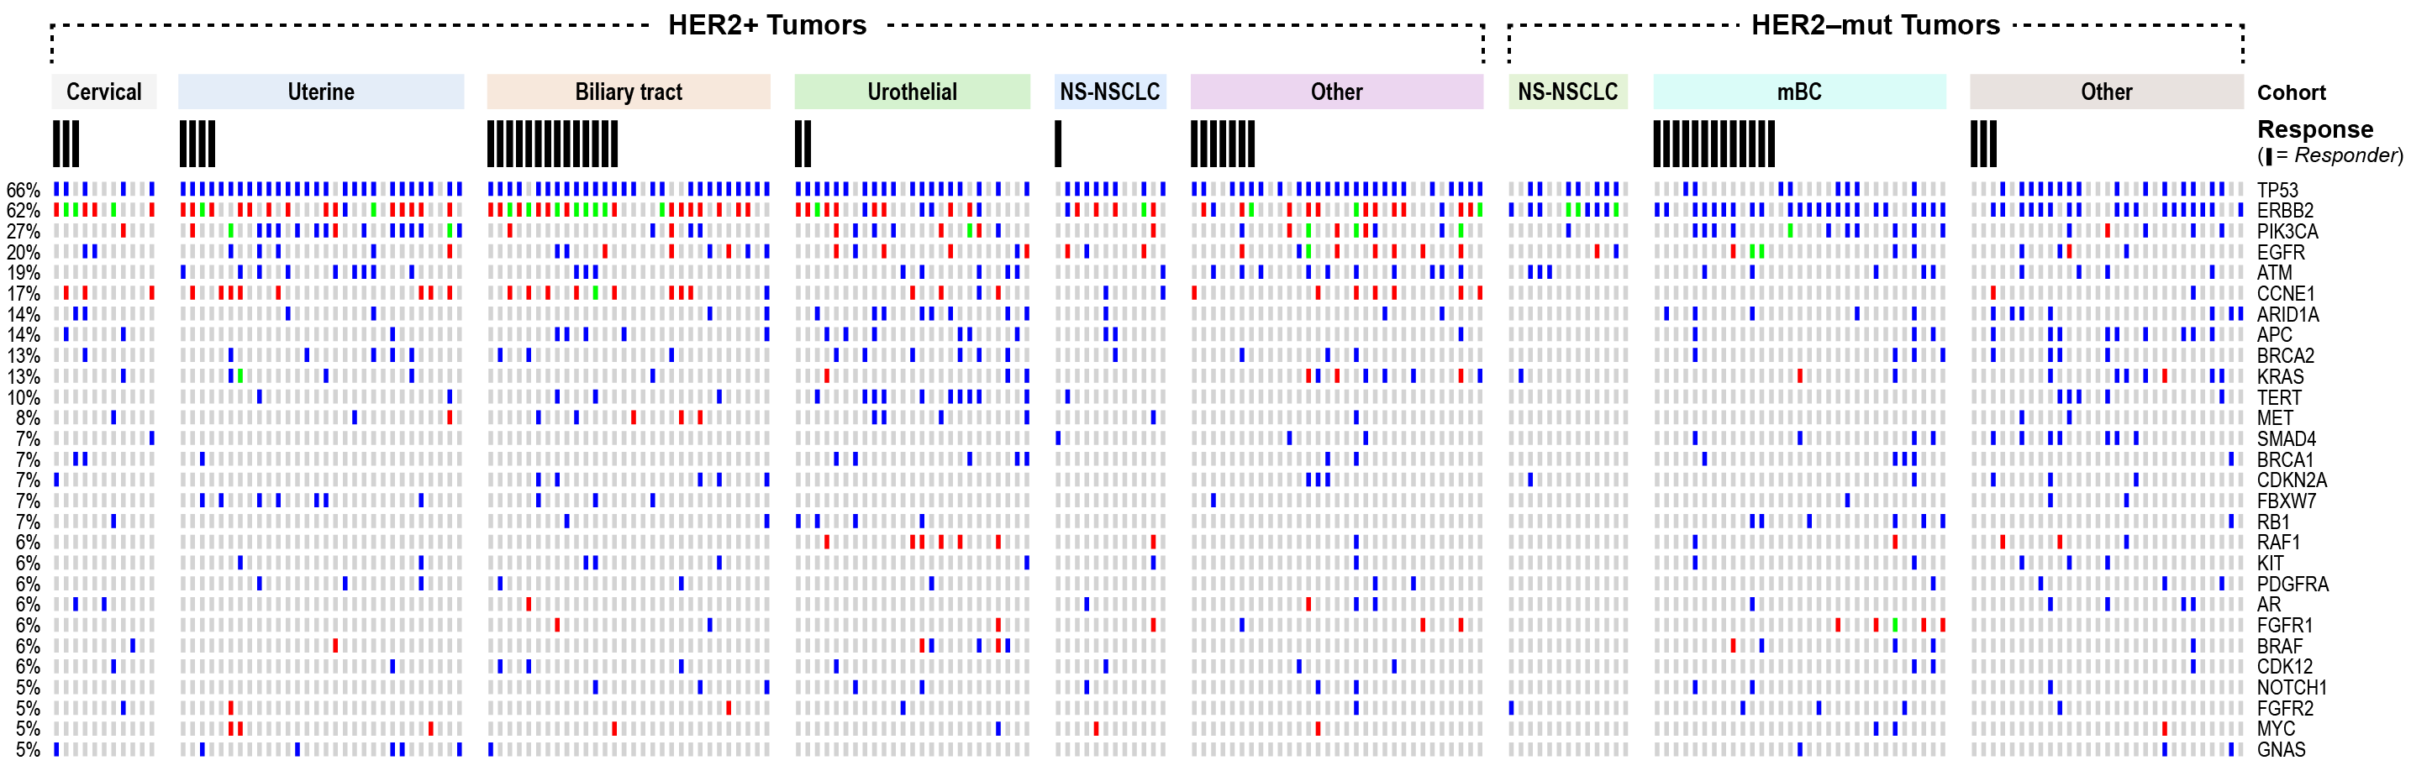
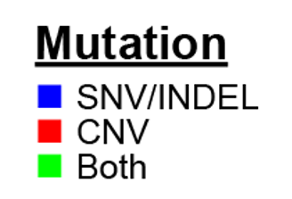
Most Frequently Occurring Genomic Alterationsª
Most common altered genes were TP53^{b}, ERBB2, and PIK3CA
Responses were observed in patients with PIK3CA alterations across multiple tumor types

Slide 12
Response in HER2+ Patients by HER2 Mutation Status
 | Prevalence | Response (ORR)
HER2+ Cohort | HER2-mut prevalence in HER2+ patients (%, n/N) | HER2+ with HER2-mut (%, n/N) | HER2+ without HER2-mut (%, n/N)
Cervical | 42.9% (3/7) | 66.7% (2/3) | 25.0% (1/4)
Uterine | 12.5% (2/16) | 50.0% (1/2) | 21.1% (3/14)
Biliary tract | 36.4% (8/22) | 87.5% (7/8) | 50.0% (7/14)
Urothelial | 11.1% (1/9) | 0% (0/1) | 25.0% (2/8)
Nonsquamous NSCLC | 20.0% (1/5) | 0% (0/1) | 0% (0/4)
Other | 21.4% (3/14) | 33.3% (1/3) | 18.2% (2/11)
Total | 24.7% (18/73) | 61.1% (11/18) | 27.3% (15/55)
Presence of a concomitant HER2 mutation in HER2+ tumors may enhance sensitivity to tucatinib
in combination with trastuzumab

Slide 13
Conclusions
The combination of tucatinib and trastuzumab is a well-tolerated chemotherapy-free regimen in patients with HER2-altered solid tumors
  No new safety signals were identified
  Discontinuations due to TEAEs were uncommon, and no treatment-related TEAEs leading to death were reported
There were variable response rates across tumor types, with clinically meaningful activity in HER2+ biliary tract cancer and HER2-mut mBCª
  HER2+ biliary tract cancer: cORR of 46.7%, median DOR of 6.4 months, and median PFS of 5.5 months
  HER2-mut mBCª: cORR of 41.9%, median DOR of 12.6 months, and median PFS of 9.5 months
Different HER2 testing modalities can be used to identify HER2+ or HER2-mut patients across tumor types who may benefit from treatment with tucatinib and trastuzumab
  Exploratory biomarker findings are limited by small sample size in each cohort, and further investigation is needed​

Slide 14
Acknowledgments
The authors thank the patients who participated in this study, their families, and the investigators and
staff at SGNTUC-019 clinical sites
This study was sponsored by Seagen Inc. (Bothell, WA, USA), which was acquired by Pfizer Inc.
(New York, NY, USA) in December 2023, in collaboration with Merck Sharp & Dohme LLC, a subsidiary
of Merck & Co., Inc. (Rahway, NJ, USA)
Medical writing and editorial support were provided by Diana Avery, PhD, of Oxford PharmaGenesis Inc. and were funded by Pfizer Inc.

