Slide 1
BREAKWATER: Analysis of first-line encorafenib + cetuximab + chemotherapy in BRAF V600E-mutant metastatic colorectal cancer
Scott Kopetz, MD, PhD,¹ Takayuki Yoshino, MD, PhD,² Eric Van Cutsem, MD, PhD,³ Cathy Eng, MD, FACP, FASCO,⁴
Tae Won Kim, MD, PhD,⁵ Harpreet Singh Wasan, MD,⁶ Jayesh Desai, FRACP,⁷ Fortunato Ciardiello, MD, PhD,⁸
Rona Yaeger, MD,⁹ Timothy S. Maughan, MD,¹⁰ Elena Beyzarov, PharmD,¹¹ Xiaoxi Zhang, PhD,¹¹ Graham Ferrier, PhD,¹¹ Xiaosong Zhang, MD, PhD,¹¹ Josep Tabernero, MD, PhD¹²
¹University of Texas MD Anderson Cancer Center, Houston, TX, USA; ²National Cancer Center Hospital East, Kashiwa, Japan; ³University Hospitals Gasthuisberg Leuven and KU Leuven, Leuven, Belgium; ⁴Vanderbilt-Ingram Cancer Center, Nashville, TN, USA; ⁵Asan Medical Center, University of Ulsan College of Medicine, Seoul, South Korea; ⁶Hammersmith Hospital, Division of Cancer, Imperial College London, London, UK; ⁷Peter MacCallum Cancer Centre and the University of Melbourne, Melbourne, VIC, Australia; ⁸University of Campania Luigi Vanvitelli, Naples, Italy; ⁹Memorial Sloan Kettering Cancer Center, New York, NY, USA; ¹⁰University of Liverpool, Liverpool, UK; ¹¹Pfizer, New York, NY, USA;
¹²Vall d’Hebron Hospital Campus and Vall d’Hebron Institute of Oncology (VHIO), University of Vic – Central University of Catalonia, Barcelona, Spain

Slide 2
Declaration of Interests
Dr Kopetz reports the following:
Stock and Other Ownership Interests: Lylon, Lutris, MolecularMatch, Navire
Consulting or Advisory Role: AbbVie, Amal Therapeutics, AstraZeneca/MedImmune, Bayer Health, BicaraTherapeutics, Boehringer Ingelheim, Boston Biomedical, Carina Biotech, Daiichi Sankyo, EMD Serono, Endeavor BioMedicines, Flame Biosciences, Genentech, Gilead Sciences, GSK, HalioDx, Holy Stone Healthcare, Inivata, Ipsen, Iylon, Jacobio, Jazz Pharmaceuticals, Lilly, Lutris, Merck, Mirati Therapeutics, Natera, Novartis, Numab, Pfizer, Pierre Fabre, RedxPharma, Repare Therapeutics, Servier, Xilis
Research Funding: Amgen, Array BioPharma, Biocartis, Daiichi Sankyo, EMD Serono, Genentech/Roche, Guardant Health, Lilly, MedImmune, Novartis, Sanofi

Slide 3
Key Takeaway Points/Conclusions
We present the primary analysis of ORR by BICR (a primary endpoint), an interim OS analysis, and
safety in the encorafenib plus cetuximab with mFOLFOX6 (EC + mFOLFOX6) and SOCª arms:
BREAKWATER showed statistically significant and clinically meaningful benefit in ORR by BICR with EC + mFOLFOX6 in first-line BRAF V600E-mutant mCRC
Data showed a trend for OS improvement with EC + mFOLFOX6 vs SOC; follow-up is ongoing, with planned additional interim and final analyses
EC + mFOLFOX6 was generally tolerable with no substantial increase in chemotherapy dose reduction or discontinuation due to AEs compared with the SOC arm; the most frequently reported TEAEs were consistent with those expected for each of the study drugs
The BREAKWATER study supports EC + mFOLFOX6 as a new first-line SOC for patients with BRAF
V600E-mutant mCRC
These results also formed the basis for the accelerated approval by the FDA (as part of Project FrontRunner) of
EC + mFOLFOX6 for the treatment of patients with BRAF V600E-mutant mCRC—including in the first line setting
ªInvestigator's choice of chemotherapy ± bevacizumab.
AE, adverse event; BICR, blinded independent central review; EC, encorafenib plus cetuximab; FDA, US Food and Drug Administration; mCRC, metastatic colorectal cancer; mFOLFOX6, modified fluorouracil/leucovorin/oxaliplatin; SOC, standard of care; TEAE, treatment-emergent adverse event.

Slide 4
BREAKWATER: Background
BRAF V600E mutations occur in 8% to 12% of mCRC^{1,2}
Encorafenib is a highly selective, ATP-competitive, small molecule BRAF inhibitor with anti-proliferative and apoptotic activity
in tumor cells expressing BRAF V600E and has prolonged pharmacodynamic activity compared with other approved
BRAF inhibitors^{3,4}
Preclinical data have demonstrated the combinatorial benefit of encorafenib, cetuximab, and cytotoxic chemotherapy⁵
Encorafenib plus cetuximab is approved for BRAF V600E-mutant mCRC in second- and later-line settings based on results from the BEACON study (NCT02928224)^{6,7}
First-line chemotherapies with or without a biologic agent have had limited efficacy for BRAF V600E-mutant mCRC⁸
There are currently no first-line activation-pathway targeted treatments indicated for patients with BRAF V600E-mutant mCRC
BREAKWATER (NCT04607421) is a phase 3 study evaluating EC ± mFOLFOX6 vs SOC in previously untreated
BRAF V600E-mutant mCRC
  Data from the safety lead-in portion demonstrated encouraging response rates and PFS of EC with chemotherapy (mFOLFOX6 or FOLFIRI)^{9,10}
EC, encorafenib plus cetuximab; FOLFIRI, fluorouracil/leucovorin/irinotecan; mCRC, metastatic colorectal cancer; mFOLFOX6, modified fluorouracil/leucovorin/oxaliplatin; SOC, standard of care.
1. Tabernero J, et al. Am Soc Clin Oncol Educ Book. 2022;42:254-263. 2. Tran B, et al. Cancer. 2011;117:4623-4632. 3. Delord JP, et al. Clin Cancer Res. 2017;23:5339-5348. 4. Stuart DD, et al. Cancer Res. 2012;72(8_Suppl):3790.
5. Napolitano S et al. Clin Cancer Res. 2023;29:2299-2309. 6. Kopetz S, et al. N Engl J Med. 2019;381:1632-1643. 7. Morris VK, et al. J Clin Oncol. 2023;41:678-700. 8. Cohen R, et al. J Natl Cancer Inst. 2021;113:1386-1395.
9. Kopetz, S. et al. J Clin Onc. 2023;41(4_suppl):119. 10. Tabernero J, et al. Ann Oncol. 2024;35(suppl_2):S428-S481.

Slide 5
BREAKWATER: Study Design
BREAKWATER (NCT04607421) is an open-label, multicenter, phase 3 study in first line BRAF V600E-mutant mCRC
Inclusion criteria
Age ≥16 years (or ≥18 years based on country) No prior systemic treatment for metastatic disease Measurable disease (RECIST 1.1) BRAF V600E-mutant mCRC by local or central laboratory testing ECOG PS 0 or 1 Adequate bone marrow, hepatic, and renal function
EC (n=158)
Dual primary endpoints: PFS and ORR^{d} by BICR (EC + mFOLFOX6 vs SOC)
Key secondary endpoint: OS (EC + mFOLFOX6 vs SOC)
R
1:1:1^{a,b}
N=637
EC + mFOLFOX6 (n=236)
Exclusion criteria
Prior BRAF or EGFR inhibitors Symptomatic brain metastases MSI-H/dMMR tumors (unless patients were ineligible to receive immune checkpoint inhibitors due to a pre-existing medical condition) Presence of a RAS mutation
SOC (n=243)^{c}
Stratified by regions (US/Canada vs Europe
vs Rest of World) and ECOG PS (0 vs 1)
Here we present the primary analysis of ORR by BICR (one of the dual primary endpoints), an interim analysis of OS, and safety in the EC + mFOLFOX6 and SOC arms
ªFollowing a protocol amendment, enrollment to the EC arm was stopped and patients were randomized 1:1 to the EC+mFOLFOX6 or SOC arms; data in the EC arm will be reported at a later date. ^{b}Patients were enrolled between November 16, 2021, and December 22, 2023. ^{c}mFOLFOX6/FOLFOXIRI/CAPOX ± bevacizumab. ^{d}In the first 110 patients in each of the EC+mFOLFOX6 and SOC arms.
CAPOX, capecitabine/oxaliplatin; BICR, blinded independent central review; dMMR, deficient mismatch repair; EC, encorafenib plus cetuximab; ECOG PS, Eastern Cooperative Oncology Group performance status; EGFR, epidermal growth factor receptor; mFOLFOX6, modified fluorouracil/leucovorin/oxaliplatin; FOLFOXIRI, fluorouracil/leucovorin/oxaliplatin/irinotecan; mCRC, metastatic colorectal cancer; MSI-H, microsatellite instability-high cancer; RECIST, Response Evaluation Criteria in Solid Tumors.

Slide 6
BREAKWATER: Statistical Analysis
Dual primary endpoints:
one-sided alpha 0.024
ORR by BICR (n=220):
one-sided alpha 0.001
PFS by BICRª:
one-sided alpha 0.023
Analyzed in the first 110 patients randomized in each of the
EC + mFOLFOX6 and SOC arms
For ORR, the following statistical hypothesis will be tested:
H₀: OR ≤1 vs H₁: OR >1
ORR significant at 0.001?
OS interim:
OS significant at a portion^{b}
of 0.001?
If yes
ªPFS by BICR in all randomized patients will be analyzed once the required number of events has been observed.
^{b}Following a prespecified hierarchical testing procedure to control the family-wise type I error rate, based on the proportion of information fraction observed at the time of the OS
interim analysis.
BICR, blinded independent central review; EC, encorafenib plus cetuximab; H₀, null hypothesis; H₁, alternative hypothesis; mFOLFOX6, modified fluorouracil/leucovorin/oxaliplatin; OR, odds ratio for objective response of EC+mFOLFOX6 vs SOC; SOC, standard of care.

Slide 7
Summary of Disposition
 | EC + mFOLFOX6 | SOCª
 | n=236 | n=243
Duration of treatment, median (range), weeks | 28.1 (1.3-107.4) | 20.4 (1.1-98.3)
Follow-up for OS, median (95% CI), months | 10.3 (8.6-11.6) | 9.8 (7.5-11.3)
Randomized, n (%) | 236 (100) | 243 (100)
Not treated, n (%) | 5 (2.1) | 14 (5.8)
Ongoing treatment, n (%) | 137 (58.1) | 82 (33.7)
Discontinued study treatment, n (%) | 99 (41.9) | 161 (66.3)
AE | 11 (4.7) | 22 (9.1)
Death | 8 (3.4) | 10 (4.1)
Progressive disease | 49 (20.8) | 77 (31.7)
Withdrawal by patient | 13 (5.5) | 28 (11.5)
Global deterioration of health status | 8 (3.4) | 4 (1.6)
Other | 10 (4.2) | 20 (8.2)
Data cutoff: December 22, 2023.
ªmFOLFOX6/FOLFOXIRI/CAPOX ± bevacizumab.
AE, adverse event; CAPOX, capecitabine/oxaliplatin; EC, encorafenib plus cetuximab; mFOLFOX6, modified fluorouracil/leucovorin/oxaliplatin; FOLFOXIRI, fluorouracil/leucovorin/oxaliplatin/irinotecan; SOC, standard of care.

Slide 8
Key Demographic and Baseline Disease Characteristics
 | EC + mFOLFOX6 n=236 | SOC n=243 | Total N=479
Age, median (range), years | 60.0 (24-81) | 62.0 (28-84) | 61.0 (24-84)
Sex, n (%)
Male | 123 (52.1) | 119 (49.0) | 242 (50.5)
Female | 113 (47.9) | 124 (51.0) | 237 (49.5)
ECOG PS, n (%)
0 | 129 (54.7) | 131 (53.9) | 260 (54.3)
1 | 103 (43.6) | 98 (40.3) | 201 (42.0)
Side of tumor, n (%)
Left | 89 (37.7) | 98 (40.3) | 187 (39.0)
Right | 147 (62.3) | 145 (59.7) | 292 (61.0)
No. of organs involved, n (%)ª
≤2 | 122 (51.7) | 129 (53.1) | 251 (52.4)
≥3 | 114 (48.3) | 114 (46.9) | 228 (47.6)
Liver metastases, n (%)ª | 144 (61.0) | 156 (64.2) | 300 (62.6)
CEA at baseline, n (%)
≤5 μg/L | 65 (27.5) | 63 (25.9) | 128 (26.7)
>5 μg/L | 166 (70.3) | 163 (67.1) | 329 (68.7)
CRP at baseline, n (%)
≤10 mg/L | 125 (53.0) | 119 (49.0) | 244 (50.9)
>10 mg/L | 105 (44.5) | 107 (44.0) | 212 (44.3)
Data cutoff: December 22, 2023.
ªBased on BICR.
BICR, blinded independent central review; CEA, carcinoembryonic antigen; CRP, C-reactive protein; EC, encorafenib plus cetuximab; ECOG PS, Eastern Cooperative Oncology Group performance status;
mFOLFOX6, modified fluorouracil/leucovorin/oxaliplatin; SOC, standard of care.

Slide 9
Overview of Response by BICR
Confirmed ORR by BICR
Confirmed Best Overall Response, TTR, and DOR by BICR
Odds ratio (95% CI): 2.443 (1.403-4.253)
One-sided P-value=0.0008
 | EC + mFOLFOX6 n=110 | SOC n=110
Confirmed best overall response, n (%)
CR | 3 (2.7) | 2 (1.8)
PR | 64 (58.2) | 42 (38.2)
SD | 31 (28.2) | 34 (30.9)
Non-CR/non-PD | 3 (2.7) | 4 (3.6)
PD | 3 (2.7) | 9 (8.2)
NE | 6 (5.5) | 19 (17.3)
 | n=67 | n=44
TTR, median (range), weeks | 7.1 (5.7-53.7) | 7.3 (5.4-48.0)
Estimated DOR, median (range), months | 13.9 (8.5-NE) | 11.1 (6.7-12.7)
Patients with a DOR of ≥6 months, n (%) | 46 (68.7) | 15 (34.1)
Patients with a DOR of ≥12 months, n (%) | 15 (22.4) | 5 (11.4)
60.9%
(51.6%-69.5%)
40.0%
(31.3%-49.3%)
Percentage of patients
n=110
n=110
CR
PR
CR
PR
Data cutoff: December 22, 2023.
BICR, blinded independent central review; CR, complete response; DOR, duration of response; EC, encorafenib plus cetuximab; mFOLFOX6, modified fluorouracil/leucovorin/oxaliplatin; NE, not estimable; PD, progressive disease; PR, partial response; SD, stable disease; SOC, standard of care; TTR, time to response.

Slide 10
Subgroup Analysis of ORR by BICR
 | Number of responders/ Number of patients |  | ORR (%) |  |  | Odds ratio (95% CI)
 | EC + mFOLFOX6 | SOC | EC + mFOLFOX6 | SOC
Age
<65 years | 41/64 | 22/61 | 64.1 | 36.1 |  | 3.160 (1.432-7.010)
≥65 years | 26/46 | 22/49 | 56.5 | 44.9 |  | 1.595 (0.658-3.883)
Gender
Male | 36/57 | 20/50 | 63,2 | 40.0 |  | 2.571 (1.099-6.050)
Female | 31/53 | 24/60 | 58.5 | 40.0 |  | 2.114 (0.934-4.803)
ECOG PS at baseline
0 | 37/56 | 26/56 | 66.1 | 46.4 |  | 2.247 (0.981-5.178)
1 | 30/54 | 18/54 | 55.6 | 33.3 |  | 2.500 (1.070-5.880)
Number of organs involved at baseline per BICR
≤2 | 32/58 | 20/58 | 55.2 | 34.5 |  | 2.338 (1.037-5.301)
≥3 | 35/52 | 24/52 | 67.3 | 46.2 |  | 2.402 (1.010-5.758)
Side of tumor
Left | 28/43 | 17/46 | 65.1 | 37.0 |  | 3.184 (1.232-8.313)
Right | 39/67 | 27/64 | 58.2 | 42.2 |  | 1.909 (0.901-4.053)
Liver metastases at baseline per BICR
Yes | 47/69 | 31/71 | 68.1 | 43.7 |  | 2.757 (1.310-5.836)
No | 20/41 | 13/39 | 48.8 | 33.3 |  | 1.905 (0.704-5.210)
Favors SOC
Favors EC + mFOLFOX6
Data cutoff: December 22, 2023.
BICR, blinded independent central review; EC, encorafenib plus cetuximab; ECOG PS, Eastern Cooperative Oncology Group performance status; mFOLFOX6, modified fluorouracil/leucovorin/oxaliplatin; SOC, standard of care.

Slide 11
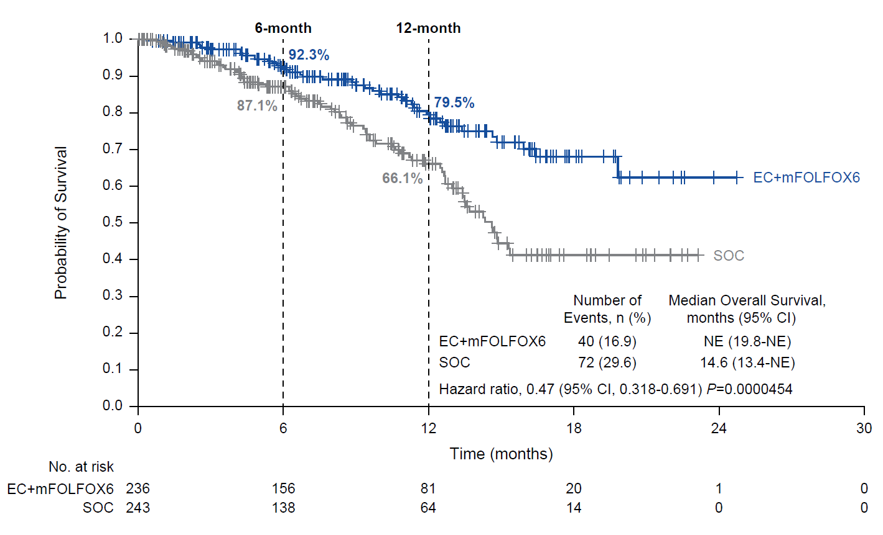
Interim Overall Survivalª
Data cutoff: December 22, 2023.
ªOS was tested following the prespecified plan with one-sided alpha of 0.000000083, calculated as a portion of the nominal one-sided alpha of 0.001. Statistical significance was not achieved at this time.
EC, encorafenib plus cetuximab; mFOLFOX6, modified fluorouracil/leucovorin/oxaliplatin; NE, not estimable; SOC, standard of care.
Notes:
Added P=0.0000454 after HR

Slide 12
Safety Summary
Patients, n (%) | EC + mFOLFOX6 | SOC
 | n=231 | n=228
All causality
TEAE | 230 (99.6) | 223 (97.8)
Grade 3 or 4 TEAE | 171 (74.0) | 139 (61.0)
Grade 5 TEAE | 10 (4.3) | 10 (4.4)
Serious TEAE | 87 (37.7) | 79 (34.6)
TEAE leading to permanent discontinuation of any study treatment | 48 (20.8) | 34 (14.9)
TEAE leading to dose reduction of any study treatment | 141 (61.0) | 109 (47.8)
TEAE leading to dose interruption of any study treatment | 196 (84.8) | 146 (64.0)
Treatment-related
AE related to any drug | 228 (98.7) | 212 (93.0)
Grade 3 or 4 TRAE | 161 (69.7) | 123 (53.9)
Grade 5 TRAE | 0 | 1 (0.4)ª
Serious AE related to any drug | 42 (18.2) | 44 (19.3)
Data cutoff: December 22, 2023.
ªSepsis (preferred term).
AE, adverse event; EC, encorafenib plus cetuximab; mFOLFOX6, modified fluorouracil/leucovorin/oxaliplatin; SOC, standard of care; TEAE, treatment-emergent adverse event; TRAE, treatment-related adverse event.

Slide 13
Most Frequent (≥20%)ª All-Causality TEAEs
EC + mFOLFOX6
SOC
Nausea
Anemia
Diarrhea
Decreased appetite
Vomiting
Neutrophil count decrease
Asthenia
Pyrexia
Peripheral sensory neuropathy
Rash
Fatigue
Neuropathy peripheral
Arthralgia
Neutropenia
Alopecia
Constipation
Grade 1/2
Grade ≥3
Grade 1/2
Grade ≥3
Percentage of patients
Data cutoff: December 22, 2023.
ªFrequency is based on the EC + mFOLFOX6 arm.
EC, encorafenib plus cetuximab; mFOLFOX6, modified fluorouracil/leucovorin/oxaliplatin; SOC, standard of care; TEAE, treatment-emergent adverse event.

Slide 14
Dose Modifications Due to AEs
Patients, n (%) | EC + mFOLFOX6 | SOC
 | n=231 | n=228
Discontinuation
Encorafenib | 27 (11.7) | N/A
Cetuximab | 30 (13.0) | N/A
Other study interventionª | 36 (15.6) | 34 (14.9)
Dose reduction
Encorafenib | 51 (22.1) | N/A
Cetuximab | 14 (6.1) | N/A
Other study interventionª | 129 (55.8) | 109 (47.8)
Dose interruption
Encorafenib | 131 (56.7) | N/A
Cetuximab | 135 (58.4) | N/A
Other study interventionª | 175 (75.8) | 146 (64.0)
Data cutoff: December 22, 2023.
ªIrinotecan, oxaliplatin, leucovorin or levo-leucovorin, fluorouracil, capecitabine, and bevacizumab (as appropriate for the treatment group).
AE, adverse event; EC, encorafenib plus cetuximab; mFOLFOX6, modified fluorouracil/leucovorin/oxaliplatin; N/A, not applicable; SOC, standard of care.

Slide 15
Conclusions
BREAKWATER showed a statistically significant and clinically meaningful benefit in ORR by BICR,
one of the dual primary endpoints, with EC + mFOLFOX6 vs SOC that was rapid and durable
  Data showed a trend for OS improvement with EC + mFOLFOX6 vs SOC; follow-up is ongoing, with planned additional interim and final analyses
EC + mFOLFOX6 was generally tolerable
  There was no substantial increase in chemotherapy dose reduction or discontinuation due to AEs compared with
  the SOC arm
  The most frequently reported TEAEs were consistent with those expected for each of the study drugs
Prespecified analyses of mature PFS and OS data are planned
The BREAKWATER study supports EC + mFOLFOX6 as a new first-line SOC for patients with BRAF V600E-mutant mCRC​
These results also formed the basis for the accelerated approval by the FDA (as part of Project FrontRunner) of EC + mFOLFOX6 for the treatment of patients with BRAF V600E-mutant mCRC—including in the first line setting
EC, encorafenib plus cetuximab; FDA, US Food and Drug Administration; mFOLFOX6, modified fluorouracil/leucovorin/oxaliplatin; SOC, standard of care; TEAE, treatment-emergent adverse event.

Slide 16
Lay Summary
What did this research tell us?
  A larger proportion of patients with metastatic colorectal cancer who have a BRAF V600E mutation in their tumor who received EC + mFOLFOX6 had their tumor shrink after treatment than those who received standard of care
  Patients in the EC + mFOLFOX6 group appeared to live longer after the start of treatment than those in the standard of care group; however, there was a low number of patients who had died at the time of this analysis, and therefore definitive conclusions cannot be made at this time. The researchers will continue to follow patients and assess these results in the future
Who does this research impact?
  People with a type of cancer of the large intestine (also known as the colon and rectum) that is called colorectal cancer that has spread from the large intestine to other parts of the body (metastatic) and has a change in the BRAF gene known as the BRAF V600E mutation
  People who had not received a previous treatment for their metastatic cancer
What does this mean for patients right now?
  EC + mFOLFOX6 is a new standard of care for people with metastatic colorectal with a BRAF V600E mutation

Slide 17


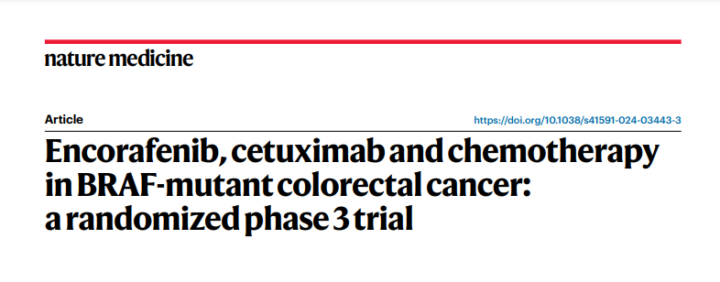
Acknowledgments
The authors thank the participating patients and their families, as well as the staff at the participating sites
We thank Tiziana Usari, Renae Chavira, Ave Mori, Robert Laliberte, Samuel Dychter, Katherine Liau, Kelechi Olu, and
Chin-Hee Chung for their contributions to the BREAKWATER study
BREAKWATER was sponsored by Pfizer and was conducted with support from ONO Pharmaceutical, Merck KGaA, Darmstadt, Germany, and Eli Lilly and Company
Medical writing support was provided by Eleanor Porteous, MSc, of Nucleus Global, an Inizio Company, and was funded by Pfizer
Oral presentation
Plain language summary
Manuscript
Please scan this Quick Response (QR) code with your smartphone to view this oral. Copies of this oral obtained through QR code are for personal use only and may not be reproduced without permission from ASCO® or the authors of this oral.
Please scan this QR Code with your smartphone to view a plain language summary.
https://www.nature.com/articles/s41591-024-03443-3

