Slide 1
EV-302: Exploratory Analysis of Nectin-4 Expression and Response to 1L Enfortumab Vedotin (EV) + Pembrolizumab (P) in Previously Untreated Locally Advanced or Metastatic Urothelial Cancer (la/mUC)
1966MO
Thomas B. Powles,¹ Michiel Van der Heijden,² Shilpa Gupta,³
Begoña Pérez Valderrama,⁴ Matthew D. Galsky,⁵ Jens Bedke,⁶
Eiji Kikuchi,⁷ Jean Hoffman-Censits,⁸ Jose Pablo Maroto Rey,⁹
Christof Vulsteke,¹⁰ Gopakumar Iyer,¹¹ Umang Swami,¹² Sang Joon Shin,¹³ Alejo Rodriguez-Vida,¹⁴ Michele Wozniak,¹⁵ Blanca Homet Moreno,¹⁶
Yi-Tsung Lu,¹⁷ Xuesong Yu,¹⁷ Leah Hogdal,¹⁷ Yohann Loriot¹⁸
¹Barts Cancer Centre, QMUL, London, UK; ²Netherlands Cancer Institute, Amsterdam, Netherlands; ³The Cleveland Clinic, Cleveland, OH, USA; ⁴Hospital Universitario Virgen del Rocio, Seville, Spain; ⁵Mount Sinai Medical Center, New York, NY, USA; ⁶Department of Urology & Eva Meyr-Stihl Cancer Center, Klinikum Stuttgart, Stuttgart, Germany; ⁷St. Marianna University School of Medicine, Kawasaki, Japan; ⁸The Sidney Kimmel Comprehensive Cancer Center, Johns Hopkins Medical Center, Baltimore, MD, USA; ⁹Hospital de la Santa Creu i Sant Paul, Barcelona, Spain; ¹⁰Integrated Cancer Center Ghent, AZ Maria Middelares and Center for Oncological Research (CORE), Antwerp University, Antwerp, Belgium; ¹¹Memorial Sloan Kettering Cancer Center, New York, NY, USA; ¹²Huntsman Cancer Institute, University of Utah, Salt Lake City, UT, USA; ¹³Severance Hospital, Yonsei University Health System, Seoul, South Korea; ¹⁴Hospital del Mar, Barcelona, Spain; ¹⁵Astellas Pharma Inc., Northbrook, IL, USA; ¹⁶Merck & Co., Inc., Rahway, NJ, USA; ¹⁷Pfizer Inc., Bothell, WA, USA; ¹⁸Institut Gustave Roussy, Villejuif, France.
NCT04223856

Slide 2
Declaration of Interests
The authors were responsible for all content and editorial decisions
Prof Tom Powles has the following to disclose:
  Research grants (institution) from Astellas Pharma, AstraZeneca, Bristol-Myers Squibb, Eisai, EMD Serono Inc., Exelixis, F. Hoffmann-La Roche, Gilead Sciences Inc., Ipsen Biopharm Limited, Johnson & Johnson Health Care Systems Inc., Merck, MSD, Novartis, Pfizer, Seagen
  Research grants (individual) from Mashup Communications
  Consultancy/honoraria for Astellas Pharma, AstraZeneca, Bristol-Myers Squibb, Eisai, EMD Serono Inc., Exelixis, F. Hoffmann-La Roche, Gilead Sciences Inc., Incyte Corporation, Ipsen Biopharm Limited, Johnson & Johnson Health Care Systems Inc., Mashup Communications, Merck, MSD, Novartis, Pfizer, Seagen
  Travel and accommodation expenses from AstraZeneca, F. Hoffmann-La Roche, Gilead Sciences Inc, Ipsen Biopharm Limited, Mashup Communications, Merck, MSD, Pfizer
The EV-302 study was funded by Astellas Pharma Inc., Northbrook, IL, USA; Merck Sharp & Dohme LLC, a subsidiary of Merck & Co., Inc., Rahway, NJ, USA; and Seagen Inc., Bothell, WA, USA, which was acquired by Pfizer in December 2023
2

Slide 3
Background
Nectin-4 is a cell-adhesion molecule involved in multiple cellular processes associated with oncogenesis, and is highly expressed on the surface of most UC cells across EV UC clinical trials^{1–9}
Data on the correlation between Nectin-4 expression and response to EV to date are limited to prospective single arm trials and retrospective real-world analyses^{5,6,10,11}
In the phase 3 EV-302 study of patients with previously untreated la/mUC, EV+P nearly doubled median PFS and OS vs chemotherapy (gemcitabine + cisplatin/carboplatin),⁷ and is the new SOC
in la/mUC¹²
  Superior EV+P efficacy vs chemotherapy was consistently demonstrated across prespecified subgroups, including PD-L1 expression (high/low)ª, cisplatin eligibility, and presence/absence
  of liver metastases⁷
EV+P was approved by the EC in August 2024 for the 1L treatment of patients with la/mUC¹³
Here, we explore the relationship between Nectin-4 expression and outcomes using data from the large randomized phase 3 EV-302 study of 1L EV+P
3

Slide 4
Study Design and Methods
EV-302: Global, Open-Label, Randomized, Phase 3 Study⁷
Exploratory Nectin-4 Biomarker Analysis
Retrospective assessment of Nectin-4 expressionª by a CAP/CLIA validated Nectin-4 IHC assay in primary
or metastatic tumor tissue^{b}
  Nectin-4 expression and Nectin-4/PD-L1 expression were available for 800 of 886 randomized patients (EV+P: n=394; chemotherapy: n=406)
  PD-L1 expression status was determined as high (CPS ≥10) or low (CPS <10) using a validated PD-L1 IHC assay^{c}
Clinical efficacy (PFS, OS, and ORR) was assessed in Nectin-4 expression subgroups
ITT Patient Population (N=886)
Previously untreated la/mUC
Eligible for platinum, EV, and P
PD-L(1) inhibitor-naive
GFR ≥30 mL/min
ECOG PS ≤2
EV+P
No maximum treatment
cycles for EV
Maximum 35 cycles for P
Dual primary endpoints:
PFS by BICR
OS
Select secondary endpoints:
ORR per RECIST
1.1 by BICR
and investigator assessment
Safety
R
1:1
Chemotherapy
(Cisplatin or carboplatin + gemcitabine)
Maximum 6 cycles
Stratification factors: cisplatin eligibility (eligible/ineligible), PD-L1 expression (high/low), liver metastases (present/absent)

Slide 5
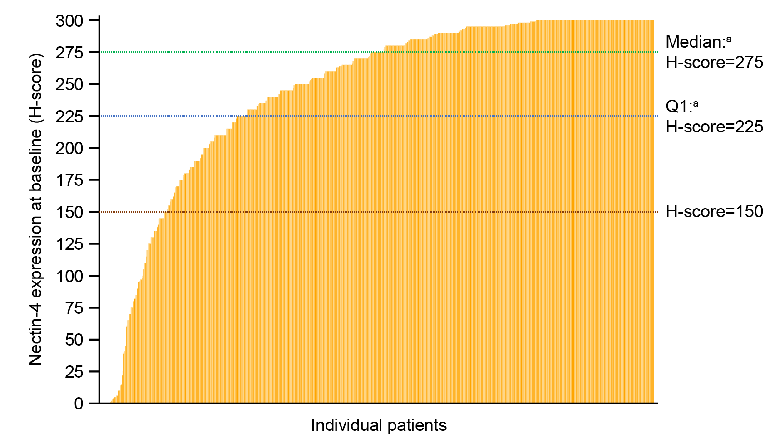
Distribution of Nectin-4 H-Scores Was Skewed Toward High Expression
H-Score of Nectin-4 Expression at Across Both Arms
(N=800)
Variable | EV+P (n=394) | Chemotherapy (n=406)
H-score, median (IQR) | 280 (230-298) | 270 (215-297)
Subgroup, H-score, n (%)
<150 | 38 (9.6) | 50 (12.3)
≥150 to <225 | 50 (12.7) | 56 (13.8)
≥225 | 306 (77.7) | 300 (73.9)
Patients with H-score 0, n (%) | 3 (0.8) | 6 (1.5)
Data cutoff: 8 August 2023.
EV, enfortumab vedotin; IQR, interquartile range; P, pembrolizumab.
ªIncluding all patients across both arms.

Slide 6
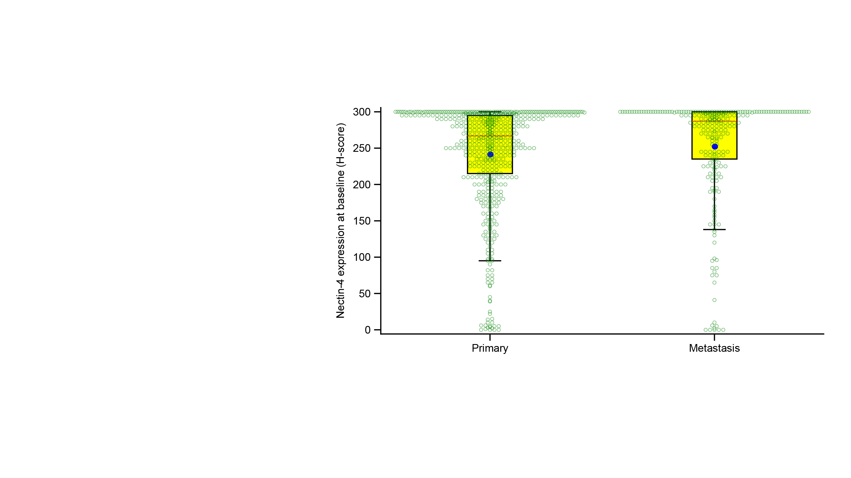
High Nectin-4 H-Scores Were Observed Regardless
of the Biopsy Origin
The majority (69%) of biopsy samples submitted were of primary originª
Median
Mean
Biopsy origin | Primary (n=554) | Metastasis (n=246)
H-score, median (IQR) | 267 (215-295) | 287 (235-300)
Data cutoff: 8 August 2023.
EV, enfortumab vedotin; IQR, interquartile range; la/mUC, locally advanced or metastatic urothelial cancer; P, pembrolizumab.
ªThese are not matched biopsies; one tumor tissue sample was submitted for each patient.

Slide 7
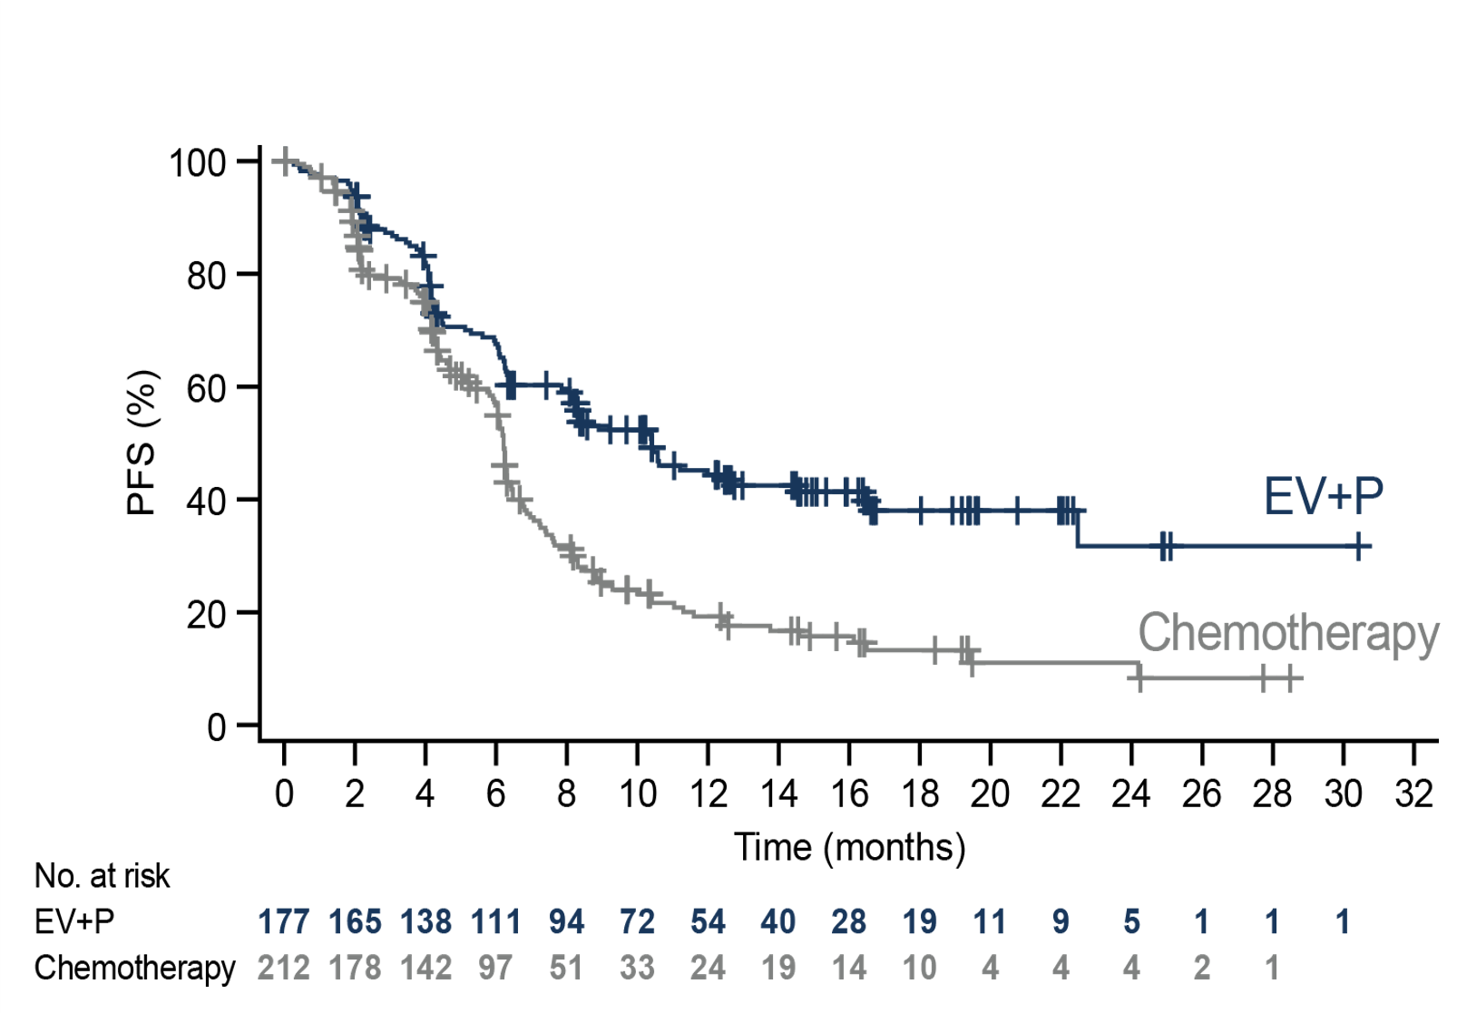
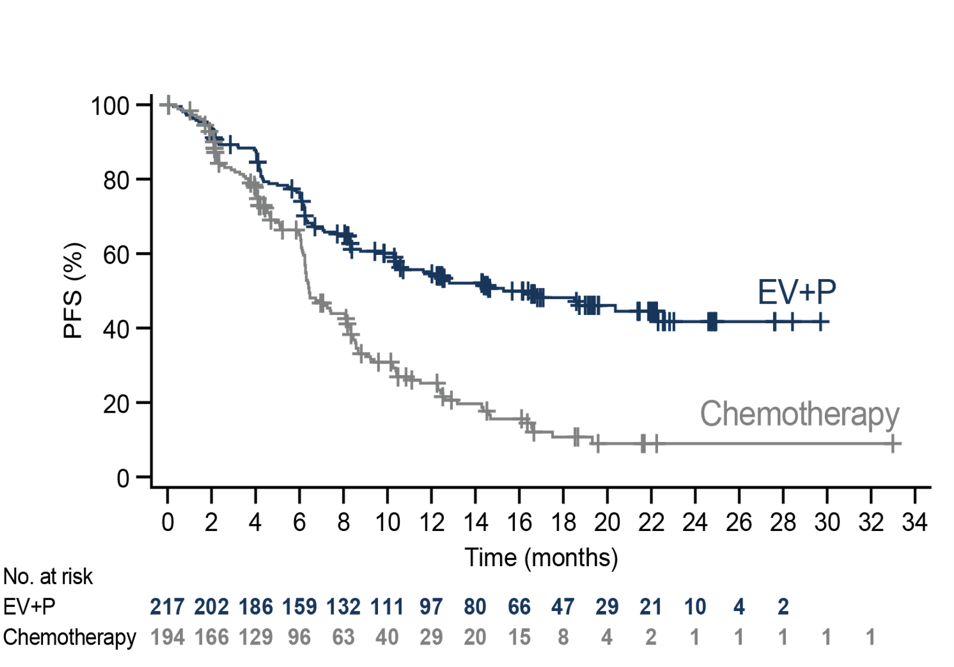
Consistent PFS Benefit With EV+P in Both <275 and ≥275 Nectin-4 H-Score Subgroups
Nectin-4 H-score <275ª
Nectin-4 H-score ≥275ª
 | N | Events | Median (months) | 95% CI | Stratified HR (95% CI)
EV+P | 177 | 95 | 10.4 | (8.2, 14.5) | 0.503 (0.385, 0.657)
Chemotherapy | 212 | 150 | 6.2 | (5.9, 6.4)
 | N | Events | Median (months) | 95% CI | Stratified HR (95% CI)
EV+P | 217 | 106 | 15.3 | (10.5, –) | 0.410 (0.313, 0.537)
Chemotherapy | 194 | 130 | 6.4 | (6.2, 8.1)
Data cutoff: 8 August 2023.
EV, enfortumab vedotin; P, pembrolizumab.
ªThe median Nectin-4 H-score was 275 across patients in both arms.

Slide 8
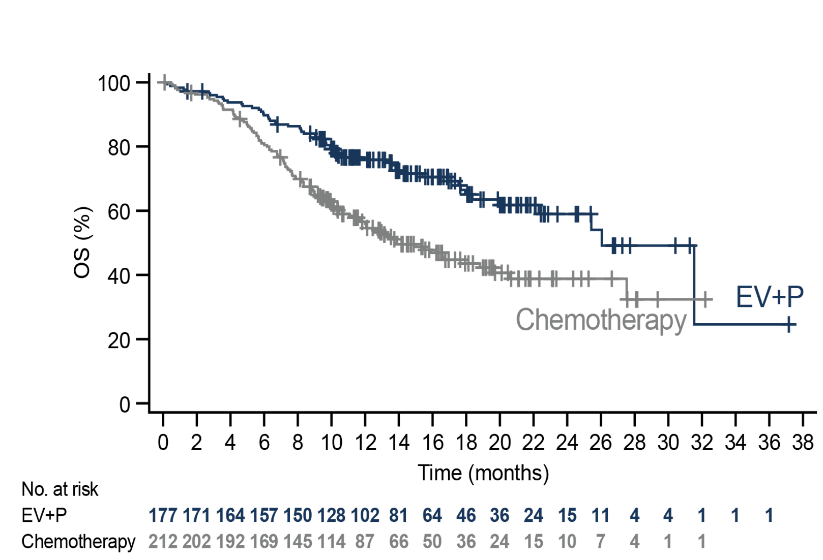
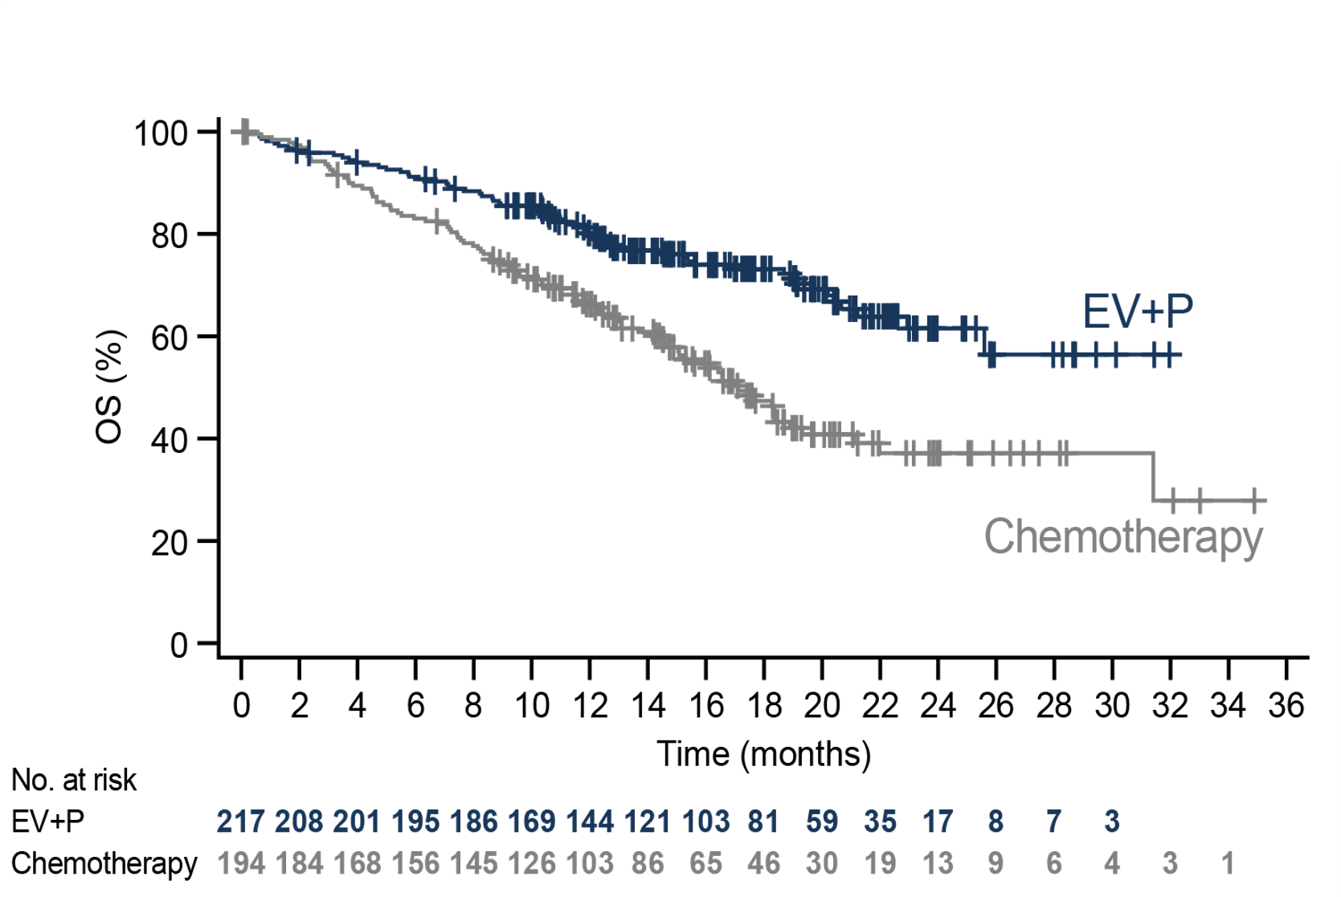
Consistent OS Benefit with EV+P in Both <275 and ≥275 Nectin-4 H-Score Subgroups
Nectin-4 H-score <275ª
Nectin-4 H-score ≥275ª
 | N | Events | Median (months) | 95% CI | Stratified HR (95% CI)
EV+P | 177 | 57 | 26.1 | (22.3, –) | 0.518 (0.372, 0.721)
Chemotherapy | 212 | 108 | 13.9 | (11.6, 19.7)
 | N | Events | Median (months) | 95% CI | Stratified HR (95% CI)
EV+P | 217 | 62 | – | (25.6, –) | 0.426 (0.305, 0.595)
Chemotherapy | 194 | 95 | 17.1 | (14.7, 19.3)
Data cutoff: 8 August 2023.
EV, enfortumab vedotin; P, pembrolizumab.
ªThe median Nectin-4 H-score was 275 across patients in both arms.

Slide 9
Consistent PFS and OS Benefit with EV+P Across
Nectin-4 H-Score Subgroups
PFS
OS
Median PFS, months (event/N)
Median OS, months (event/N)
 | EV+P | Chemotherapy |  | HR (95% CI)
Overall | 12.5 (223/442) | 6.3 (307/444) |  | 0.450 (0.377 to 0.538)
Subgroup, Nectin-4 H-score
<150 | 10.4 (19/38) | 6.2 (34/50) |  | 0.538 (0.290 to 0.998)
≥150 to <225 | 6.3 (34/50) | 6.2 (41/56) |  | 0.680 (0.408 to 1.133)
≥225 | 14.6 (148/306) | 6.4 (205/300) |  | 0.399 (0.320 to 0.497)
 | EV+P | Chemotherapy |  | HR (95% CI)
Overall | 31.5 (133/442) | 16.1 (226/444) |  | 0.468 (0.376 to 0.582)
Subgroup, Nectin-4 H-score
<150 | 18.4 (15/38) | 10.4 (28/50) |  | 0.531 (0.268 to 1.052)
≥150 to <225 | 25.4 (16/50) | 11.8 (32/56) |  | 0.435 (0.220 to 0.857)
≥225 | 31.5 (88/306) | 17.1 (143/300) |  | 0.466 (0.355 to 0.613)
0.1
1
5
0.1
1
5
Favors EV+P
Favors chemotherapy
Favors EV+P
Favors chemotherapy
The size of diamonds is relative to the size of the population in each subgroup.
Data cutoff: 8 August 2023.
EV, enfortumab vedotin; P, pembrolizumab.

Slide 10
Consistent ORR Benefit with EV+P Across All
Nectin-4 Subgroups
Nectin-4 H-score, median (IQR) | EV+P n=437 | Chemotherapy n=441
Responders^{b} | 284.5 (240-300) | 280 (225-300)
Non-responders^{b} | 270 (210-295) | 265 (210-295)
ORRª (%)
n=437
n=441
n=173
n=210
n=216
n=193
n=38
n=50
n=50
n=56
n=301
n=297
 | Overall population |  | H-score <275^{c} |  | H-score ≥275^{c} |  | H-score <150 |  | H-score ≥150 to <225 |  | H-score ≥225
Data cutoff: 8 August 2023.
CR, complete response; EV, enfortumab vedotin; IQR, interquartile range; P, pembrolizumab; PR, partial response; RECIST, Response Evaluation Criteria in Solid Tumors.
ªBest overall response according to RECIST 1.1. CR or PR were confirmed with repeat scans ≥28 days after initial response.
^{b}With Nectin-4 expression data available.
^{c}The median Nectin-4 H-score was 275 across patients in both arms.

Slide 11
Nectin-4 and PD-L1 Expression Distribution
 | EV+P (N=442) |  | Chemotherapy (N=444)
 | PD-L1 Low (CPS <10)ª n=184 | PD-L1 High (CPS ≥10)ª n=254 | PD-L1 Low (CPS <10)ª n=185 | PD-L1 High (CPS ≥10)ª n=254
Nectin-4 H-score, n (%)
<275^{b} | 70 (15.8) | 107 (24.2) | 86 (19.4) | 126 (28.4)
≥275^{b} | 97 (21.9) | 120 (27.1) | 84 (18.9) | 109 (24.5)
Missing | 17 (3.8) | 27 (6.1) | 15 (3.4) | 19 (4.3)
Data cutoff: 8 August 2023.
CPS, combined positive score; EV, enfortumab vedotin; P, pembrolizumab; PD-L1, programmed death ligand 1.
ªCPS was calculated by the number of PD-L1 staining cells (tumor cells, lymphocytes, macrophages) divided by the total number of viable tumor cells, multiplied by 100;
PD-L1 low was defined as CPS <10, and PD-L1 high was defined as CPS ≥10.
^{b}The median Nectin-4 H-score was 275 across patients in both arms.

Slide 12
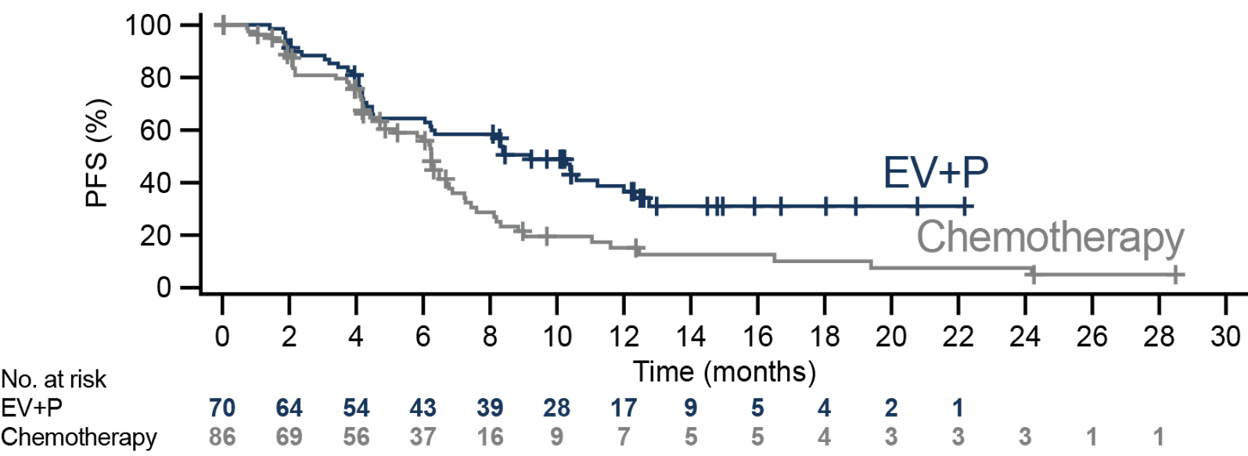
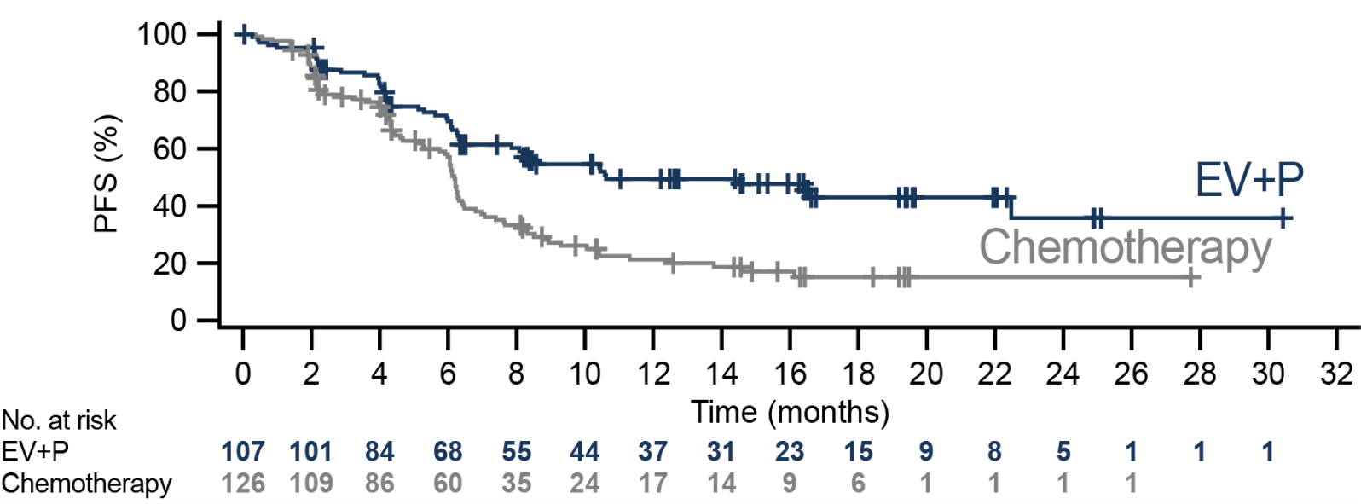
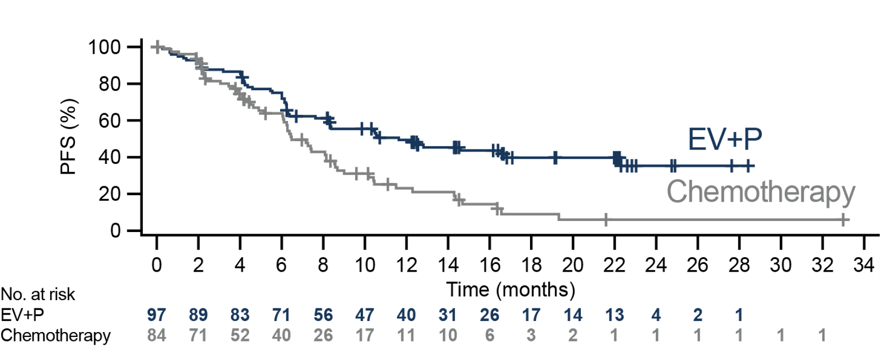
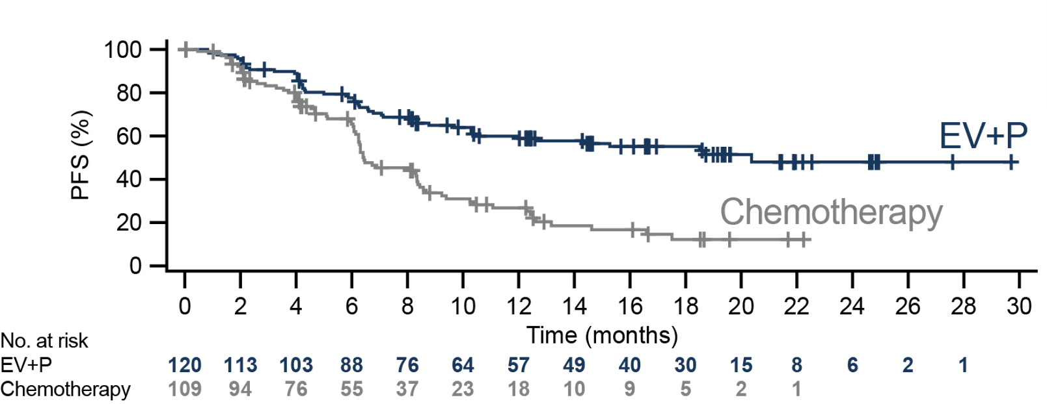
Consistent PFS Benefit with EV+P Across Nectin-4
and PD-L1 Subgroups
Nectin-4 H-score <275ª / PD-L1 Low^{b}
Nectin-4 H-score <275ª / PD-L1 High^{c}
 | N | Events | Median (months) | 95% CI | Stratified HR (95% CI)
EV+P | 70 | 42 | 9.2 | (6.2, 12.0) | 0.543 (0.359, 0.820)
Chemotherapy | 86 | 60 | 6.2 | (4.9, 6.8)
 | N | Events | Median (months) | 95% CI | Stratified HR (95% CI)
EV+P | 107 | 53 | 10.6 | (8.1, –) | 0.476 (0.334, 0.677)
Chemotherapy | 126 | 90 | 6.2 | (5.7, 6.4)
Nectin-4 H-score ≥275ª / PD-L1 Low^{b}
Nectin-4 H-score ≥275ª / PD-L1 High^{c}
 | N | Events | Median (months) | 95% CI | Stratified HR (95% CI)
EV+P | 97 | 54 | 11.6 | (8.2, 22.3) | 0.463 (0.311, 0.688)
Chemotherapy | 84 | 57 | 6.5 | (6.0, 8.1)
 | N | Events | Median (months) | 95% CI | Stratified HR (95% CI)
EV+P | 120 | 52 | 20.4 | (12.0, –) | 0.373 (0.258, 0.539)
Chemotherapy | 109 | 72 | 6.4 | (6.2, 8.3)
Data cutoff: 8 August 2023.
CPS, combined positive score; EV, enfortumab vedotin; P, pembrolizumab; PD-L1, programmed death ligand 1.
ªThe median Nectin-4 H-score was 275 across patients in both arms. ^{b}CPS <10. ^{c}CPS ≥10.
12

Slide 13
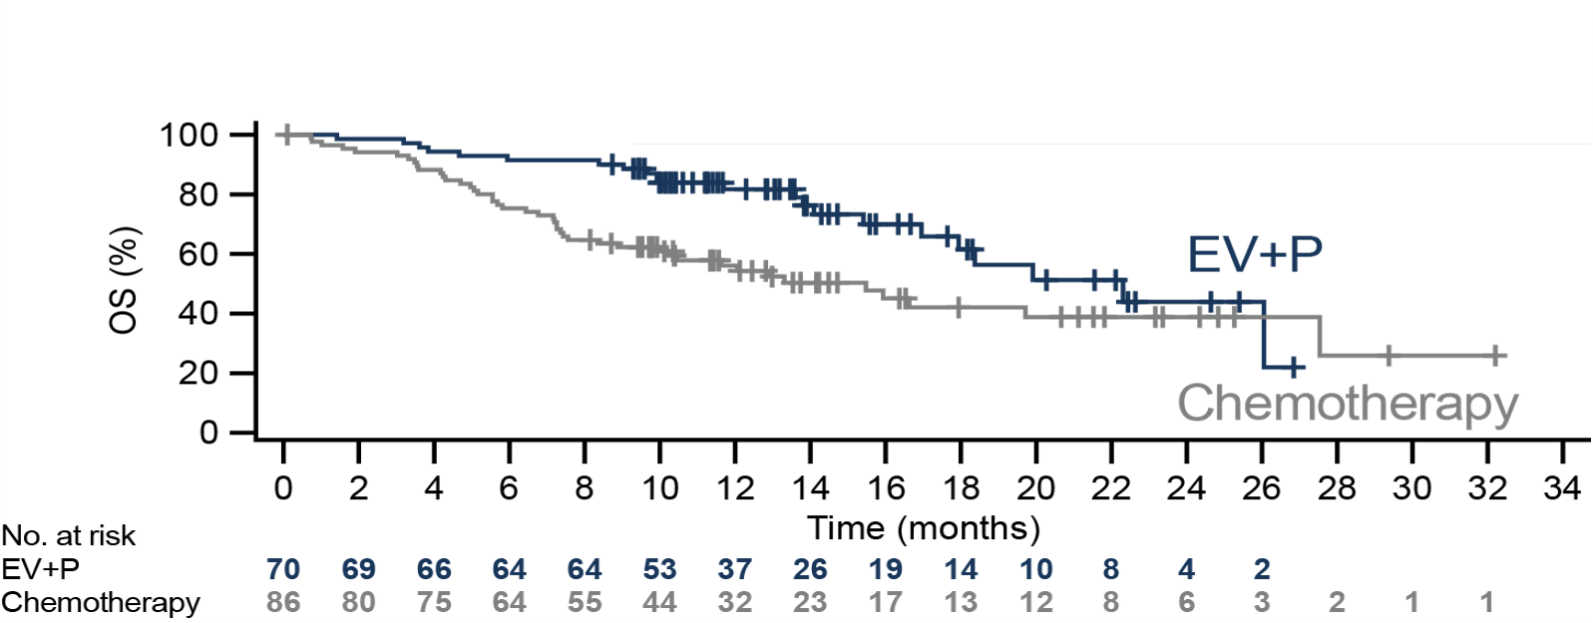
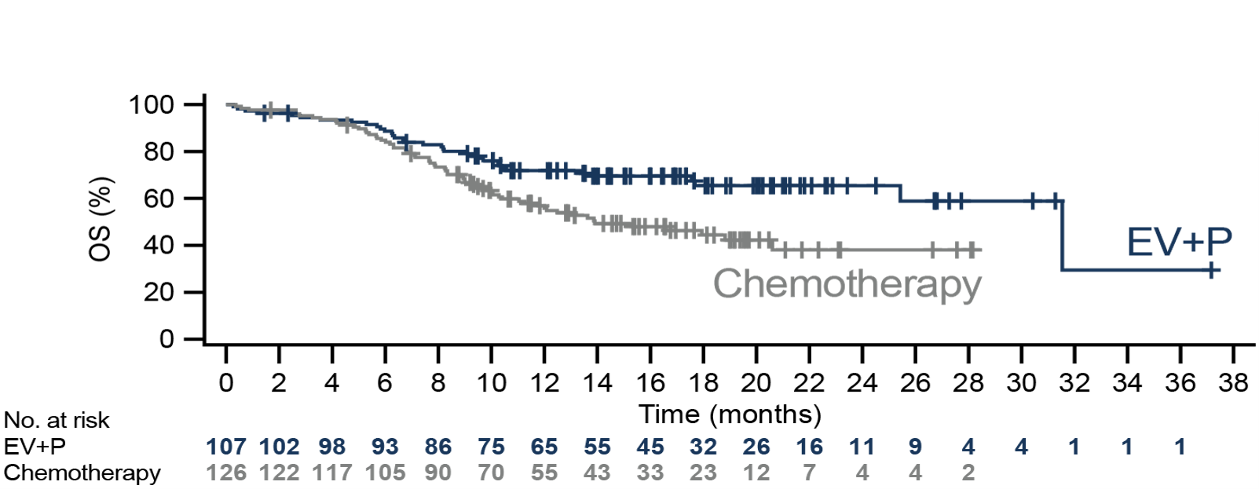
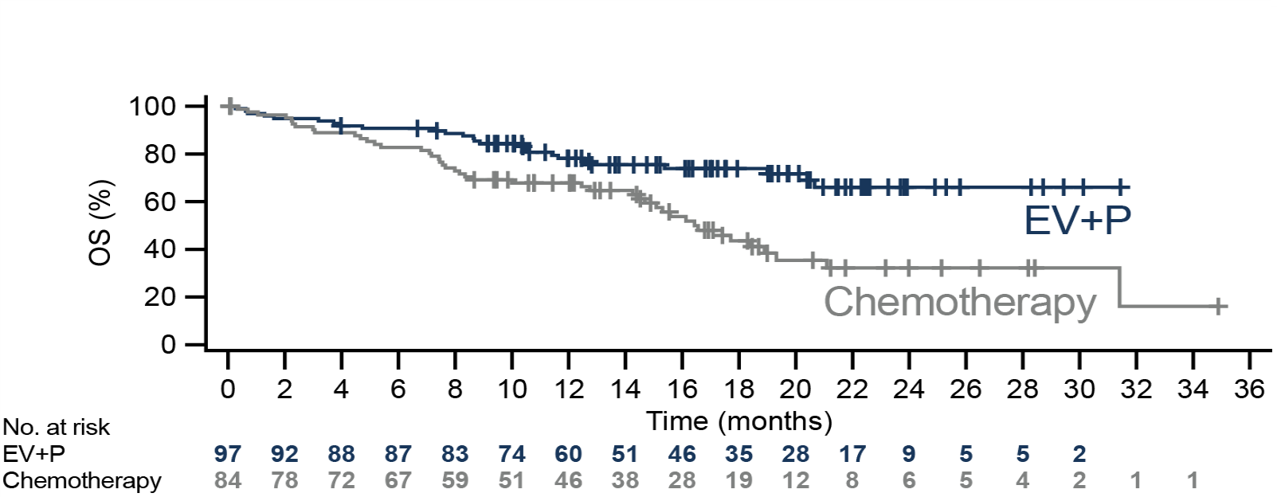
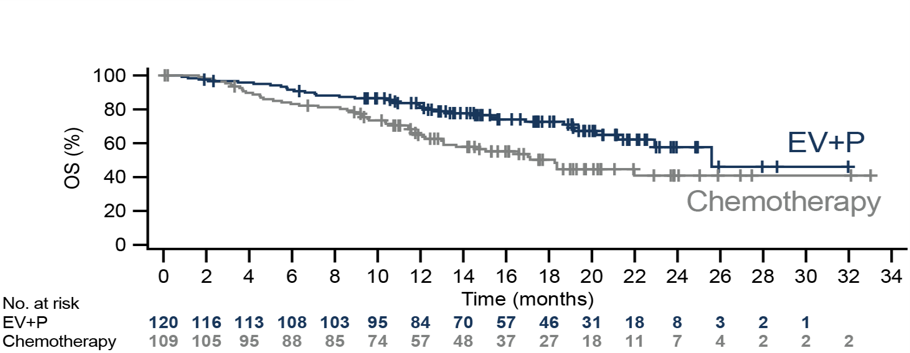
Consistent OS Benefit with EV+P Across Nectin-4
and PD-L1 Subgroups
Nectin-4 H-score <275ª / PD-L1 Low^{b}
Nectin-4 H-score <275ª / PD-L1 High^{c}
 | N | Events | Median (months) | 95% CI | Stratified HR (95% CI)
EV+P | 70 | 22 | 22.3 | (17.0, –) | 0.522 (0.310, 0.880)
Chemotherapy | 86 | 44 | 15.5 | (10.1, 27.5)
 | N | Events | Median (months) | 95% CI | Stratified HR (95% CI)
EV+P | 107 | 35 | 31.5 | (25.4, –) | 0.516 (0.337, 0.790)
Chemotherapy | 126 | 64 | 13.9 | (11.0, 20.6)
Nectin-4 H-score ≥275ª / PD-L1 Low^{b}
Nectin-4 H-score ≥275ª / PD-L1 High^{c}
 | N | Events | Median (months) | 95% CI | Stratified HR (95% CI)
EV+P | 97 | 26 | – | (–, –) | 0.410 (0.250, 0.675)
Chemotherapy | 84 | 44 | 16.4 | (14.5, 19.3)
 | N | Events | Median (months) | 95% CI | Stratified HR (95% CI)
EV+P | 120 | 36 | 25.6 | (21.2, –) | 0.438 (0.279, 0.688)
Chemotherapy | 109 | 51 | 18.3 | (13.1, –)
Data cutoff: 8 August 2023.
CPS, combined positive score; EV, enfortumab vedotin; P, pembrolizumab; PD-L1, programmed death ligand 1.
ªThe median Nectin-4 H-score was 275 across patients in both arms. ^{b}CPS <10. ^{c}CPS ≥10.
13

Slide 14
Conclusions
Nectin-4 is highly expressed in nearly all available EV-302 patient tumor samples and shows consistency between primary and metastatic sites of origin
This is the first comprehensive assessment to demonstrate a consistent benefit of EV+P vs chemotherapy across all Nectin-4 subgroups and evaluated endpoints (PFS, OS, and ORR)
The observed benefit of EV+P remains regardless of Nectin-4 expression and PD-L1 status
These data further establish EV+P as the SOC in 1L across the overall la/mUC population and evaluated subgroups, and confirm that testing for Nectin-4 expression or PD-L1 status is not required
14

Slide 15
References
Heath EI & Rosenberg JE. Nat Rev Urol. 2021;18(2):93-103.
Challita-Eid PM, et al. Cancer Res. 2016;76(10):3003-13.
Rosenberg J, et al. J Clin Oncol. 2020;38(10):1041-49.
Rosenberg J, et al. J Clin Oncol. 2019;37(29):2592-600.
O'Donnell PH, et al. J Clin Oncol. 2023;41(25):4107-17.
Hoimes CJ, et al. J Clin Oncol. 2022;41(1):22-31.
Powles T, et al. N Engl J Med. 2024;390(10):875-88.
Powles T, et al. N Engl J Med. 2021;382(12):1125-35.
Rodler S, et al. Cancers (Basel). 2022;14(18):441.
Klümper N, et al. Clin Cancer Res. 2023;29(8):1496-505.
Klümper N, et al. J Clin Oncol. 2024;42(20):2446-55.
Powles T, et al. Ann Oncol. 2024;35(6):485-90.
Astellas. European Commission Approves Astellas’ PADCEVTM (enfortumab vedotin) in Combination with KEYTRUDA® (pembrolizumab) for First-Line Treatment of Advanced Urothelial Cancer. Accessed Aug 29, 2024. https://www.astellas.com/en/news/29371.
15

Slide 16
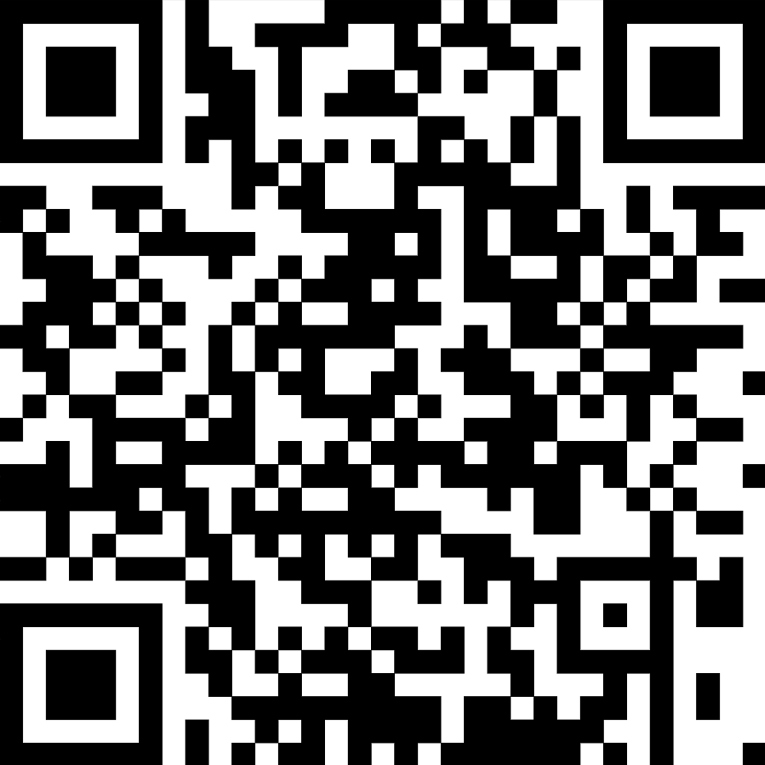
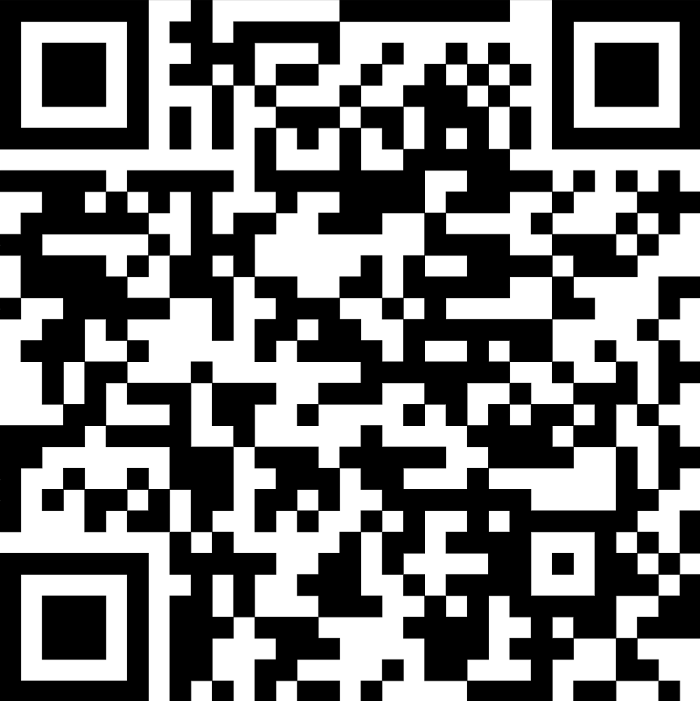
Acknowledgments
The authors would like to thank participants and their families, as well as all the staff at the participating sites
The EV-302 study (NCT04223856) was funded by Astellas Pharma Inc., Northbrook, IL, USA; Merck Sharp & Dohme LLC, a subsidiary of Merck & Co., Inc., Rahway, NJ, USA; and Seagen Inc., Bothell, WA, USA, which was acquired by Pfizer in December 2023
The authors would like to thank Keith Earley of Pfizer for his contribution to data analysis strategy and interpretation. Medical writing support was provided by Ed Carter, MSc, of Nucleus Global, an Inizio Company, and was funded by Pfizer and Astellas Pharma Inc
Presentation
Abstract PLS
Copies of this presentation obtained through the Quick Response (QR) code are for personal use only and may not be reproduced without permission from the author of this poster.
Please scan this QR Code with your smartphone to view a plain language summary.
16

