Slide 1
423RO
Addition of tucatinib to trastuzumab emtansine (T-DM1) in patients with previously treated HER2+ locally advanced/metastatic breast cancer (LA/MBC): updated efficacy analysis from the HER2CLIMB-02 trial
Giuseppe Curigliano,^{1,2} Virginia F. Borges,³ Joyce O’Shaughnessy,⁴ Alicia Okines,^{5,6} Sara M. Tolaney,⁷ Cristina Saura,⁸ Antonio C. Wolff,⁹ Sherene Loi,¹⁰ Norikazu Masuda,¹¹ Linda Vahdat,¹² Binghe Xu,¹³ Danica Chiu,¹⁴ Diqiong Xie,¹⁵ Nissa Abbasi,¹⁶ Kelechi Olu,¹⁷ Sara A. Hurvitz¹⁸
¹European Institute of Oncology, IRCCS, Milano, Italy; ²Department of Oncology and Hematology-Oncology, University of Milano, Milano, Italy; ³University of Colorado Cancer Center, Aurora, CO, USA; ⁴Baylor University Medical Center, Texas Oncology, US Oncology, Dallas, TX, USA; ⁵The Royal Marsden NHS Foundation Trust, London, UK; ⁶The Institute of Cancer Research, London, UK; ⁷Dana-Farber Cancer Institute, Boston, MA, USA; ⁸Vall d’Hebron University Hospital, Vall d’Hebron Institute of Oncology (VHIO), Barcelona, Spain; ⁹Sidney Kimmel Comprehensive Cancer Center, Johns Hopkins, Baltimore, MD, USA; ¹⁰Peter MacCallum Cancer Centre, Melbourne, Australia;¹¹Graduate School of Medicine, Kyoto University, Kyoto, Japan; ¹²Dartmouth Health, Lebanon, NH, USA; ¹³Cancer Hospital, Chinese Academy of Medical Sciences, Beijing, China; ¹⁴Pfizer Inc, London, UK; ¹⁵Pfizer Inc, Washington DC, USA; ¹⁶Pfizer Inc, Seattle, WA, USA; ¹⁷Pfizer AG, Zurich, Switzerland; ¹⁸Fred Hutchinson Cancer Center, University of Washington, Seattle, WA, USA
6-8 May 2026

Slide 2
DECLARATION OF INTERESTS
Giuseppe Curigliano
Consulting fees from Roche, Novartis, Lilly, Pfizer, Astra Zeneca, Daiichi Sankyo, Exact Science, Merck, BMS, Gilead, Sanofi, Menarini, Merck
Support for attending meetings and/or travel from Daiichi Sankyo
This study was sponsored by Seagen, which was acquired by Pfizer Inc in December 2023.

Slide 3
BACKGROUND
Most patients with HER2+ locally advanced/metastatic breast cancer (LA/MBC) ultimately experience disease progression, and approximately half of them will develop brain metastases (BM).^{1 ,2}
Tucatinib is a highly selective HER2-directed TKI indicated for patients with previously treated
HER2+ LA/MBC, including patients with BM.
Preclinical data have shown that the combination of tucatinib and T-DM1 results in enhanced antitumor activity compared with either agent alone.³
In the primary analysis of HER2CLIMB-02 (median follow-up: 24.4 months), tucatinib added to T-DM1 significantly improved PFS in previously treated HER2+ LA/MBC, including in patients with BM, with a safety profile consistent with the established adverse event profiles of each drug.⁴
  Median PFS of 9.5 vs 7.4 months for tucatinib vs placebo, combined with T-DM1;
  HR = 0.76 (95% CI, 0.61−0.95), P = 0.0163.
Here, we report updated efficacy outcomes from HER2CLIMB-02.
HER2+, human epidermal growth factor receptor 2 positive; PFS, progression-free survival; T-DM1, trastuzumab emtansine; TKI, tyrosine kinase inhibitor.
1. Wen X, et al. Crit Rev Oncol Hematol. 2026;221:105179. 2. Lin NU, et al. Lancet Oncol. 2013;14:185-186. 3. Olson D, et al. Cancer Res Commun. 2023;3(9):1927-1939.
4. Hurvitz, SA, et al. Ann Oncol. 2026;37(3):341-352.

Slide 4
STUDY DESIGN
HER2CLIMB-02 (NCT03975647) is a randomized, double-blind, placebo-controlled, phase 3 trial assessing the efficacy and safety of tucatinib versus placebo, combined with T-DM1 in patients with HER2+ LA/MBC.
Treatments
Endpoints
Tucatinib (300 mg orally BID)
+
T-DM1
(3.6 mg/kg IV every 21 days)
(n = 228)
Primary
PFS per investigator assessment
Secondary
  OS
  PFS & OS in BM subgroup
  Tumor response
  PFS per BICR
  Safety
Other
  Subsequent systemic anticancer therapies
Key eligibility criteria
≥ 18 years of age
Centrally confirmed HER2+ LA/MBC
Prior treatment with trastuzumab and a taxane
Patients with BM were permitted
R
1:1
Placebo (orally BID)
+
T-DM1
(3.6 mg/kg IV every 21 days)
(n = 235)
Stratification factors
LOT for metastatic disease (1L or other)
HR status (positive or negative)
Presence/history of BM (yes or no)
ECOG PS (0 or 1)
1L, first-line: BICR, blinded independent central review; BID, twice a day; BM, brain metastases; ECOG PS, Eastern Cooperative Oncology Group performance status, HER2+, human epidermal growth factor receptor 2-positive; HR+, hormone receptor-positive; IV, intravenous; LA/MBC, locally advanced/metastatic breast cancer; LOT, line of treatment; OS, overall survival; PFS, progression-free survival;
R, randomization; T-DM1, trastuzumab emtansine.

Slide 5
DEMOGRAPHICS AND BASELINE DISEASE CHARACTERISTICS
Arm | TUC + T-DM1 (n = 228) | PBO + T-DM1 (n = 235)
Median age, years (range) | 55.0 (26−83) | 53.0 (27−82)
Female sex, n (%) | 226 (99.1) | 235 (100)
Presence of history of brain metastases, n (%) | 99 (43.4) | 105 (44.7)
Active | 50 (21.9) | 57 (24.3)
Untreated | 15 (6.6) | 25 (10.6)
Treated, progressive | 35 (15.4) | 32 (13.6)
Treated stable | 49 (21.5) | 48 (20.4)
HR+ status, n (%) | 137 (60.1) | 140 (59.6)
ECOG performance status, n (%)
0 | 137 (60.1) | 141 (60.0)
1 | 91 (39.9) | 94 (40.0)
Stage IV at initial diagnosis, n (%) | 103 (45.2) | 98 (41.7)
ECOG, Eastern Cooperative Oncology Group; HR+, hormone receptor-positive; PBO, placebo; T-DM1, trastuzumab emtansine; TUC, tucatinib.

Slide 6
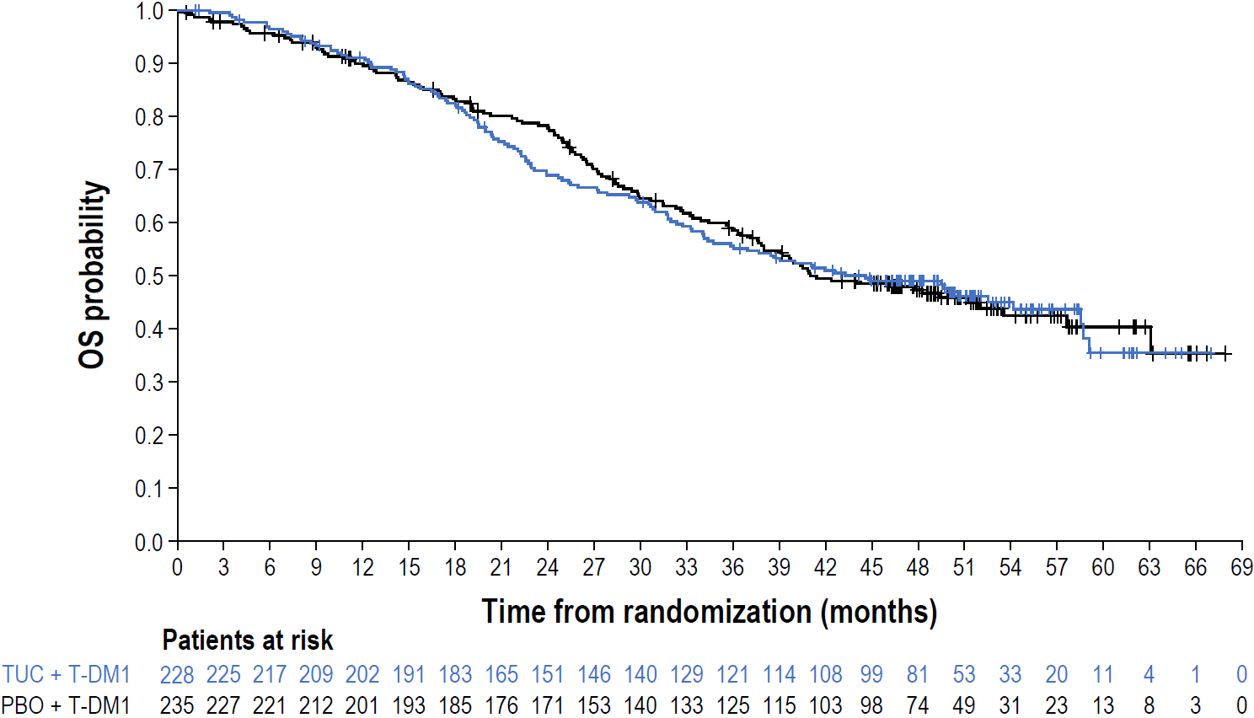
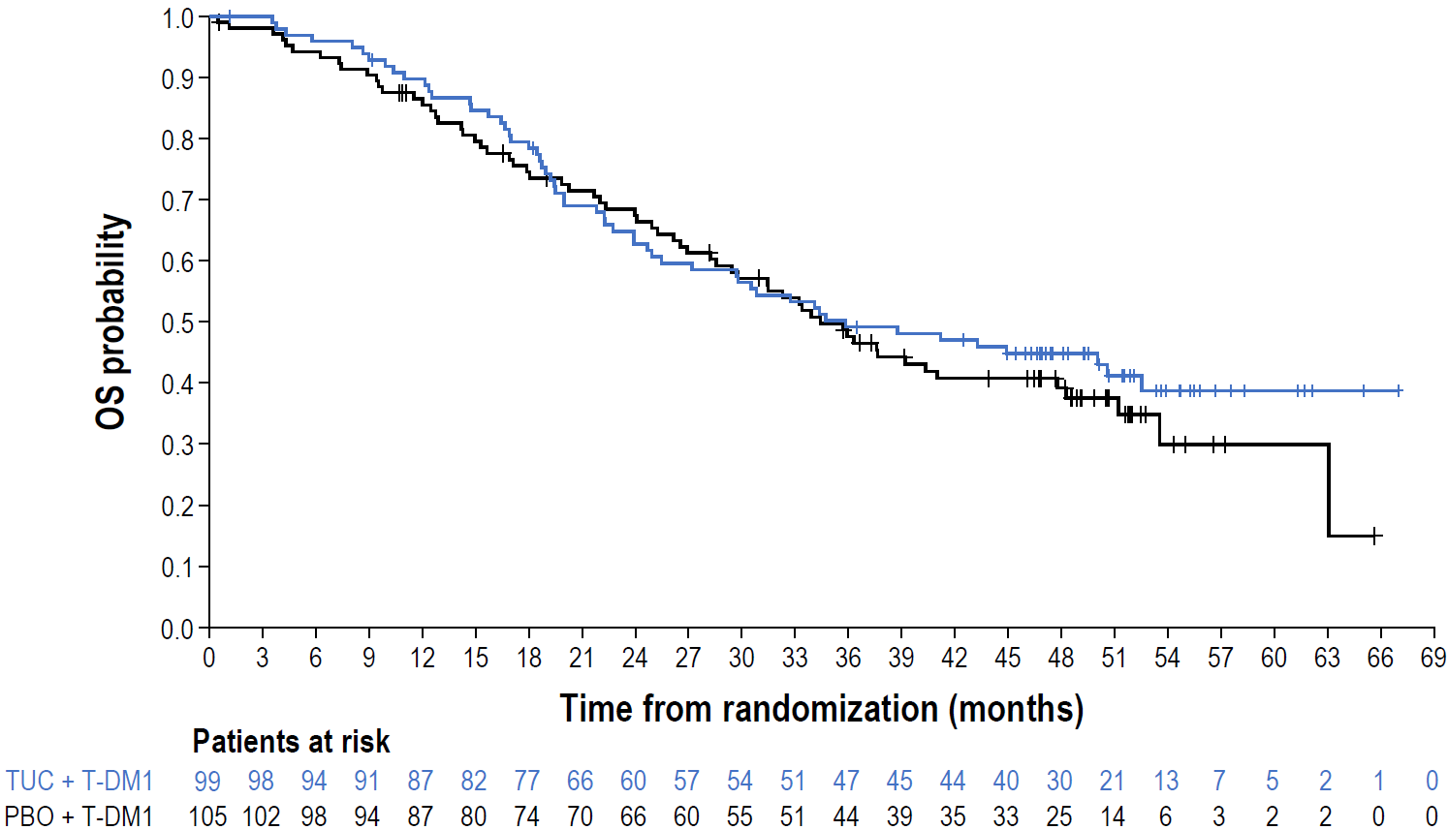

RESULTS: OVERALL SURVIVAL
Median follow-up for OS: 50.7 months
Total population
Patients with baseline BM
Arm | Event/N | Median (95% CI)
TUC + T-DM1 | 121/228 | 43.3 mos (34.4−58.5)
PBO + T-DM1 | 122/235 | 41.0 mos (37.6−53.6)
Arm | Event/N | Median (95% CI)
TUC + T-DM1 | 56/99 | 35.8 mos (25.5−52.5)
PBO + T-DM1 | 63/105 | 34.4 mos (28.2−47.8)
HR = 0.983 (95% CI, 0.762−1.269); Stratified logrank P value = 0.8959
HR = 0.886 (95% CI, 0.616−1.275); Stratified logrank P value = 0.5146
No significant difference in OS between treatment arms in the total study population and those with baseline BM
BM, brain metastases; CI, confidence interval; HR, hazard ratio; mos, months; OS, overall survival; PBO, placebo; T-DM1, trastuzumab emtansine; TUC, tucatinib.

Slide 7
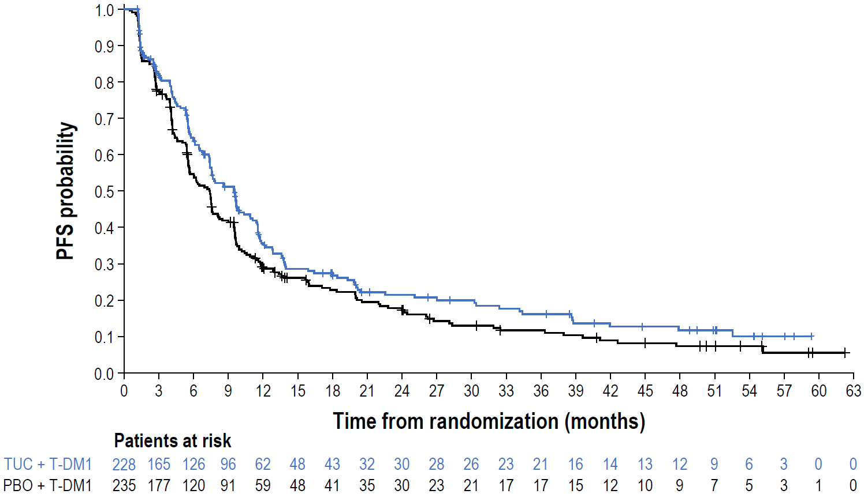
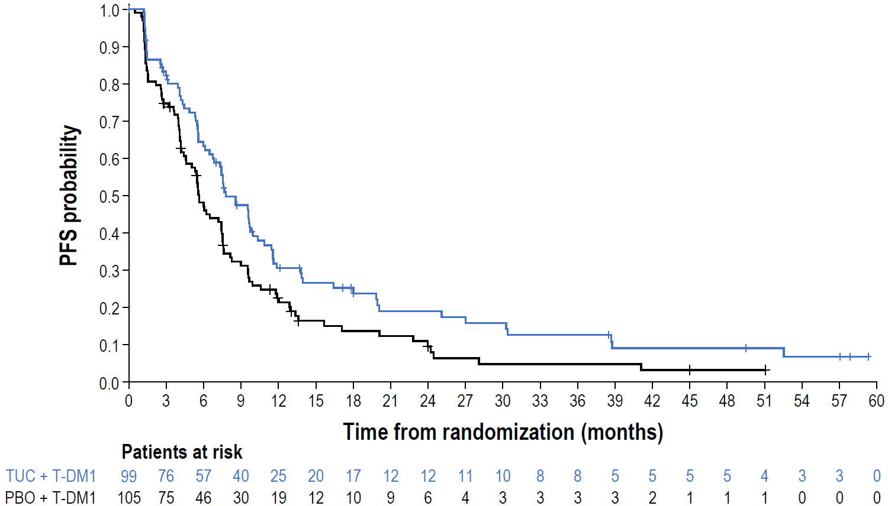
RESULTS: INVESTIGATOR-ASSESSED PFS
Median follow-up for PFS: 45.0 months
Total population
Patients with baseline BM
Arm | Event/N | Median (95% CI)
TUC + T-DM1 | 163/228 | 9.5 mos (7.4−10.9)
PBO + T-DM1 | 196/235 | 7.4 mos (5.6−8.1)
Arm | Event/N | Median (95% CI)
TUC + T-DM1 | 77/99 | 7.8 mos (6.7−10.0)
PBO + T-DM1 | 90/105 | 5.7 mos (4.6−7.5)
HR = 0.739 (95% CI, 0.592−0.921)
HR = 0.608 (95% CI, 0.437−0.846)
PFS remained consistent with the tucatinib benefit observed in the primary analysis
PFS consistent with a tucatinib benefit
BM, brain metastases; CI, confidence interval; HR, hazard ratio; mos, months; PBO, placebo; PFS, progression-free survival; T-DM1, trastuzumab emtansine; TUC, tucatinib.

Slide 8
SUBSEQUENT SYSTEMIC ANTICANCER THERAPIES
Arm | First subsequent line of therapy |  | Second subsequent line of therapy
 | TUC + T-DM1 (n = 215)ª | PBO + T-DM1 (n = 229)ª | TUC + T-DM1 (n = 215)ª | PBO + T-DM1 (n = 229)ª
Subsequent systemic therapy received, n (%) | 180 (83.7) | 201 (87.8) | 108 (50.2) | 102 (44.5)
Cytotoxic agent | 50 (23.3) | 62 (27.1) | 55 (25.6) | 50 (21.8)
HER2-directed therapy
Monoclonal antibody | 57 (26.5) | 60 (26.2) | 41 (19.1) | 41 (17.9)
Antibody-drug conjugate | 100 (46.5) | 115 (50.2) | 41 (19.1) | 36 (15.7)
T-DXd^{b} | 73 (34.0) | 88 (38.4) | 37 (17.2) | 36 (15.7)
Small molecule inhibitor | 32 (14.9) | 33 (14.4) | 24 (11.2) | 29 (12.7)
Tucatinib^{b} | 23 (10.7) | 22 (9.6) | 16 (7.4) | 16 (7.0)
Lapatinib^{b} | 7 (3.3) | 10 (4.4) | 7 (3.3) | 11 (4.8)
Neratinib^{b} | 2 (0.9) | 0 | 1 (0.5) | 2 (0.9)
ªPatients who discontinued study treatment. ^{b}Agent was either a monotherapy or included in a regimen.
Similar proportions of patients in both arms received subsequent anticancer therapies.
T-DXd was the preferred first subsequent anti-HER2 therapy in both arms.
~10% of patients received first subsequent regimens containing tucatinib.
HER2, human epidermal growth factor receptor 2; PBO, placebo; T-DM1, trastuzumab emtansine; T-DXd, trastuzumab deruxtecan; TUC, tucatinib.

Slide 9
CONCLUSIONS
In HER2CLIMB-02, the final OS analysis after 50.7 months of follow-up did not show a statistically significant difference between treatment arms.
The updated PFS analysis with longer follow-up confirmed the benefit of tucatinib + T-DM1 over the control arm in previously treated patients with HER2+ LA/MBC, consistent with the primary analysis, with a similar benefit seen in patients with BM.
Similar proportions of patients received subsequent anticancer therapies in both arms, with T-DXd as the preferred first subsequent anti-HER2 therapy.
In this updated analysis, the safety profile of tucatinib + T-DM1 was consistent with the primary analysis with no new safety signals identified.
BM, brain metastases; HER2+, human epidermal growth factor receptor 2-positive; LA/MBC, locally advanced/metastatic breast cancer; OS, overall survival;
PFS, progression-free survival; T-DM1, trastuzumab emtansine; T-DXd, trastuzumab deruxtecan.

Slide 10

ACKNOWLEDGEMENTS
All patients and their families who participated in this study
Investigators and staff from all participating sites
Copies of this presentation obtained through this QR code are for personal use only and may not be reproduced without written permission of the authors

