Slide 1
Phase 2 Open-Label Study of Brentuximab Vedotin + Pembrolizumab in Patients With Treatment-Naive Metastatic Head and Neck Squamous Cell Carcinoma
Cristina Rodriguez,¹ Sylvia M. Lee,¹ Graham Watson,² Amanda Gillespie-Twardy,³ Douglas Laux,⁴ Patrick Ward,⁵ Jeffrey Yorio,⁶ Omar Abughanimeh,⁷ J. Thaddeus Beck,⁸ Kevin Kim,⁹ Hailing Lu,⁹ Jason Berndt,⁹ Marya Chaney,¹⁰ Eeman Shaikh,⁹ Erin R. Alesi¹¹
¹Fred Hutchinson Cancer Center, Seattle, WA, USA; ²Virginia Oncology Associates, Norfolk, VA, USA; ³Blue Ridge Cancer Care, Roanoke, VA, USA; ⁴University of Iowa Hospital and Clinics, Iowa City, IA, USA; ⁵Oncology Hematology Care, Cincinnati, OH, USA; ⁶Texas Oncology, Austin, TX, USA; ⁷University of Nebraska Medical Center, Omaha, NE, USA; ⁸Highlands Oncology, Fayetteville, AR, USA; ⁹Pfizer, Bothell, WA, USA; ¹⁰Merck & Co., Inc., Rahway, NJ, USA; ¹¹Virginia Commonwealth University Health System, Richmond, VA, USA
Dr. Cristina Rodriguez, MD
Dr. Cristina Rodriguez, MD, rodrigcr@uw.edu

Slide 2
Key Takeaway Points
SGN35-033 is an ongoing multi-cohort study evaluating the efficacy and safety of brentuximab vedotin (BV) plus pembrolizumab (pembro) in patients with solid tumors, including recurrent/metastatic HNSCC
BV + pembro demonstrated promising clinical efficacy and a safety profile consistent with each individual agent in patients with treatment-naive recurrent/metastatic HNSCC with a PD-L1 CPS of ≥1
  Responses were observed across PD-L1 expression levels
These data suggest that combining MMAE-vedotin antibody-drug conjugates and checkpoint inhibitors is an effective therapy for patients in solid tumors, including HNSCC
CPS; combined positive score; HNSCC, head and neck squamous cell carcinoma; MMAE, monomethyl auristatin E; PD-L1, programmed death ligand 1.
Dr. Cristina Rodriguez, MD, rodrigcr@uw.edu

Slide 3
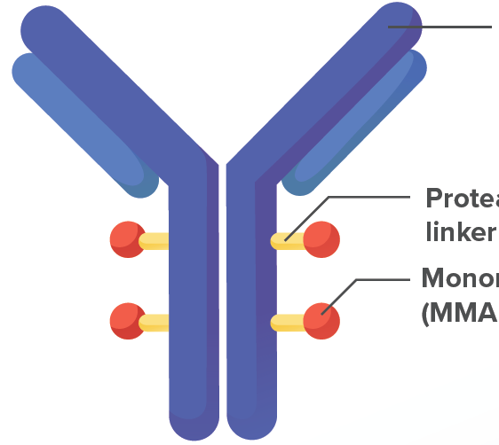
Background
BV mechanism of action
BV is a CD30-directed antibody-drug conjugate
indicated for treatment of certain lymphomas.¹
BV may selectively deplete regulatory T cells
that express CD30 and resensitize tumors to
anti–PD-1 therapy^{2,3}
SGN35-033 (NCT04609566) is an ongoing multicohort study evaluating the efficacy and safety of BV + pembro in patients with solid tumors
  In patients with metastatic NSCLC and metastatic cutaneous melanoma that relapsed/progressed on anti-PD-1 therapy, BV + pembro showed an ORR of 13% and 21%, median OS of 12.7 and 12.9 months, and median PFS of 4.2 and 4.1 months, respectively⁴
Anti-CD30 monoclonal antibody
Protease-cleavable linker
Monomethyl auristatin E (MMAE)
BV, brentuximab vedotin; NSCLC, non-small cell lung cancer; ORR, overall response rate; OS, overall survival; PD-1, programmed death 1; pembro, pembrolizumab; PFS, progression-free survival.
1. Adcetris (brentuximab vedotin) Prescribing information. Seagen; 2025. 2. Grogan B, et al. SITC 2020. Abstract 696. 3. Lee S, et al. SITC 2023. Abstract 699. 4. Zakharia Y, et al. ASCO 2024. Abstract 2617.
Dr. Cristina Rodriguez, MD, rodrigcr@uw.edu

Slide 4
Study design
Cohort 6 included patients with treatment-naive recurrent/metastatic head and neck squamous cell carcinoma (HNSCC) with a PD-L1 combined positive score (CPS) of ≥1
Phase 2 SGN35-033 cohort 6 study design
Patient population
Cohort 6
Metastatic HNSCC with CPS ≥1 by local testing
No prior therapy for metastatic disease or exposure to a PD-1/PD-L1 inhibitor
Dose
BV
1.8 mg/kg Q3W
+
pembrolizumab
200 mg Q3W
Endpoints
Primary endpoint
Confirmed ORR per RECIST 1.1 by investigator
Secondary endpoints
DOR
PFS per RECIST 1.1 by investigator
Safety evaluation per NCI CTCAE v5.0
Exploratory
OS
Biomarker analyses
Data cutoff: Mar 28, 2025
BV, brentuximab vedotin; CTCAE, Common Terminology Criteria for Adverse Events; DOR, duration of response; NCI, National Cancer Institute; ORR, overall response rate; OS, overall survival; PD-1, programmed death 1; PD-L1, programmed death ligand 1; PFS, progression-free survival; Q3W, every 3 weeks; RECIST, Response Evaluation Criteria in Solid Tumors.
Dr. Cristina Rodriguez, MD, rodrigcr@uw.edu

Slide 5
Disposition, demographics and disease characteristics
Patient disposition | BV + pembro (N=38)
Received ≥1 dose of study drug, n (%) | 38 (100)
On treatment | 9 (24)
Off treatment | 29 (76)
In long-term follow-up, n (%) | 10 (26)
Reason for treatment discontinuation, n (%)
Progressive disease | 17 (45)
Adverse event | 6 (16)
Patient decision, non-AE | 4 (11)
Physician decision | 2 (5)
Patients remaining on study, n (%) | 21 (55)
Reason for study discontinuation, n (%)
Death | 14 (37)
Consent withdrawal | 2 (5)
Other | 1 (3)
Demographics and disease characteristics | BV + pembro (N=38)
Age, median (range), years | 61 (30-81)
Male, n (%) | 31 (82)
Race, n (%)
American Indian/Native Alaskan | 1 (3)
Asian | 1 (3)
Black or African American | 3 (8)
White | 33 (87)
Disease subtype, n (%)
Hypopharynx | 1 (3)
Larynx | 8 (21)
Nasopharynx | 3 (8)
Oral cavity | 11 (29)
Oropharynx P16 positive P16 negative P16 unknown | 13 (34) 8/13 (62) 3/13 (23) 2/13 (15)
Other | 2 (5)
PD-L1 expression score (CPS), n (%)
1-19 | 8 (21)
≥20 | 30 (79)
AE, adverse event; BV, brentuximab vedotin; CPS, combined positive score; pembro, pembrolizumab; PD-L1, programmed death ligand 1.
Dr. Cristina Rodriguez, MD, rodrigcr@uw.edu

Slide 6
Best overall response
Median duration of follow-up, 13.4 months
100
Disease progression
80
Stable disease
 | BV + pembro (N=38)
Best overall response, n (%)
Confirmed complete response (CR) | 2 (5)
Confirmed partial response (PR) | 12 (32)
Response pending confirmation | 0
Stable disease (SD) | 13 (34)
Progressive disease | 8 (21)
Not evaluable | 0
Not applicable | 3 (8)
Confirmed overall response rate (CR + PR), n (%) | 14 (37)
95% CI | (21.8-54.0)
Duration of response, median (95% CI), months | NR (7.49-NR)
Disease control rate (CR + PR + SD), n (%) | 27 (71)
95% CI | (54.1-84.6)
60
Partial response
Complete response
40
20
Change from baseline in tumor burden, %
0
-20
-40
-60
-80
-100
Patients (n=34)
140
Disease progression
Stable disease
120
Partial response
100
Complete response
80
On treatment
60
40
Change from baseline in tumor size, %
20
0
-20
-40
-60
-80
-100
0
4
8
12
16
20
24
28
32
36
40
44
48
52
56
60
64
68
72
76
80
84
88
92
96
100
104
108
112
Weeks
Waterfall and spider plot excludes 4 patients, 3 who discontinued treatment with no postbaseline response assessment (not applicable) and 1 who had postbaseline response assessment but no postbaseline sum of diameters reported.
BV, brentuximab vedotin; NR, not reached; pembro, pembrolizumab.
Dr. Cristina Rodriguez, MD, rodrigcr@uw.edu

Slide 7
Best overall response based on PD-L1 status
100
80
CPS status by local laboratory | ORR, n (%) | 95% CI
CPS 1-19 (n=8) | 2 (25) | (3.2-65.1)
CPS ≥20 (n=30) | 12 (40) | (22.7-59.4)
60
PD
CPS 1-19
40
PD
PD
CPS ≥20
20
PD
SD
SD
SD
Change from baseline in tumor burden, %
SD
0
-20
SD
SD
PD
SD
PD
-40
SD
SD
SD
SD
PR
-60
PR
PR
SD
PR
SD
PD
PR
ORR was calculated from full analysis set including all patients who received any amount of study medication (N=38); Only patients with postbaseline tumor assessments with sum of diameters reported are included in the waterfall and spider plots (n=34).
-80
PR
PR
PR
PR
PR
-100
PR
PR
Patients (n=34)
CR
CR
140
CPS 1-19
CPS ≥20
120
On treatment
100
80
60
40
Change from baseline in tumor size, %
20
0
-20
-40
-60
-80
-100
0
4
8
12
16
20
24
28
32
36
40
44
48
52
56
60
64
68
72
76
80
84
88
92
96
100
104
108
112
Weeks
Waterfall and spider plots exclude 4 patients, 3 who discontinued treatment with no postbaseline response assessment (not applicable) and 1 who had postbaseline response assessment but no postbaseline sum of diameters reported.
CPS, combined positive score; ORR, overall response rate; PD-L1, programmed death ligand 1.
Dr. Cristina Rodriguez, MD, rodrigcr@uw.edu

Slide 8
Best overall response based on HPV status
ORR by HPV status across all subtypes | ORR, n (%) | 95% CI
HPV positive (n=15) | 7 (47) | (21.3-73.4)
HPV negative (n=11) | 3 (27) | (6.0-61.0)
Unknown/Missing (n=12) | 4 (33) | (9.9-65.1)
ORR by P16 expression in oropharyngeal cancer | ORR, n (%) | 95% CI
P16 positive (n=8) | 4 (50) | (15.7-84.3)
P16 negative (n=3) | 0 | (0.0-70.8)
Unknown (n=2) | 1 (50) | (1.3-98.7)
HPV, human papillomavirus; ORR, overall response rate.
Dr. Cristina Rodriguez, MD, rodrigcr@uw.edu

Slide 9

Duration of response
Median duration of follow-up, 13.4 months
100
90.9% (95% CI: 50.8-98.7)
DOR | BV + pembro (N=38)
Confirmed CR or PR, n (%) | 14 (37)
PD or death, n (%) | 3 (8)
DOR, monthsª
Median (95% CI)^{b} | NR (7.49-NR)
Observed min, max^{c} | 1.45+, 20.76+
90
80
70
60
Patients responding, %
50
40
30
20
10
0
0
3
6
9
12
15
18
21
24
Months
No. at risk (events)
14 (0) | 11 (0) | 8 (1) | 5 (2) | 5 (2) | 2 (3) | 2 (3) | 0 (3) | 0 (3)
BV, brentuximab vedotin; CR, complete response; DOR, duration of response; NR, not reached; PD, progressive disease; pembro, pembrolizumab; PR, partial response.
ªAs estimated using Kaplan-Meier method. ^{b}Calculated using the complementary log-log transformation method (Collett, 1994). ^{c}'+' means the observed time was from censored patient.
Dr. Cristina Rodriguez, MD, rodrigcr@uw.edu

Slide 10
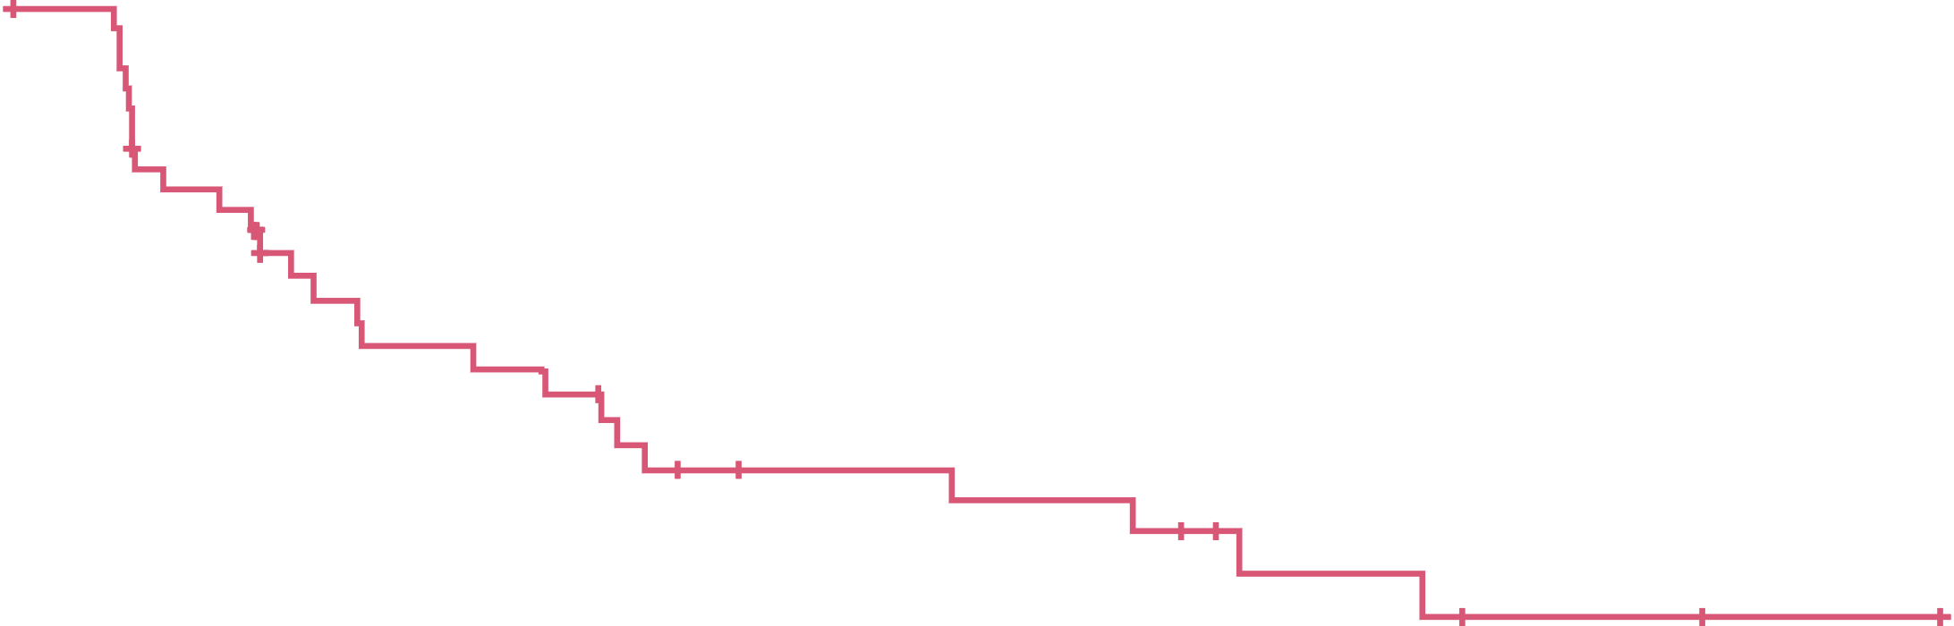
Progression-free survival
100
PFS | BV + pembro (N=38)
PFS event, n (%) | 25 (66)
Disease progression | 19 (50)
Death | 6 (16)
PFS, monthsª
Median (95% CI)^{b} | 6.11 (2.86-10.74)
Observed min, max^{c} | 0.03+, 22.05+
90
80
70
60
50.9% (95% CI: 33.2-66.2)
PFS, %
50
40
30
20
10
0
0
3
6
9
12
15
18
21
24
Months
No. at risk (events)
38 (0) | 21 (12) | 16 (17) | 9 (21) | 8 (22) | 4 (24) | 2 (25) | 1 (25) | 0 (25)
BV, brentuximab vedotin; pembro, pembrolizumab; PFS, progression-free survival.
ªAs estimated using Kaplan-Meier method. ^{b}Calculated using the complementary log-log transformation method (Collett, 1994). ^{c}'+' means the observed time was from censored patient.
Dr. Cristina Rodriguez, MD, rodrigcr@uw.edu

Slide 11
Summary of safety of BV + pembro in HNSCC
 | BV + pembro (N=38)
Any-grade TEAE, n (%) | 38 (100)
Grade 3/4 TEAE, n (%) | 29 (76)
Treatment-related serious TEAE, n (%) | 3 (8)
Any-grade treatment-related AE, n (%) | 36 (95)
Pruritus | 14 (37)
Fatigue | 13 (34)
Peripheral sensory neuropathy | 11 (29)
Nausea | 9 (24)
Anemia | 8 (21)
Grade 3/4 treatment-related AE, n (%) | 12 (32)
Lymphocyte count decreased | 4 (11)
ALT increased | 2 (5)
Fatigue | 2 (5)
Neutropenia | 2 (5)
Neutrophil count decreased | 2 (5)
Any treatment-emergent IMAE, n (%) | 10 (26)
Hypothyroidism | 5 (13)
Pruritus | 4 (11)
Pneumonitis | 2 (5)
No new safety signals were identified
  Observed safety data is consistent with the individual safety profiles of both BV and pembro
No grade 5 TEAE was observed
Immune-mediated AEs with BV + pembro were similar to those with pembro monotherapy
Six patients (16%) discontinued treatment due to TEAEs
Eight patients (21%) had a dose elimination due to treatment-related AEs
Six patients (16%) had a dose delay due to treatment-related AEs
AE, adverse event; ALT, alanine aminotransferase; BV, brentuximab vedotin; HNSCC, head and neck squamous cell carcinoma; IMAE, immune-mediated adverse event; pembro, pembrolizumab; TEAE, treatment-emergent adverse event.
Dr. Cristina Rodriguez, MD, rodrigcr@uw.edu

Slide 12
Transient decrease in Tregs and increase in CD8 T-cell proliferation in peripheral blood
Tregs
(CD4⁺ CD25⁺ CD127^{low/-})
Proliferating CD8 T cells
(CD3⁺ CD8⁺ Ki67⁺)
Immune cell phenotyping in peripheral blood was performed by flow cytometry in real time using freshly collected blood samples
It has been previously reported that Tregs express a higher level of CD30 compared with other T cells and are selectively depleted after treatment with BV^{1,2}
2
1
Fold change over baseline
0
-1
-2
C1D1
n=33
C1D8
n=30
C1D15
n=26
C2D1
n=28
C3D1
n=25
C1D1
n=32
C1D8
n=28
C1D15
n=25
C2D1
n=27
C3D1
n=24
Visit
Absolute counts of Tregs and proliferating CD8 T cells (cells/uL) were normalized to baseline for each patient. The “n” refers to number of patient included in each time point. The red line indicates group median, and the box indicates 75% range.
BV, brentuximab vedotin; CD, cluster of differentiation; Treg, regulatory T cell.
1. Advani RH, et al. Blood. 2021;138(6):427-438. 2. Lee SM, et al. Clin Can Res. 2025;31(5):848-859.
Dr. Cristina Rodriguez, MD, rodrigcr@uw.edu

Slide 13
Conclusions
In this phase 2 study, BV + pembro demonstrated promising clinical efficacy with a safety profile consistent with that of each individual agent in patients with treatment-naive metastatic HNSCC with PD-L1 CPS ≥1
  Responses were observed across PD-L1 expression levels
Biomarker analyses support the hypothetical immunomodulatory mechanism of action of
BV + pembro
Immune-related adverse events observed were consistent with the safety profile of
pembro monotherapy
These data, together with previously published results with other vedotin combinations,¹⁻³ show that combining MMAE-vedotin antibody-drug conjugates and checkpoint inhibitors is an effective therapy for patients in solid tumors, including HNSCC
BV, brentuximab vedotin; CPS, combined positive score; HNSCC, head and neck squamous cell carcinoma; MMAE, monomethyl auristatin E; PD-L1, programmed death ligand 1; pembro, pembrolizumab.
1. Lee SM, et al. Clin Cancer Res. 2025;31(5):848-859. 2. Vergote I, et al. J Clin Oncol. 2024;41(36):5536-5549. 3. Powles T, et al. N Engl J Med. 2023;390(10):875-888.
Dr. Cristina Rodriguez, MD, rodrigcr@uw.edu

Slide 14


Electronic Presentation
Copies of this presentation obtained through Quick Response (QR) Code are for personal use only and may not be reproduced without permission from ASCO® or the author of this presentation. If you don’t have a smartphone, access the presentation via the internet at: https://scientificpubs.congressposter.com/p/8a6rmt76xagztbn8
Abstract Plain Language Summary
Please scan this QR code with your smartphone to view a plain language summary of the abstract. If you do not have a smartphone, access the summary via the internet at: https://scientificpubs.congressposter.com/pls/8a6rmt76xagztbn8
Thank you to the patients and their families for their participation in the study and to all research personnel for their support of this important trial. This study was sponsored by Seagen, Inc, which was acquired by Pfizer in December 2023. This study is in collaboration with Merck Sharp & Dohme LLC, a subsidiary of Merck & Co., Inc., Rahway, NJ, USA. Editorial support was provided by Kakoli Parai, PhD, of Nucleus Global, and was funded by Pfizer.
Dr. Cristina Rodriguez, MD, rodrigcr@uw.edu

